Slide 1
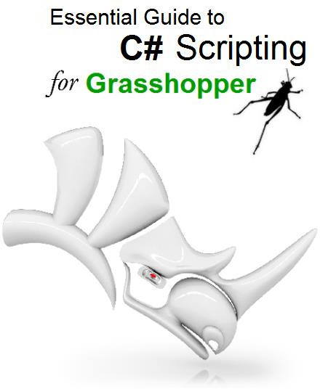
Rajaa Issa
Robert McNeel & Associates

Slide 2
Chapter One: Grasshopper C# Component
1_1: Introduction
Grasshopper supports multiple scripting languages such as VB.NET, C# and Python to help develop custom components using the Rhino and Grasshopper SDKs (software development kit). Rhino publishes a cross-platform SDK for .NET languages called RhinoCommon. The documentation of the SDK and other developer resources are available at http://developer.rhino3d.com/

Slide 3
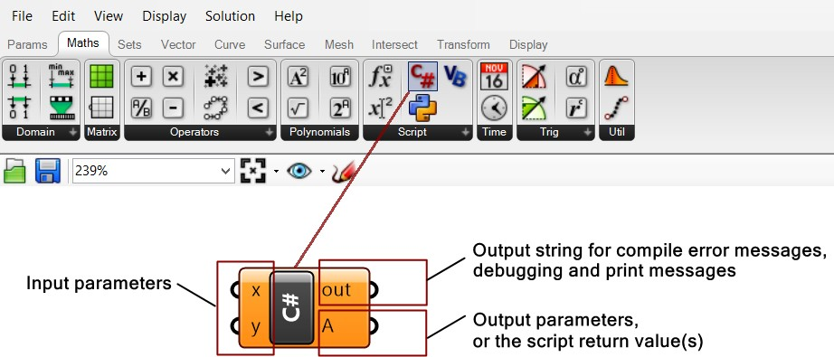
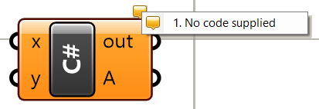
Grasshopper - C# component interface
1_2: C# component interface
The scripting components are integrated within Grasshopper and have a similar interface to that of other typical components. They can read input and produce output, and have an editor to write custom code with access to RhinoCommon. They are used to create specialized code and workflows not supported by other Grasshopper components. You can also use them to simplify, optimize and streamline your definitions by combining multiple functions.
To add an instance of the C# script component to the canvas, drag and drop the component from the Script panel under the Maths tab. The default script component has two inputs and two outputs. The user can change the names of input and output, set the input data type and data structure and also add more inputs and outputs parameters or remove them. We will explain how to do all that shortly.
Figure(1): The C# component and its location in the toolbar. x: first input parameter. y: second input parameter. Out: output string with compiling messages. A: Returned output of type object.
When you first drag to canvas, the component shows with the color orange indicating a warning. This is because there is no code typed inside it to start with. If you click on the bubble at the top- right corner, you can see what the warning is as shown in figure 2.
Figure(2): The default C# component in Grasshopper

Slide 4
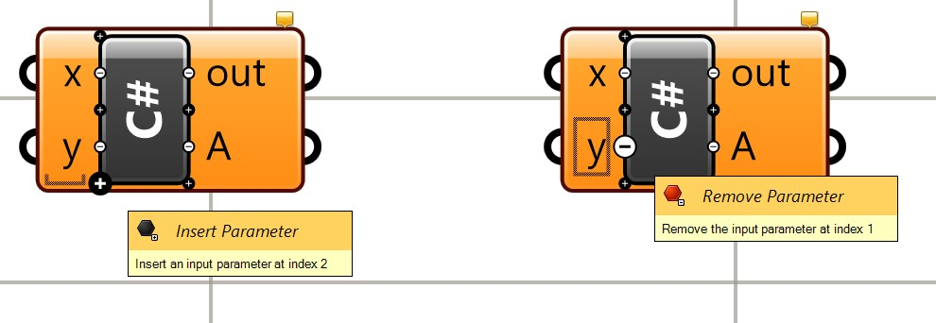
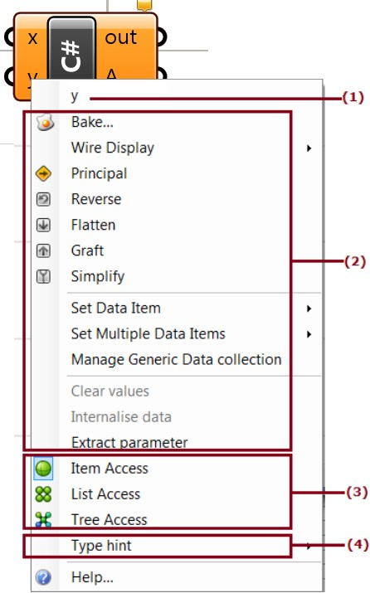
C# component – Input Parameters
1_3: The input parameters
By default, there are two input parameters named x and y. It is possible to edit the parameters’ names, delete them or add new ones. If you zoom in, you will notice a few “+” and “-” signs appearing. You can click on those to add or remove parameters. You can also right-mouse click on a parameter to change its name. Note that the names of the parameters and their types are passed to the main function inside the script component, which is called RunScript. It is a good practice to set the input and output parameter names to reflect what each parameter does.
Parameter names should not use white spaces or special characters.
Figure(3): Zoom in to add a remove input parameters by pressing the + and - signs
If you right-mouse click on an input parameter, you will see a menu that has four parts as detailed in Figure 4 below.
Figure(4): Expand the input parameter menu (access by right-mouse click on the parameter).
The input parts are:
1. Name: you can click on it and type a new parameter name.

Slide 5
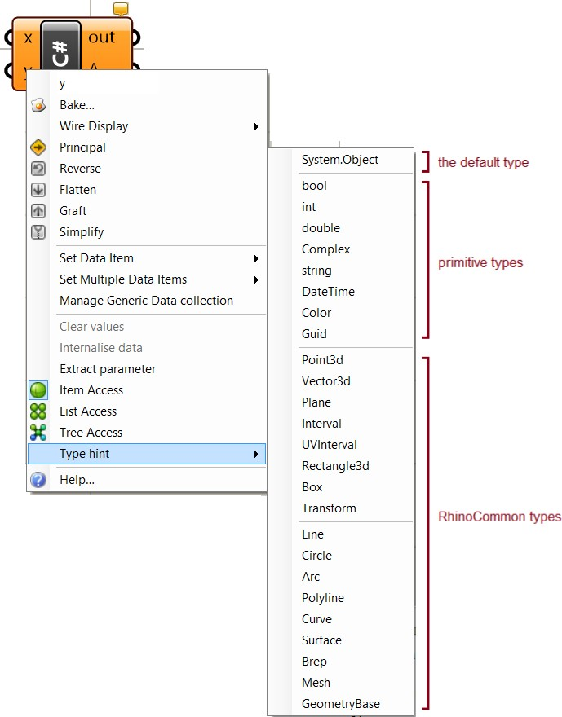
C# component – Input Parameters
The input parts are:
1. Name: you can click on it and type a new parameter name.
General attributes: common to most other GH components.
Data access: to indicate whether the input should be accessed as a single item, a list of items or as a tree¹.
Type: Input parameters are set by default to be of an object type. It is best to specify a type to make the code more readable and efficient. Types can be primitive, such as int or double, or RhinoCommon types that are used only in Rhino such as Point3d or Curve. You need to set the type for each input.
Just like all other GH components, you can hook data to the input parameters of the script components. Your script component can process most data types. You can specify the data type of your input using the Type hint as in the following image.
Figure(5): The type hint in the input allows setting input parameters to specific type
The Type hint, gives access to many types and can be divided into three groups:
System.Object. if you do not specify the input type, GH assigns the base type System.Object. The System.Object is the root type that all other types are built on. Therefore it is safe to assign System.Object type to any data type.
Primitive types. Those are made available by the .NET framework.
RhinoCommon types. Those are defined in the RhinoCommon SDK.

Slide 6
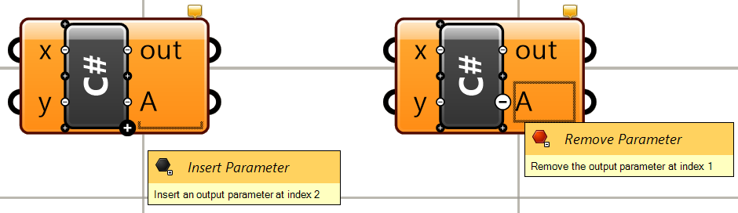
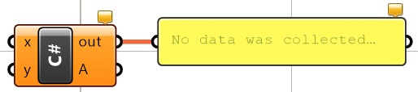
C# component – Output Parameters
1_4: The output parameters
Just like with input parameters, you can add or remove output parameters by zooming in, then use the “+” or “-” signs. You can also change the name of the output. However, there is no data access or data types that you can set. They are always defined as System.Object, and hence you can assign any type, and as defined by your script and GH, take care of parsing it to use downstream.
Figure(6): Zoom in to add or remove an output parameter by pressing the + and - gadgets
1_5: The out string
The out string is used to list errors and other useful information about your code. You can connect the out to a Panel component to be able to read the information.
Figure(7): The out parameter includes compile and runtime messages
There are two types of messages that print to the out string.
Compile-time messages. These include compiler errors and warnings about your code.
This is very helpful information to point you to the lines in code that the compiler is complaining about, so that you can correct the errors.
Runtime messages. You can print any text to the out string to track information generated inside your code during execution.

Slide 7
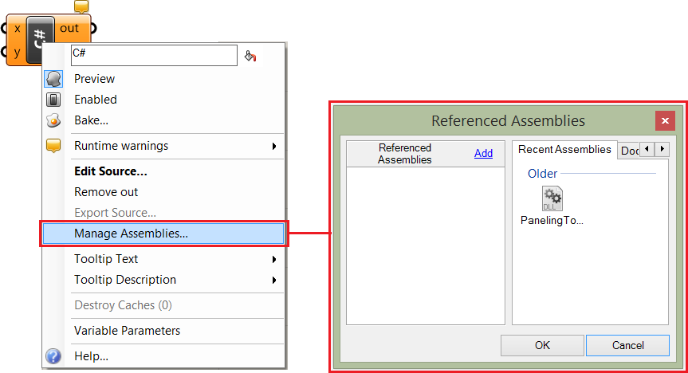
C# component – Main menu
1_6: Main menu
You can access the main component menu with a mouse-right-click while hovering over the middle of the scripting component. Most of the functions are similar to other GH components, but there are a couple specialized functions such as Edit Source... to open the code editor and Manage Assemblies to help add external libraries to access in your script.
Figure(8): Manage assemblies allows adding external libraries to access inside the scripting component

Slide 8
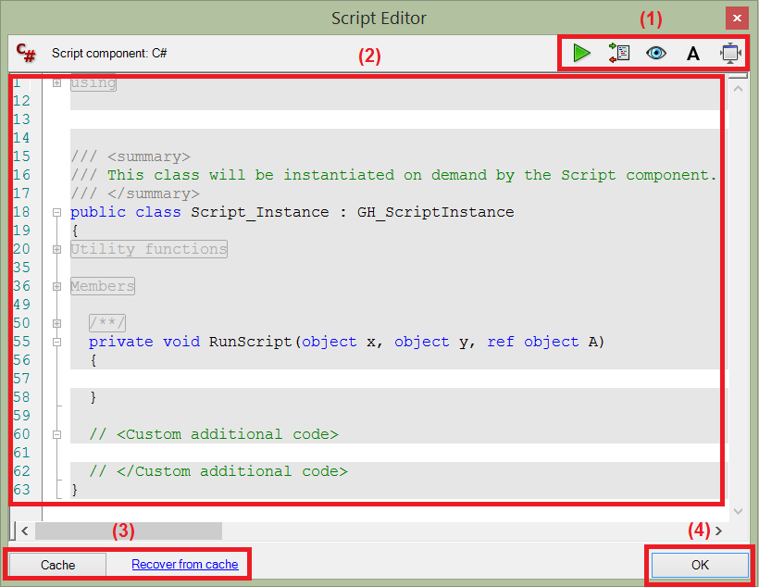

C# component – Code editor
1_7: Code editor
To show the code editor window for the C# script component, you need to double click in the middle of the component (or right-mouse-click the middle, and select Edit Source…). The code editor consists of 4 parts; the toolbar, the code, the caching tools and the OK button as in the following figure 9.
Figure(9): The code editor has 4 parts. (1) toolbar, (2) code, (3) cache, (4) OK
The top and bottom toolbars have multiple buttons. The following explains what each one means.
 | Runs the code without closing the editor
 | If you need to run some code once before calling your RunScript or afterwards, then there are functions that you can place in your additional code section. This may be used to initialize or reset some variables or settings before and after running your script.
 | Insert additional overrides that are related to preview. This helps you create a custom preview.
 | Set the editor font.
 | If selected, the editor will shrink when it goes out of focus (you click outside the editor).
 | When clicked, the current content of your script is saved. Even if you make modifications, you can revert to a previous state by clicking “Recover from cache”. There are time stamps of the saved states.
 | Click to close the editor and run the script.

Slide 9
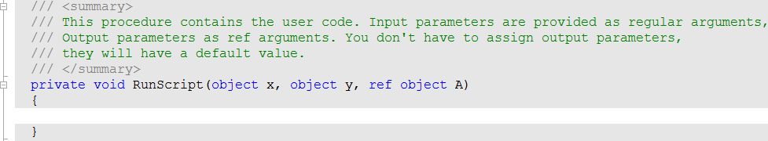
C# component code sections - RunScript
1_7_4: The RunScript
This is the main function where you write your code. The signature of the RunScript includes the input and output parameters along with their data types and names. There is white space between the open and closed parentheses to indicate the region where you can type your code.
Figure(14): The RunScript is the main function within which the user can put their code.
1_7_5: Custom additional code
You can place all additional functions and variables in the <Custom additional code> area just below the RunScript. Your main code inside the RunScript can reference the additional members and functions placed in this portion of the code.
Figure(15): There is a designated region to put the additional custom code outside the RunScript function.

Slide 10
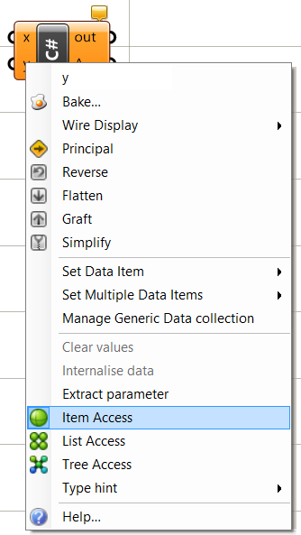
C# component – Data access
1_8: Data access
This topic requires knowledge in C# programming. If you need to review or refresh you knowledge in C# programming, please review chapter two before reading this section. Grasshopper scripting components, just like all other GH components, can process three types of data access; item access, list access and tree access.
>>
Icon in GH | Data Access
 | Item Access
 | List Access
 | Tree Access
You need to right-mouse-click on the input parameter to set its data access, otherwise it is set to item access by default. We will explain what each access means, and how data is processed inside the component in each case.
Figure(22): Set the input parameter to be an item access to indicate that input in processed one element at a time

Slide 11
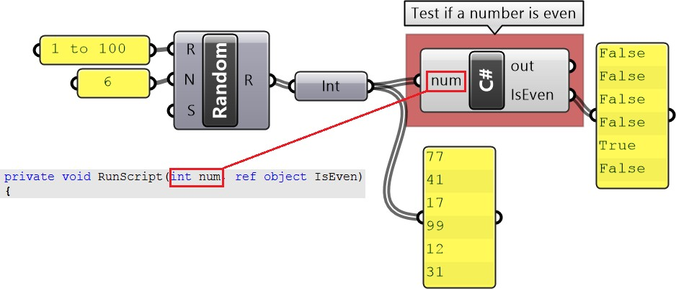
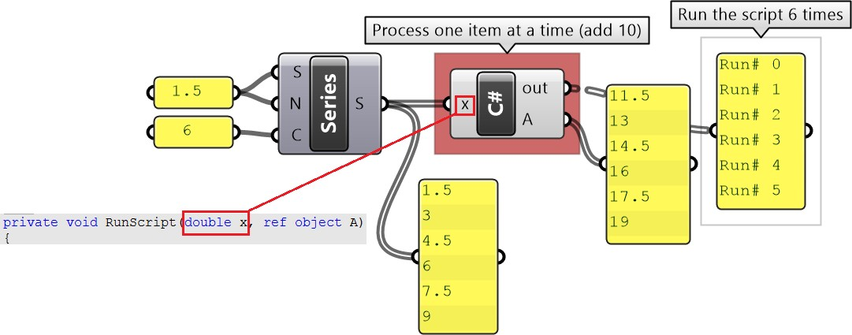
C# component – Data Access: Item
1_8_1: Item access
Item access means that the input is processed one item at a time. Suppose you have a list of numbers that you need to test if they are odd or even. To simplify your code, you can choose to only process one number at a time. In this case, item access is appropriate to use. So even if the input to num is a list of integers, the scripting component will process one integer at a time and run the script a number of times equal to the length of the list.
>>
private void RunScript(int num, ref object IsEven) {
int mod = num % 2; IsEven = (mod == 0 ? true : false);
}
With item access, each element in a list is processed independently from the rest of the elements. For example if you have a list of 6 numbers {1, 2, 3, 4, 5, 6} that you like to increment
each one of them by some number, let’s say 10, to get the list {11, 12, 13, 14, 15, 16}, then you can set the data access to item access. The script will run 6 times, once for each element in
the list and the output will be a list of 6 numbers. Notice in the following implementation in GH, x
is input as a single item of type double.
private void RunScript(double x, ref object A) {
A = x + 10; Print("Run# " + Iteration);
}

Slide 12
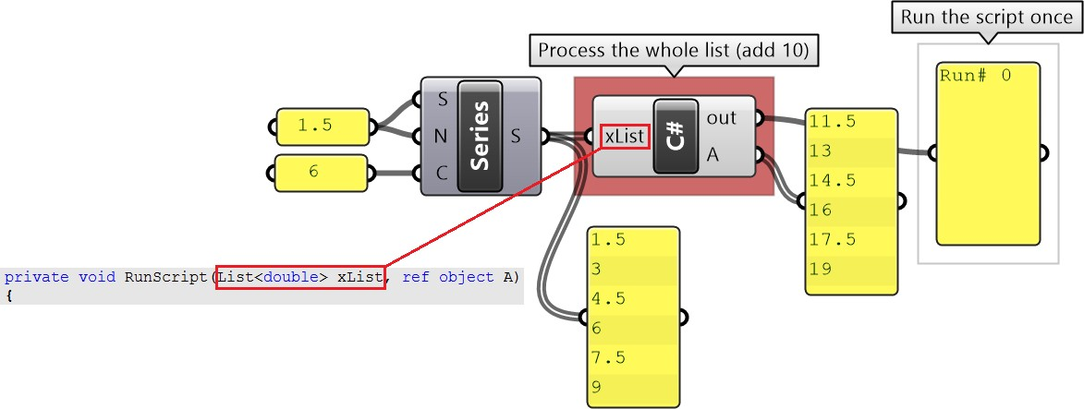
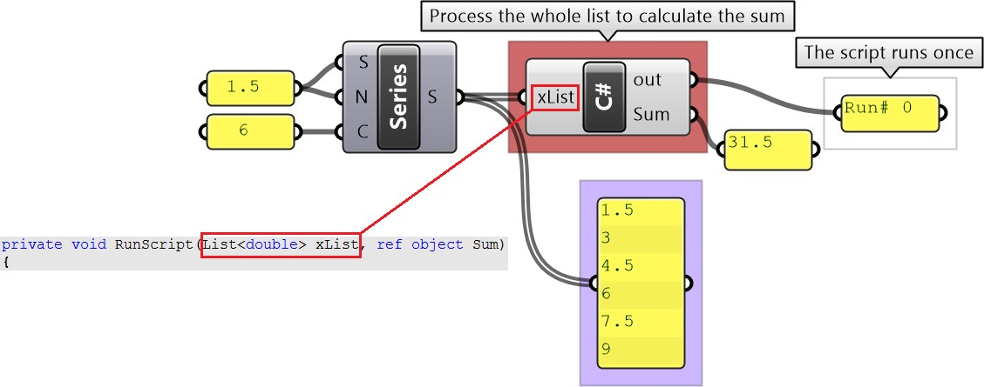
C# component – Data Access: List
1_8_2: Lists access
List access means that the whole list is processed all in one call to the scripting component. In the previous example, we can change the data access from item access to list access and change the script to add 10 to each one of the items in the list as in the following. Note that the script runs only once.
>>
private void RunScript( List<double> xList, ref object A) {
List<double> newList = new List<double>(); foreach( var x in xList) newList.Add(x + 10); Print("Run# " + Iteration); A = newList;
}
The list access is most useful when you need to process the whole list in order to find the result. For example, to calculate the sum of a list of input numbers, you need to access the whole list. Remember to set the data access to list access.
private void RunScript( List<double> xList, ref object Sum) {
double xSum = 0; foreach( var x in xList) xSum = xSum + x; Print("Run# " + Iteration); Sum = xSum;
}

Slide 13
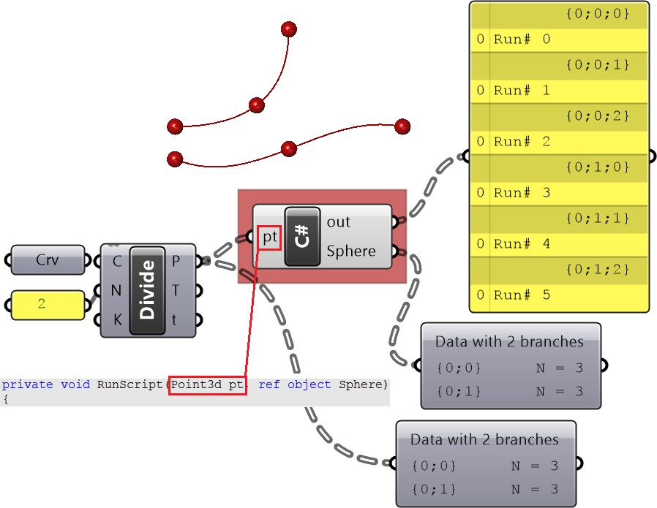
C# component – Data Access: Tree access
1_8_3: Tree access
Tree data access in Grasshopper is an advanced topic. You might not need to deal with trees, but if you encounter them in your code, then this section will help you understand how they work and how to do some basic operations with them.
Trees (or multi-dimensional data) can be processed one element at a time or one branch (path) at a time or all branches at the same time. That will depend on how you set the data access (item, list or tree). For example, if you divide two curves into two segments each, then we get a tree structure that has two branches (or paths), each with three points. Now suppose you want to write a script to place a sphere around each point. The code will be different based on how you set the data access. If you make it item access, then the script will run 6 times (once for each point), but the tree data structure will be maintained in the output with two branches and three spheres in each branch. Your code will be simple because it deals with one point at a time.
>>
private void RunScript( Point3d pt, ref object Sphere) {
Sphere ptSphere = new Sphere(x, 0.5); Print("Run# " + Iteration); Sphere = ptSphere;
}
The same result can be achieved with the list access, but this time your code will have to process each branch as a list. The script runs 2 times, once for each branch.

Slide 14
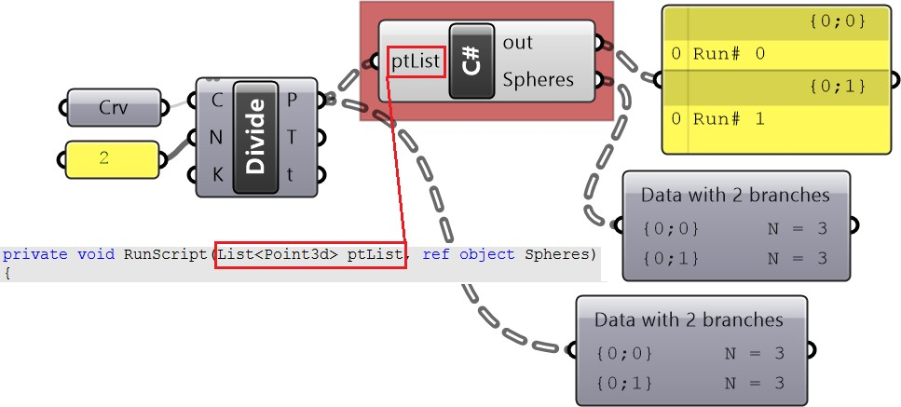
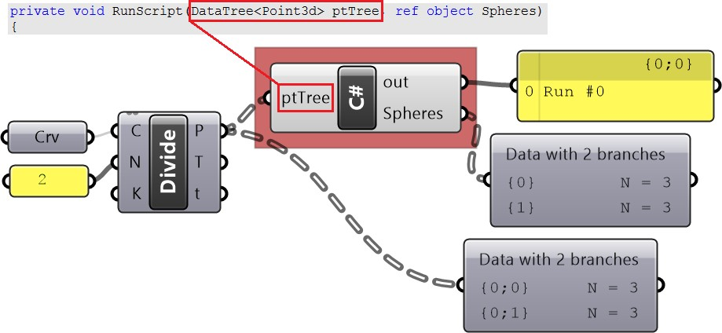
C# component – Data Access: Tree vs List
The same result can be achieved with the list access, but this time your code will have to process each branch as a list. The script runs 2 times, once for each branch.
private void RunScript( List<Point3d> ptList, ref object Spheres) {
List<Sphere> sphereList = new List<Sphere>(); foreach (Point3d pt in ptList) { Sphere sphere = new Sphere(pt, 0.5); sphereList.Add(sphere); } Print("Run# " + Iteration); Spheres = sphereList;
}
The tree access allows you to process the whole tree and your code will run only once. While this might be necessary in some cases, it also complicates your code.
private void RunScript( DataTree<Point3d> ptTree, ref object Spheres) {
//Declare a tree of spheres DataTree<Sphere> sphereTree = new DataTree<Sphere>(); int pathIndex = 0; foreach (List<Point3d> branch in ptTree.Branches) { List<Sphere> sphereList = new List<Sphere>(); GH_Path path = new GH_Path(pathIndex); pathIndex = pathIndex + 1; foreach (Point3d pt in branch) { Sphere sphere = new Sphere(pt, 0.5); sphereList.Add(sphere); } sphereTree.AddRange(sphereList, path); } Print("Run# " + Iteration); Spheres = sphereTree;

Slide 15
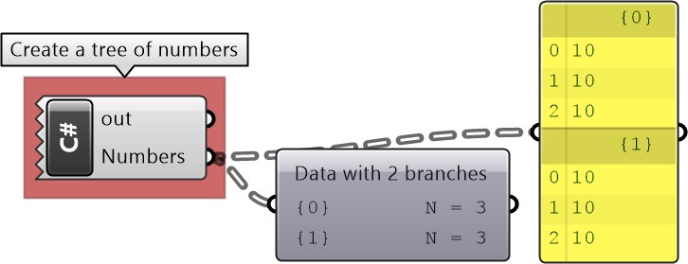
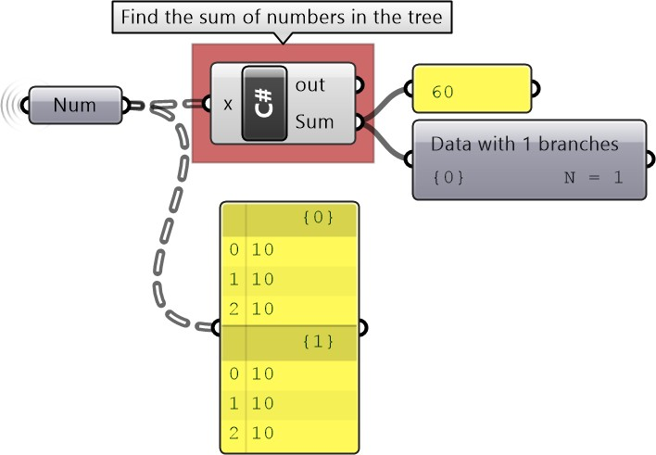
C# component code: Generate & access a tree
The tree data structure is a special data type that is unique to Grasshopper². If you need to generate a tree inside your script, then the following shows how to do just that.
private void RunScript( ref object Numbers) {
DataTree<double> numTree = new DataTree<double>(); int pathIndex = 0; for (int b = 0; b <= 1; b++) { List<double> numList = new List<double>(); GH_Path path = new GH_Path(pathIndex); pathIndex = pathIndex + 1; for (int i = 0; i <= 2; i++) { numList.Add(10); } numTree.AddRange(numList, path); } Numbers = numTree;
}
The following example shows how to step through a given data tree of numbers to calculate the overall sum.
private void RunScript( DataTree<double> x, ref object Sum) {
double xSum = 0; foreach (List<double> branch in x.Branches){ foreach (double num in branch) { xSum = xSum + num; } } Sum = xSum;
}

Slide 16
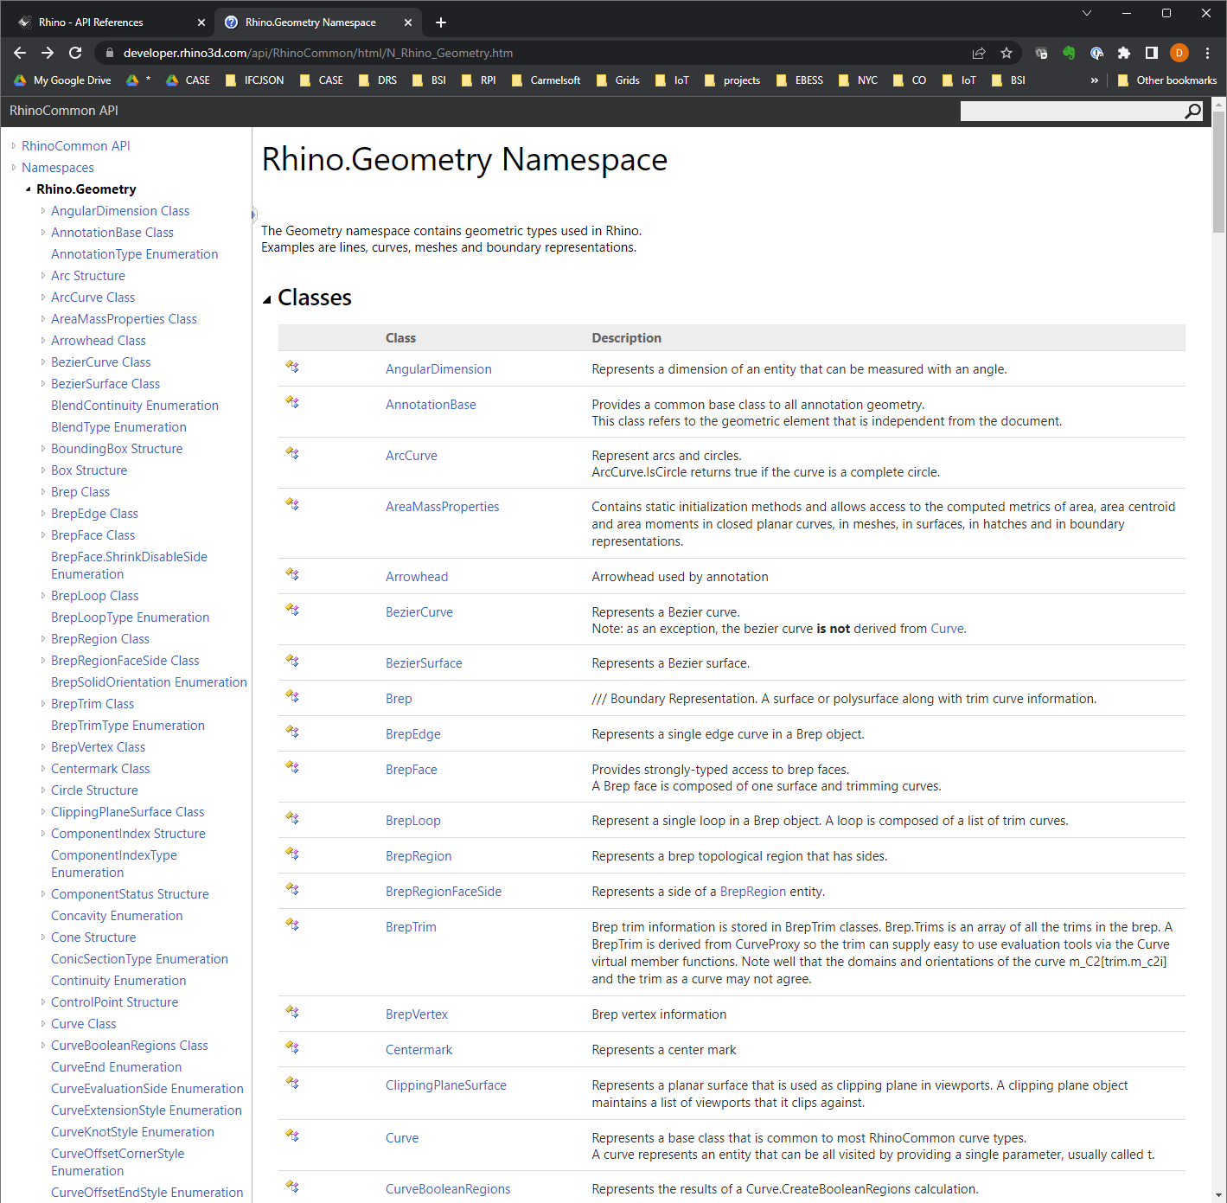
https://developer.rhino3d.com/api/RhinoCommon/html/N_Rhino_Geometry.htm

Slide 17
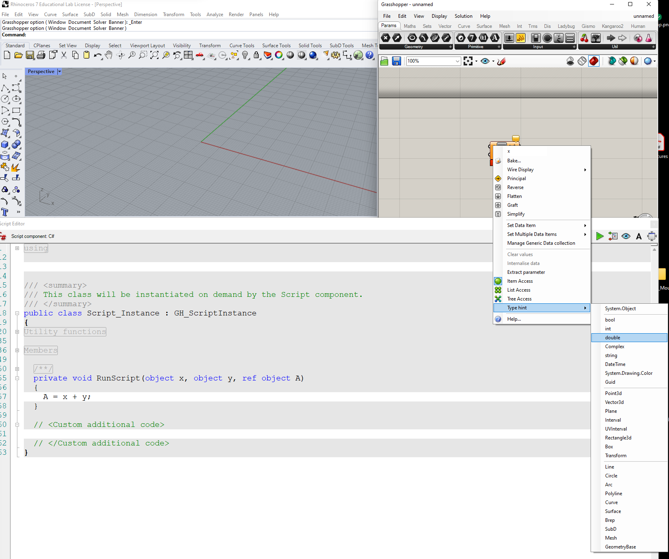
0_01 Make a point
>>

Slide 18
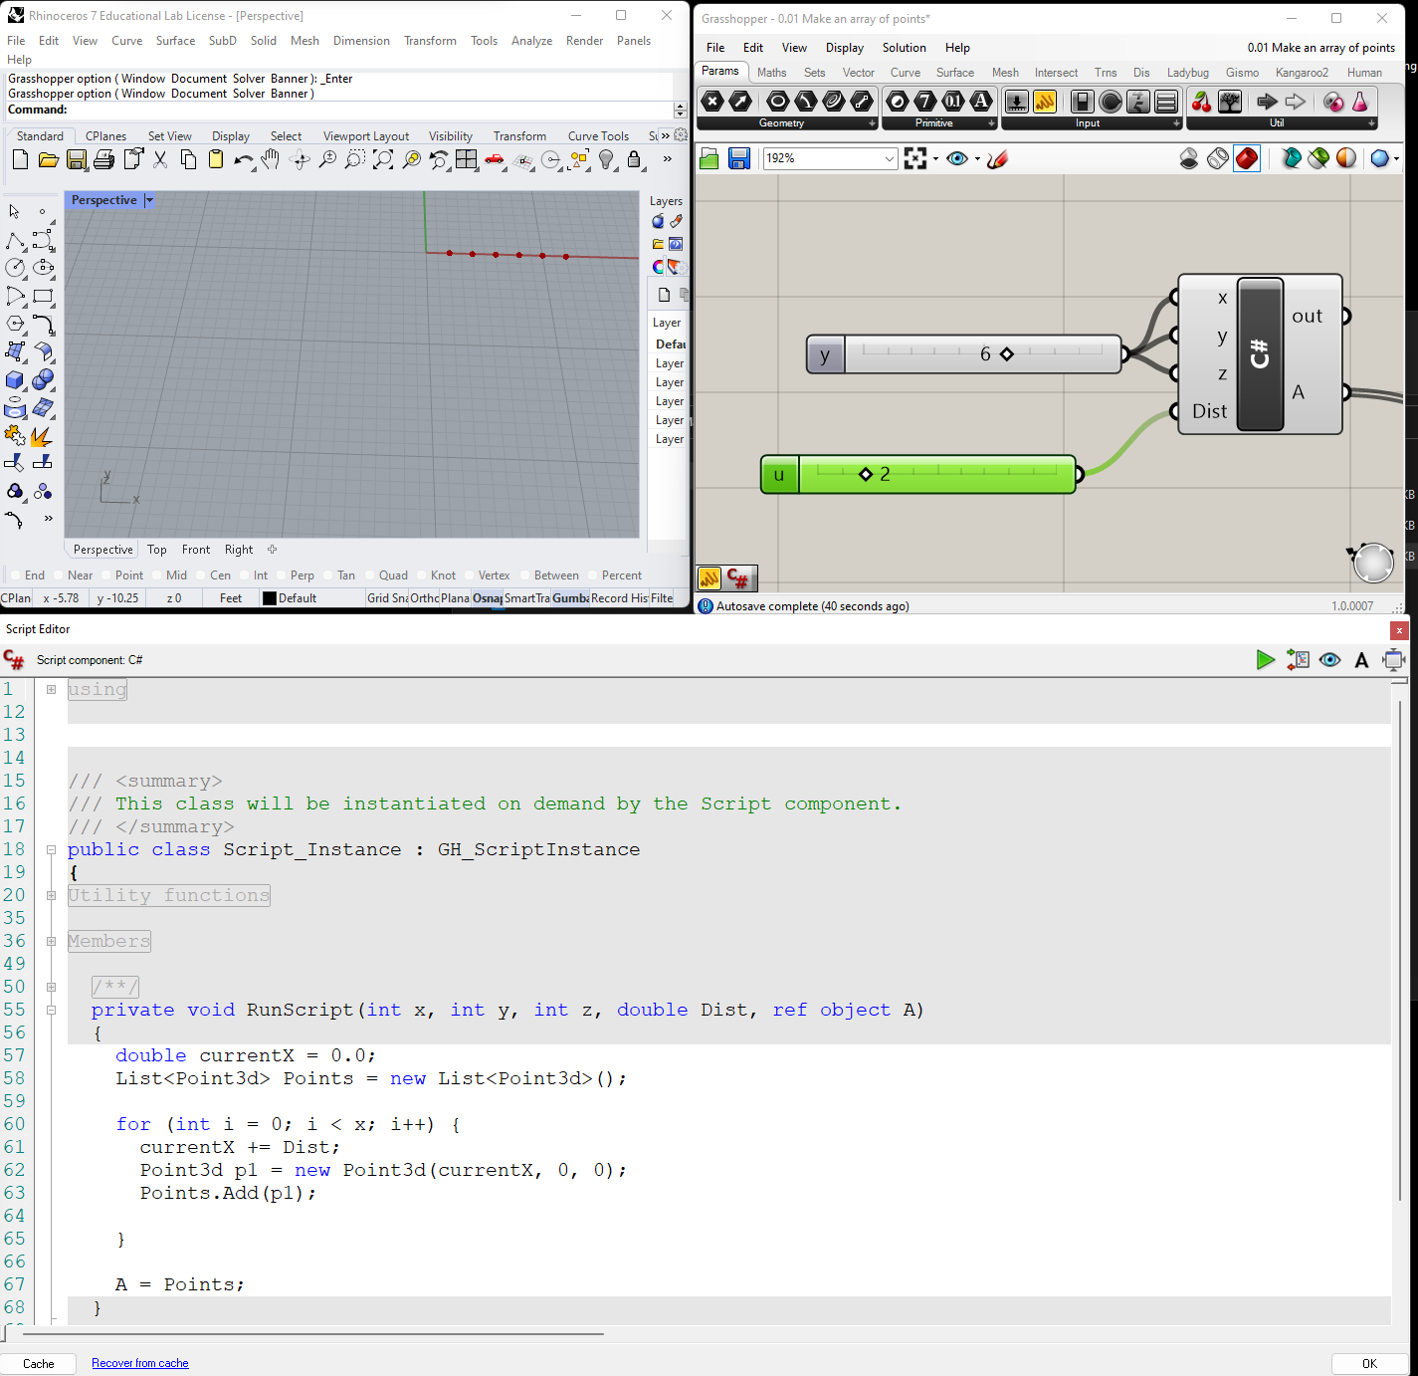
0_02 Make a 1D Array of points
>>

Slide 19
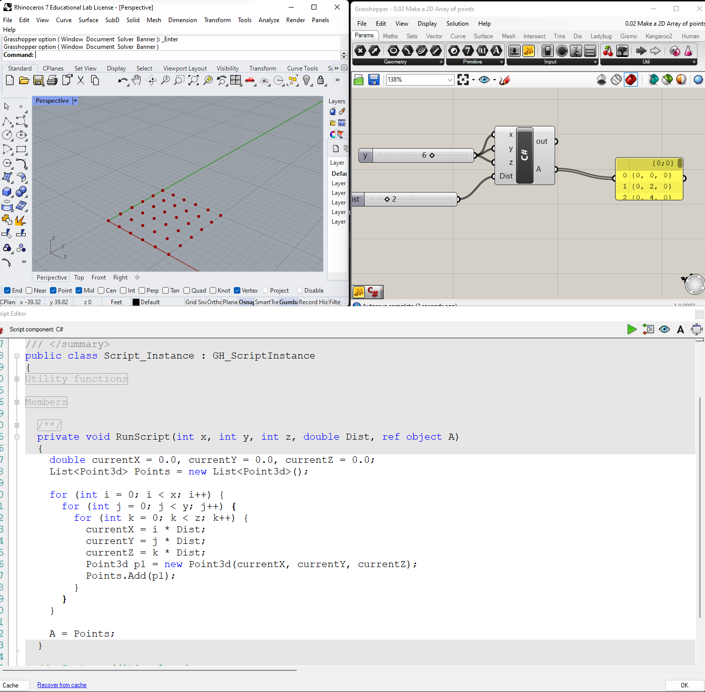
0_02_2 Make a 2D Array of points
>>

Slide 20
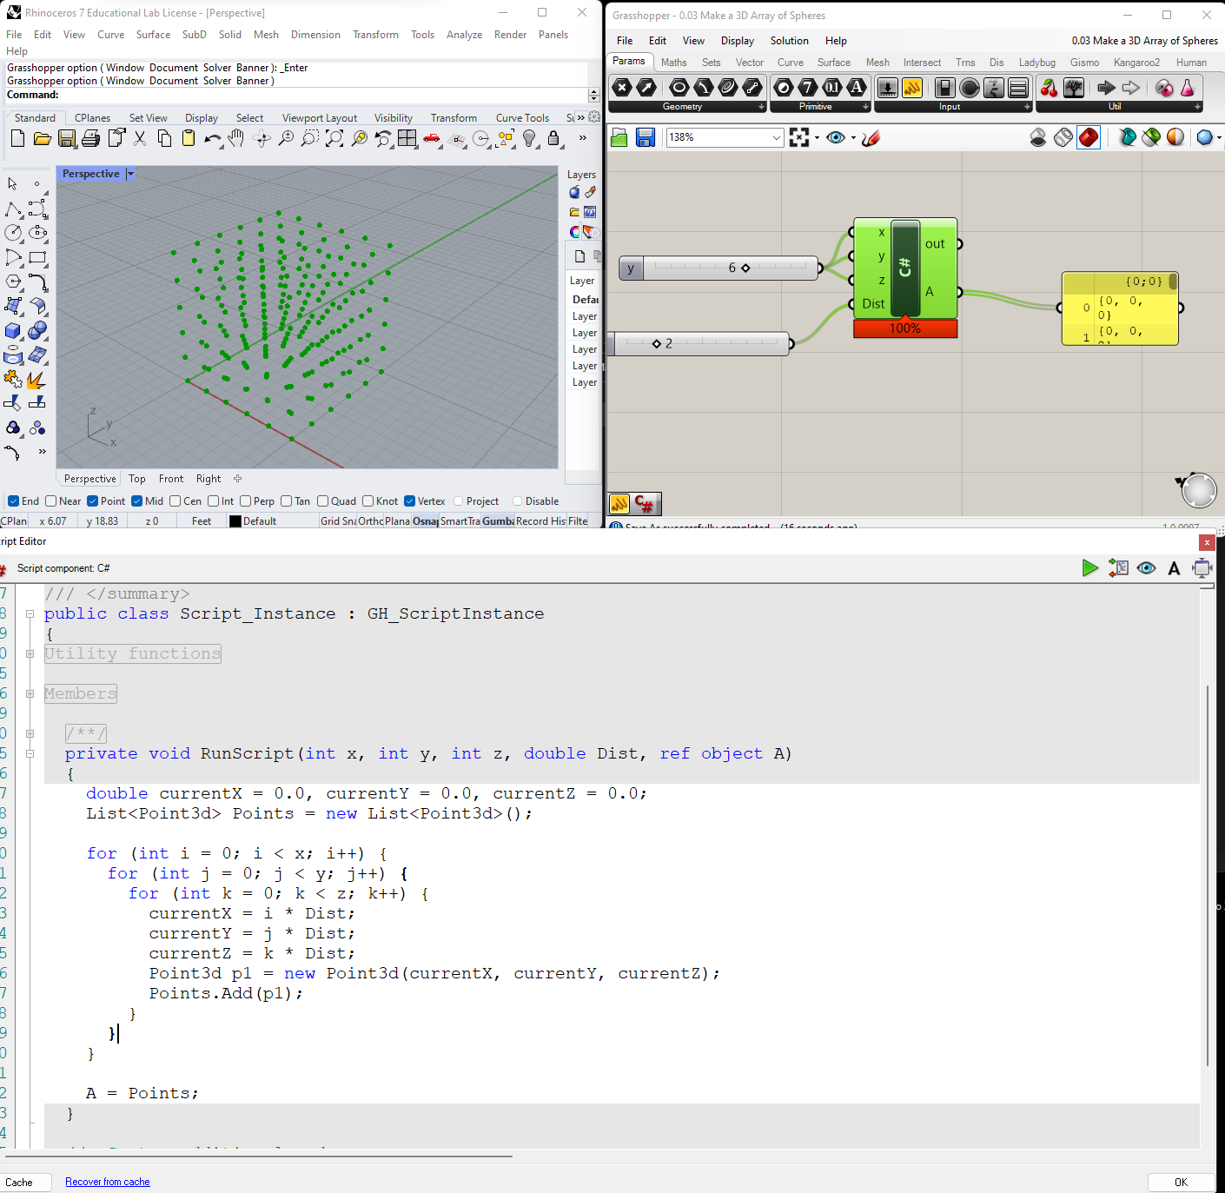
0.03 Make a 3D Array of Spheres
>>

Slide 21
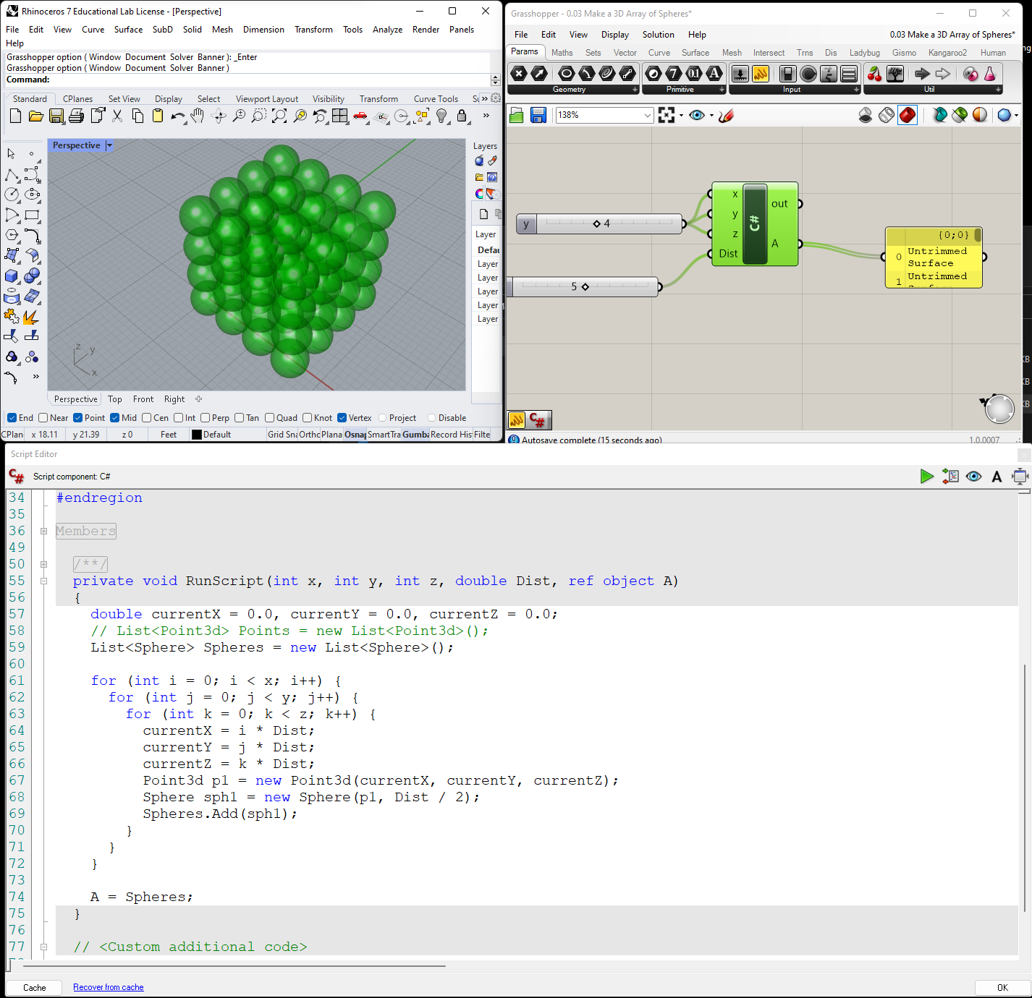
0_03 Make a 3D Array of Spheres
>>

Slide 22
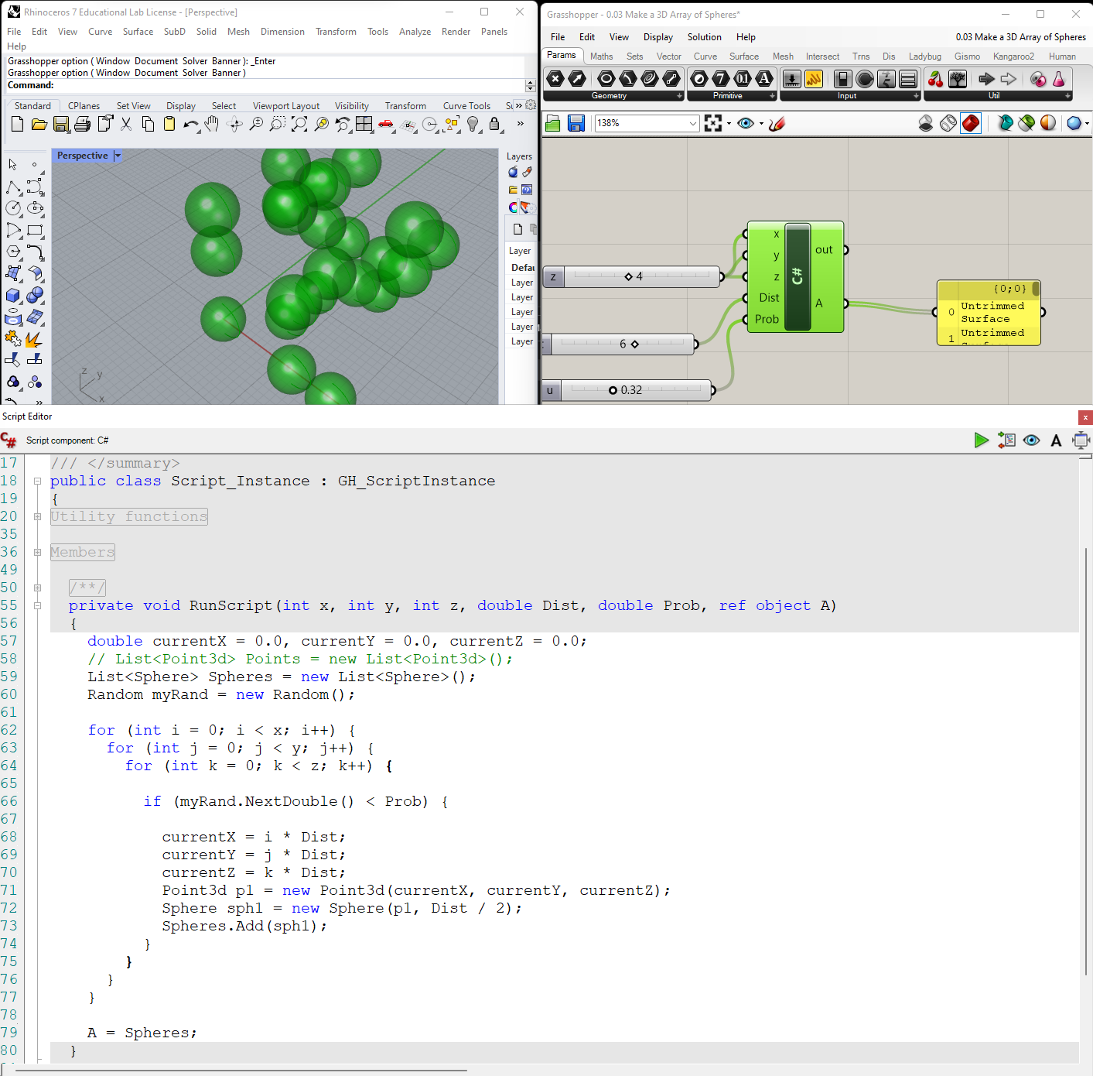
0_04 Make a random 3D Array of Spheres
>>

Slide 23
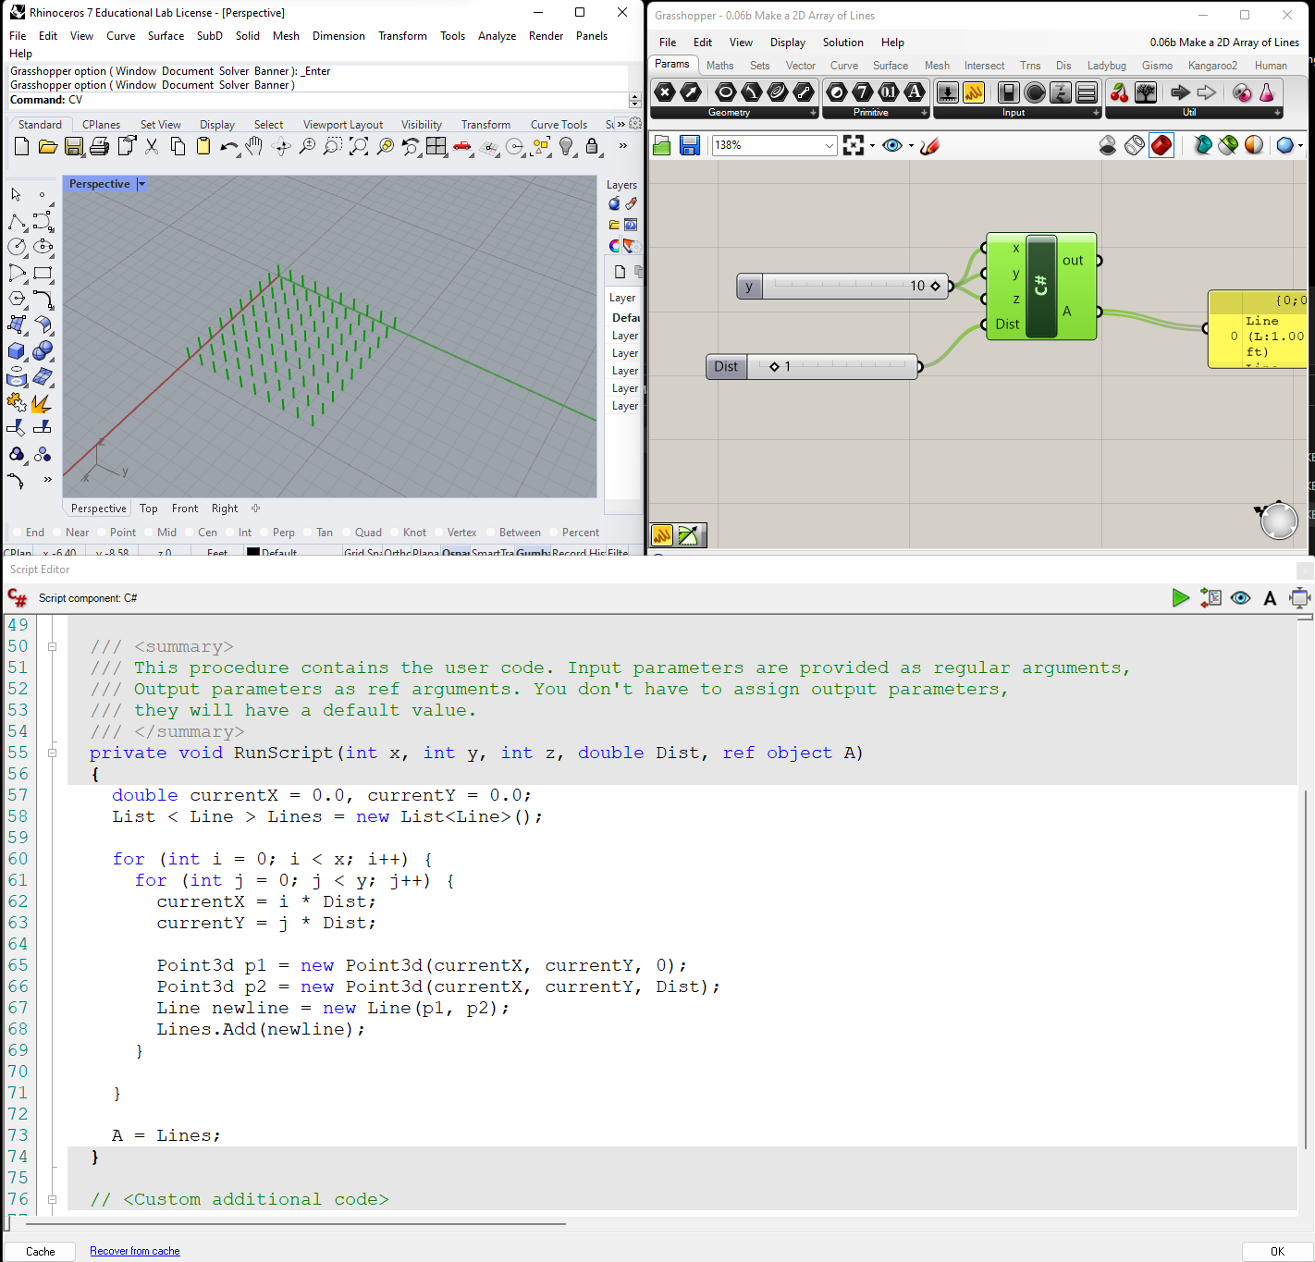
0.06a Make a 2D Array of Lines.gh
>>

Slide 24
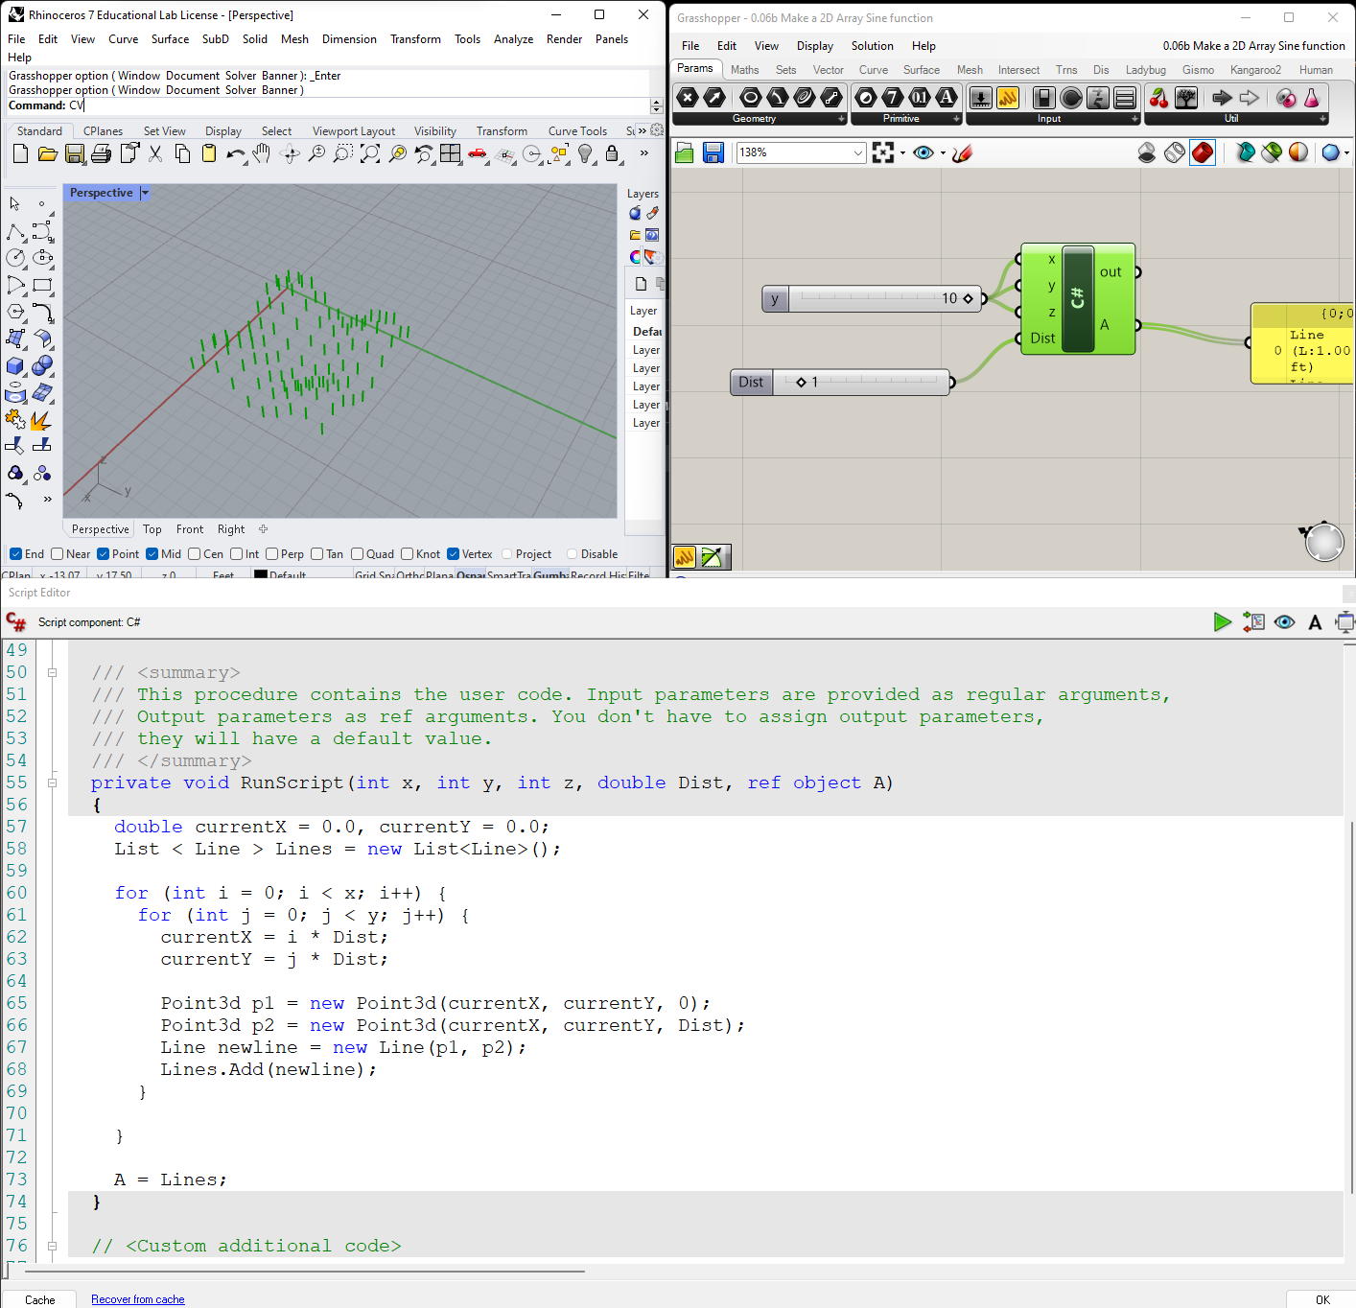
0.06b Make a 2D Array Sine function.gh
>>

Slide 25
Chapter Two: C# Programming Basics
2_1: Introduction
This chapter covers basic C# programming concepts. It serves as an introduction and quick reference to the language syntax. It is not meant to be complete by any measure, so please refer to the C# resources available online and in print³. All examples in this chapter are implemented using the Grasshopper C# component.
³ The Microsoft documentation is a good resource: https://docs.microsoft.com/en- us/dotnet/csharp/programming-guide/

Slide 26
C# - Comments
2_2: Comments
Comments are very useful to describe your code in plain language. They are useful as a reminder for you, and also for others to help them understand your code. To add a comment, you can use two forward slashes // to signal that the rest of the line is a comment and the compiler should ignore it. In the Grasshopper C# code editor, comments are displayed in green. You should enclose a multi-line comment between /* and */ as in the following example.
// The compiler ignores this line
/*
The compiler ignores all lines enclosed within this area
*/

Slide 27
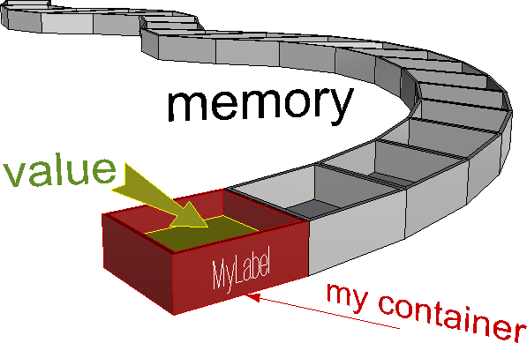
C# - Variables
2_3: Variables
You can think of variables as labeled containers in your computer’s memory where you can store and retrieve data. Your script can define any number of variables and label them with the names of your choice, as long as you do not use spaces, special characters, or reserved words by the programming language. Try to always variable names that are descriptive of the data you intend to store. This will make it easier for you to remember what kind of information is stored in each variable.
Figure(16): How variables are stored in the computer memory
Your script uses variable names to access the value stored in them. In general, you can assign new values to any variable at any point in your program, but each new value wipes out the old
one. When you come to retrieve the value of your variable, you will only get the last one stored. For example, let’s define a variable and name it x. Suppose we want x to be of type integer.
Also,suppose we would like to assign it an initial value of 10. This is how you write a statement in C# to declare and assign an integer:
int x = 10;
Let us dissect all the different parts of the above statement:
int | The type of your data. int is a special keyword in C# that means the type of the variable is a signed integer (can be a positive or negative whole number)
x | The name of the variable.
= | Used for assignment, and it means that the value that follows will be stored in the variable x.
10 | The initial value stored in the x variable.
; | The Semicolon is used to end a single statement⁴.
In general, when you declare a variable, you need to explicitly specify the data type.

Slide 28
C# - Operators
2_4: Operators
Operators are used to perform arithmetic, logical and other operations. Operators make the code more readable because you can write expressions in a format similar to that in mathematics. So instead of having to use functions and write C=Add(A, B), we can write C=A+B, which is easier to read. The following is a table of the common operators provided by the C# programming language for quick reference:
Type | Operator | Description
Arithmetic Operators | ^ | Raises a number to the power of another number.
 | * | Multiplies two numbers.
 | / | Divides two numbers and returns a floating-point result.
 | \ | Divides two numbers and returns an integer result.
 | % | Remainder: divides two numbers and returns only the remainder.
 | + | Adds two numbers or returns the positive value of a numeric expression.
 | - | Returns the difference between two numeric expressions or the negative value of a numeric expression
Assignment Operators | = | Assigns a value to a variable
 | *= | Multiplies the value of a variable by the value of an expression and assigns the result to the variable.
 | += | Adds the value of a numeric expression to the value of a numeric variable and assigns the result to the variable. Can also be used to concatenate a String expression to a String variable and assign the result to the variable.
 | -= | Subtracts the value of an expression from the value of a variable and assigns the result to the variable.
Comparison Operators | < | Less than
 | <= | Less or equal
 | > | Greater than
 | >= | Greater or equal
 | == | Equal
 | != | Not equal
Concatenation Operators | & | Generates a string concatenation of two expressions.
 | + | Concatenate two string expressions.
Logical Operators | && | Performs a logical conjunction on two Boolean expressions
 | ! | Performs logical negation on a Boolean expression
 | || | Performs a logical disjunction on two Boolean expressions

Slide 29
C# - Namespaces
2_5: Namespaces
Namespaces are very useful to group and organize classes especially for large projects. The
.NET uses namespaces to organize its classes. For example System namespace has many classes under it including the Math class, so if you like to calculate the square root of a number, your code will look like the following:
double num = 16;
double sqrNum = System.Math.Sqrt(num);
Notice how you use the namespace followed by “.” to access the classes within that namespace. If you do not want to type the namespace each time you need to access one of the classes within that namespace, then you can use the using keyword as in the following.
using System;
double num = 16;
double sqrNum = Math.Sqrt(num);

Slide 30
C# Data Types : Primitives
2_6: Data
Data types refer to the kind of data stored in the variable. There are two main data types. The first is supplied by the programming language and involves things like numbers, logical true or false, and characters. Those are generally referred to as primitive or built-in types. Variables of any data type can be composed into groups or collections.
2_6_1: Primitive data types
Primitive types refer to the basic and built-in types provided by the programming language. Following examples declare variables of primitive data types:
Declare primitive data types | Notes
double pi = 3.1415; | double: big number with decimal point.
bool pass = true; | bool: set to either true or false. Used mainly to represent the truth value of a variable or a logical statement.
char initial = ‘R’; | char: stores exactly one character.
string myName = “Mary”; | string: a sequence of characters.
object someData = “Mary”; | object type can be used to store data of any type. The use of object type is inefficient and should be avoided if at all possible.

Slide 31
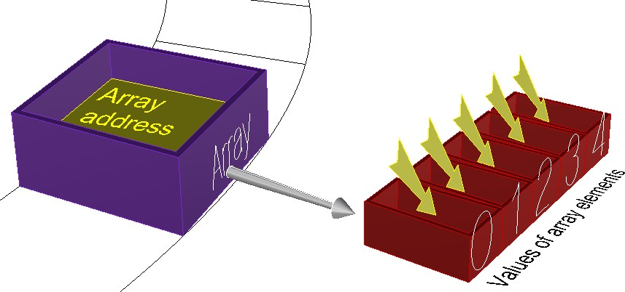
C# Data Types : Arrays
2_6_2: Collections
In many cases, you will need to create and manage a group of objects. There are generally two ways to group objects: either by organizing them in arrays or using a collection. Collections are more versatile and flexible, and they allow you to expand or shrink the group dynamically. There are many ways to create collections, but we will focus on ordered ones that contain elements of the same data type. For more information, you can reference the literature.
Arrays
Arrays are a common way to assemble an ordered group of data. Arrays are best suited if you already know the values you are storing, and do not need to expand or shrink the group dynamically.
>>
Figure(17): How arrays are stored in the computer memory
For example, you can organize the days of the week using an array. The following declares and initializes the weekdays array in one step.
//Declare and initialize the days of the week array
string[ ] weekdays = {"Sunday","Monday","Tuesday","Wednesday","Thursday","Friday","Saturday"};
You can also declare the array first with a specific dimension representing the number of elements to allocate in memory for the array, then assign the values of the elements in separate statements. In C# language, each statement ends with a semicolon.
//Declare the days of the week in one statement, then assign the values later string[ ] weekdays = new string[7];
weekdays[0] = "Sunday";
weekdays[1] = "Monday"; weekdays[2] = "Tuesday"; weekdays[3] = "Wednesday"; weekdays[4] = "Thursday"; weekdays[5] = "Friday"; weekdays[6] = "Saturday";
Let’s take the statement that sets the first value in the weekdays array in the above.
weekdays[0] = “Sunday”;
Sunday is called an array element. The number between brackets is called the index of the element in the array. Notice that in C# language the array always starts with index=0 that points to the first element. The last index of an array of seven elements therefore equals 6. If you try to retrieve data from an invalid index, for example 7 in the weekday example above, then you will get what is called an out of bound error because you are basically trying to access a part of the memory that you did not allocate for your array and it can lead to a crash.

Slide 32
C# Data Types : Lists
Lists
If you need to create an ordered collection of data dynamically, then use a List. You will need to use the new keyword and specify the data type of the list. The following example declares a new list of integers and appends elements incrementally in subsequent statements. Note that the indices of a list are also zero based just like arrays.
>>
//Declare a dynamic ordered collection using “List”
List<string> myWorkDays = new List<string>();
//Add any number of new elements to the list myWorkDays.Add("Tuesday"); myWorkDays.Add("Wednesday"); myWorkDays.Add("Thursday"); myWorkDays.Add("Friday");
You need to use the keyword new to declare an instance of a List.. We will explain what it means to be a reference type with some more details later.

Slide 33
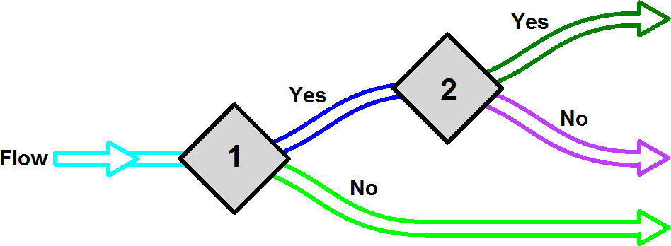
C# Flow Control : If Statements
2_7: Flow control
The flow of your scripts indicates the order of code execution. Sometimes you might need to branch or loop through specific statements several times. For example, you might want to branch your script to implement a different sequence based on some condition. Other times, you might need to repeat a certain sequence multiple times. We will discuss three important mechanisms to control the flow of a program; conditional statements, loops and methods.
2_7_1: Conditional statements
Conditional statements allow you to decide on which part of your code to use based on some condition that can change during run time. Unlike regular programming instructions, conditional statements can be described as decision-making logic. Conditional statements help control and regulate the flow of the program.
Figure(17): Conditional statements 1 and 2, and how they affect the flow of the program.
The following script examines a number variable and prints “zero” if it equals zero:
if (myNumber == 0) { Print("myNumber is zero"); }
Description
if | Keyword indicating the start of the if statement
(myNumber == 0) | The condition of the if statement enclosed by parentheses
>>
{ Print("myNumber is zero"); } | The if statement block enclosed between curly brackets. The block is executed only if the condition evaluates to true, otherwise it is skipped.
The following code checks if a number is between 0 and 100:
if (myNumber >= 0 && myNumber <= 100)
{
Print("myNumber is between 0 and 100");
}

Slide 34
C# Flow Control : If … Else Statements
Sometimes the script needs to execute one block when some condition is satisfied, and another if not. Here is an example that prints the word positive when the given number is greater than zero, and prints less than 1 if not. It uses the if… else statement.
if (myNumber > 0)
{
Print("positive");
}
else
{
Print( "less than 1" );
}
>>
You can use as many conditions as you need as shown in the following example.
if (myNumber > 0)
{
Print("myNumber is positive");
}
else if (myNumber < 0)
{
Print( "myNumber is negative" );
}
else
{
Print( "myNumber is zero" );
}

Slide 35
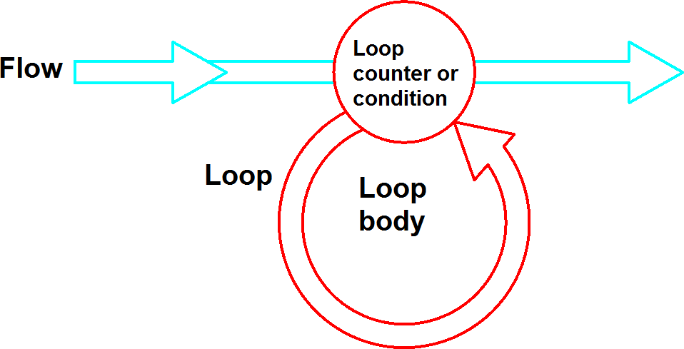
C# Language : Loops
2_7_2: Loops
Loops allows you to run the body of your loop a fixed number of times, or until the loop condition is no longer true.
Figure(18): Loops in the context of the overall flow of the program
There are two kinds of loops. The first is iterative where you can repeat code a defined number of times, and the second is conditional where you repeat until some condition is no longer satisfied.

Slide 36
Iterative loops: for loop
This is a common way of looping when you need to run some lock of code a specific number of times. Here is a simple example that prints numbers from 1 to 10. You first declare a counter and then increment in the loop to run the code specific number of times. Notice that the code statements that you would like to repeat are bound by the block after the for statement.
for (int i = 1; i <= 10; i++) { //Convert a number to string Print( i.ToString() ); }
Description
for (int i = 1; i <= 10; i++) | The for statement. It has 4 parts: for(... ; … ; ...): the for keyword and loop condition and counter i=1: the counter initial value i<=10: the condition: if evaluates to true, then execute the body of the for loop i++: increment the counter (by 1 in this case)
{ //Convert a number to string Print( i.ToString() ); } | The body of the for loop. This is the code that is executed as long as the condition is met. Note that if the condition of the for loop is always true, then the program will enter what is called an “infinite loop” that leads to a crash. For example if the condition was “i>0” instead of “i<=10” then it will cause an infinite loop.
for (int i = 10; i >= -10; i = i-2)
{
Print( i.ToString() );
}
If you happen to have an array that you need to iterate through, then you can set your counter to loop through the indices of your array. Just remember that the indices of arrays are zero based and therefore you need to remember to loop from index=0 to the length of the array minus 1, or else you will get an out-of-bound error.
string alphabet = "ABCDEFGHIJKLMNOPQRSTUVWXYZ"; char[ ] letters = alphabet.ToCharArray();
for (int i = 0; i < letters.Length; i++)
{
Print( i.ToString() + " = " + letters[i] );
}
Here is another example that iterates through a list of places.
//List of places
List< string > placesList = new List< string >(); placesList.Add( "Paris" );
placesList.Add( "NY" );
placesList.Add( "Beijing" );
int count = placesList.Count();
//Loop starting from 0 to count -1 (count = 3, but last index of the placesList is 2)
for (int i = 0; i < count; i++)
{
Print( "I have been to " + placesList[i] );
}
The loop counter does not have to be increasing, or change by 1. The following example prints the even numbers between 10 and -10. You start with a counter value equal to 10, and then change by -2 thereafter until the counter becomes smaller than -10.

Slide 37
Iterative Loops: foreach loop
You can use the foreach loop to iterate through the elements of an array or a list without using a counter or index. This is a less error prone way to avoid out of bound error. The above example can be rewritten as follows to use foreach instead of the for loop:
//List of places
List< string > placesList = new List< string >(); placesList.Add( "Paris" );
placesList.Add( "NY" ); placesList.Add( "Beijing" );
//Loop
foreach (string place in placesList)
{
Print(place);
}
>>
>>
Conditional Loops: while loop
Conditional loops are ones that keep repeating until certain conditions are no longer true. You have to be very careful when you use conditional loops because you can be trapped looping infinitely until you crash when your condition continues to be true.
Some problems can be solved iteratively but others cannot. For example if you need to find the sum of 10 consecutive positive even integers starting with 2, then this can be solved iteratively
with a for loop. Why? This is because you have a specified number of times to loop (10 in this case). This is how you might write your loop to solve your problem.
int sum = 0;
for (int i = 1; i <= 10; i++)
{
sum = sum + ( i*2 );
}
Print( sum.ToString() );
On the other hand, if you need to add consecutive positive even integers starting with 2 until the sum exceeds 1000, then you cannot simply use an iterative for loop because you do not know how many times you will have to loop. You only have a condition to stop looping. Here is how you might solve this problem using the conditional while loop:
int sum = 0;
int counter = 0; int number = 2;
//Loop
while (sum < 1000)
{
sum = sum + number;
//Make sure you increment the counter and the number
counter = counter + 1; number = number + 2;
}
//Remove last number sum -= number; counter --;
Print("Count = " + counter);
Print("Sum = " + sum);

Slide 38
Here is another example from mathematics where you can solve the Collatz conjecture. It basically says that you can start with any natural positive integer, and if even then divide by 2, but if odd, then multiply by 3 and add 1. If you repeat the process long enough, then you always converge to 1⁵. The following example prints all the numbers in a Collatz conjecture for a given number:
int x = 46;
while(x > 1)
{
Print( x.ToString() ); if( x % 2 == 0 )
x = x / 2; else
x = x * 3 + 1;
}
Print( x.ToString() );
>>
⁵ For details about the Collatz conjecture, check http://en.wikipedia.org/wiki/Collatz_conjecture

Slide 39
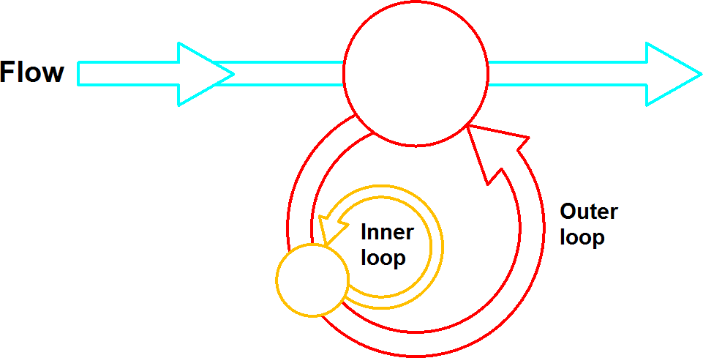
Nested loops
A nested loop is a loop that contains another loop inside it. You can nest as many loops as you need, but keep in mind that this can make the logic harder to follow.
Figure(19): Nested loops
For example, suppose you have the following list of words as input: {apple, orange, banana, strawberry} and you need to calculate the number of letters a. You will have to do the following:
Loop through each one of the fruits. This is the outer loop.
For each fruit, loop through all the letters. This is the inner, or the nested, loop.
Whenever you find the letter “a” increment your counter by 1.
Print the counter.
//Declare and initialize the fruits
string[ ] fruits = {“apple”, “orange”, “banana”, “strawberry”}; int count = 0;
//Loop through the fruits
foreach (string fruit in fruits)
{
//loop through the letters in each fruit
foreach (char letter in fruit)
{
//Check if the letter is ‘a"
If (letter == ‘a’) { count = count + 1;
}
}
}
Print( “Letter a is repeated “ + count + “ times“ );
>>

Slide 40
Using break and continue inside loops
The break statement is used to terminate or exit the loop while the continue statement helps skip one loop iteration. Here is an example to show the use of both. It checks if there is an orange in a list of fruits, and counts how many fruits have at least one letter r in their name.
//Declare and initialize the fruits
string[ ] fruits = {“apple”, “orange”, “banana”, “strawberry”};
//Check if there is at least one orange
foreach (string fruit in fruits)
{
//Check if it is an orange
if (fruit == "orange")
{
//Check if the letter is ‘a"
Print( "Found an orange" );
//No need to check the rest of the list, exit the loop
break;
}
}
//Check how many fruits has at least one letter ‘r’ in the name
int count = 0;
//Loop through the fruits
foreach (string fruit in fruits)
{
//loop through the letters in each fruit
foreach (char letter in fruit)
{
//Check if the letter is ‘r"
if (letter == ‘r’) { count = count + 1;
//No need to check the rest of the letters, and skip to the next fruit
continue;
}
}
}
Print( "Number of fruits that has at least one letter r is: " + count );

Slide 41
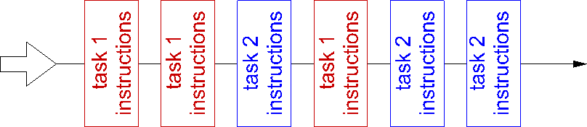
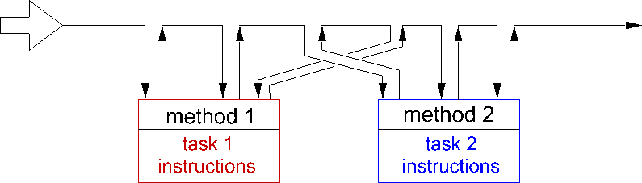
2_8: Methods
2_8_1: Overview
A method⁶ is a self-contained entity that performs a specific task. The program can call it any number of times. Functions are basically used to organize your program into sub-tasks. The following is an example of the flow of a program that uses two distinct tasks repeatedly, but does not implement as a separate function, and hence has to retype at each encounter.
Figure(20): Sequential flow of the script where tasks are repeated
Most programming languages allow you to organize your tasks into separate modules or what is called functions or methods. You can think of Grasshopper components each as a function. This allows you to write the instructions of each task once and give it an identifying name. Once you do that, anytime you need to perform the task in your program, you simply call the name of that task. Your program flow will look like the following:
Figure(21): Methods can be called and executed as many times as the script requires
Whenever you need to perform the same task multiple times in different places in your code, you should consider isolating it in a separate function. Here are some of the benefits you will get from using functions:
Break your program into manageable pieces. It is much easier to understand, develop, test and maintain smaller chunks of code, than one big chunk.
Write and test the code once, and reuse instead of writing it again. Also update in one place if a modification is required at any time.
Writing functions might not always be easy and it needs some planning. There are four general steps that you need to satisfy when writing a function:
Define the purpose of your function and give it a descriptive name.
Identify the data that comes into the function when it is called.
Identify the data that the function needs to hand back or return.
Consider what you need to include inside the function to perform your task.
⁶ The term “method” refers to functions associated with classes, but this guide may use them interchangeably.

Slide 42
For example, suppose you would like to develop a function that checks whether a given natural number is a prime number or not. Here are the four things you need to do:
Purpose & name: Check if a given number is prime. Find a descriptive name for your
function, for example “IsPrimeNumber”.
Input parameters: Pass your number as type integer.
Return: True if the number is prime, otherwise return false.
Implementation: Use a loop of integers between 2 and half the number. If the number is not divisible by any of those integers, then it must be a prime number. Note that there might be other more efficient ways to test for a prime number that can expedite the execution.
bool IsPrimeNumber( int x)
{
bool primeFlag = true;
for( int i = 2; i < (x / 2); i++)
{
if( x % i == 0)
{
primeFlag = false; break; //exit the loop
}
}
return primeFlag;
}
>>
Let us dissect the different parts of the IsPrimeNumber function to understand the different parts.
The function or method part | Description
bool IsPrimeNumber(…) { … } | The name of the function proceeded by the return type. The function body is enclosed inside the curly parenthesis.
( int x ) | Function parameters and their types.
bool primeFlag = true; for( int i = 2; i < (x / 2); i++) { if( x % i == 0) { primeFlag = false; break; //exit the loop } } | This is called the body of the function. It includes a list of instructions to examine whether the given number is prime or not, and append all divisible numbers.
return primeFlag; | Return value. Use return keyword to indicate the value the function hands back.

Slide 43
2_8_2: Method parameters
Input parameters are enclosed within parentheses after the method name. The parameters are a list of variables and their types. They represent the data the function receives from the code that calls it. Each parameter is passed either by value or by reference. Keep in mind that variables themselves can be a value-type such as primitive data (int, double, etc.), or reference- types such as lists and user-defined classes. The following table explains what it means to pass value or reference types by value or by reference.
Parameters | Description
Pass by value a value-type data such as int, double, bool | The caller passes a copy of the actual value of the parameter. Changes to the value of a variable inside the function will not affect the original variable passed from the calling part of the code.
Pass by reference a value- type data | Indicates that the address of the original variable is passed and any changes made to the value of that variable inside the function will be seen by the caller.
Pass by value a reference- type data such as lists, arrays, object, and all classes | Reference Type data holds the address of the data in the memory. Passing a Reference Type data by value simply copy the address, so changes inside the function will change original data. If the caller cares that ita data is not affected by the function, it should duplicate the data before passing it to any function.
Pass by reference a reference-type data | Indicates that the original reference of the variable is passed. Again, any changes made to the variable inside the function are also seen by the caller.
As you can see from the table, whether the parameter is passed as a copy (by value) or as a reference (by reference), is mostly relevant to value-type variables such as int, double, bool, etc. If you need to pass a reference-type such as objects and lists, and you do not wish the function to change your original data (act as though the variable is passed by value), then you need to duplicate your data before passing it. All input values to the GH RunScript function (the main function in the scripting component) are duplicated before being used inside the component so that input data is not affected.

Slide 44
Let’s expand the IsPrimeNumber function to return all the numbers that the input is divisible by. We can pass a list of numbers to be set inside the function (List is a reference type). Notice it will not matter if you pass the list with the ref keyword or not. In both cases, the caller changes the original data inside the function.
private void RunScript(int num, ref object IsPrime, ref object Factors) {
//Assign variables to output List<int> factors = new List<int>(); IsPrime= isPrimeNumber(num, factors); Factors = factors;
} //Note: “List” is a reference type and hence you can pass it by value (without “ref” keyword) // and the caller still get any changes the function makes to the list bool IsPrimeNumber( int num, ref List<int> factors ) { //all numbers are divisible by 1 factors.Add(1); bool primeFlag = true; for( int i = 2; i < (num / 2); i++) { if( num % i == 0) { primeFlag = false; factors.Add( i); //append number } } //all numbers are divisible by the number itself factors.Add(num); return primeFlag; }
Passing parameters by reference using keyword ref is very useful when you need to get more than one value-type back from your function. Since functions are allowed to return only one
value, programmers typically pass more parameters by reference as a way to return more values. Here is an example of a division function that returns success if the calculation is successful, but also returns the result of the division using the rc parameter that is passed by- reference.
public bool Divide(double x, double y, ref double rc)
{
if (Math.Abs(y) < 1e-100) return false;
else
rc = x / y; return true;
}
>>

Slide 45
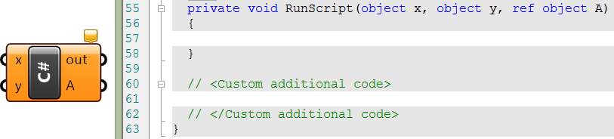
As we explained before, the RunScript is the main function that is available is the C# and other script components. This is where the user main code lives. Notice that the scripting component output is passed by reference. This is what you see when you open a default C# script component in Grasshopper.
Code part | Description
{ } | Curly parentheses enclose the function body of code.
RunScript | This is the name of the main function.
RunScript(…) | Parentheses after the function name enclose the input parameters. This is the list of variables passed to the function.
object x | x is the first input parameter. It is passed by value and its type is object. That means changes to “x” inside the RunScript does not change the original value.
object y | y is the second input parameter. It is passed ByVal and its type is Object.
ref object A | A is the third input parameter. It is passed by reference and its type is object. It is also an output because you can assign it a value inside your script and the change will be carried outside the RunScript function.
//Custom additional code | Comment indicating where you should place your additional functions, if needed.

Slide 46
2_9: User-defined data types
We mentioned above that there are built-in data types and come with and are supported by the programming language such as int, double, string and object. However, users can create their own custom types with custom functionality that suits the application. There are a few ways to create custom data types. We will explain the most common ones: enumerations, structures and classes.

Slide 47
Assignment 01
For this assignment we are going to revisit the initial example from the first class, and consider “grid-like” algorithms.
A grid-like algorithm is an algorithm that generates shapes based on a regular grid of
i points (1D),
i * j points (2D), or
i * j * k points (3D)
The “axes” of the grid do not need to be straight, but a “regular” grid:
will not self interect
Each point in the grid as a neighbor in each of the (+/- i, +/- j, +/- k) directions, except for the points at the edge (“the edge cases”).
Create a 1-dimensional algorithm and then extend this algorithm to a 2D or 3D algorithm, using the template. Your algorithm may:
Modify the placement, spacing, etc of Point3d locations over the field of the grid,
Place objects at the location of the grid points, or more complex objects may be constructed with multiple grid or other points.
Place or not place objects, replace objects, etc based on the indices of the points, random numbers, etc.
Include screen captures of the resulting spatial configurations of the algorithm and the code used to generate your two versions. Paste these screen captures in this presentation, with 1 slide per algorithm. Include your name on each slide.
Use this template to start the project. 1, 2 and 3D arrays are included.

Slide 48
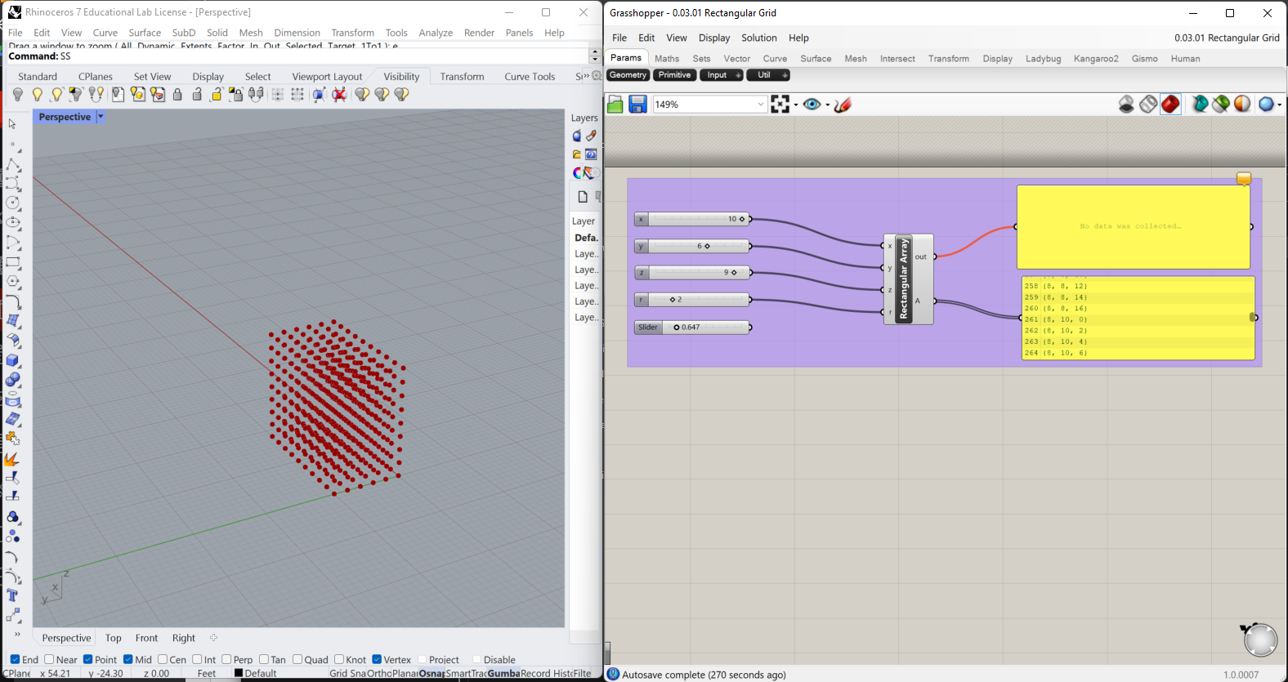
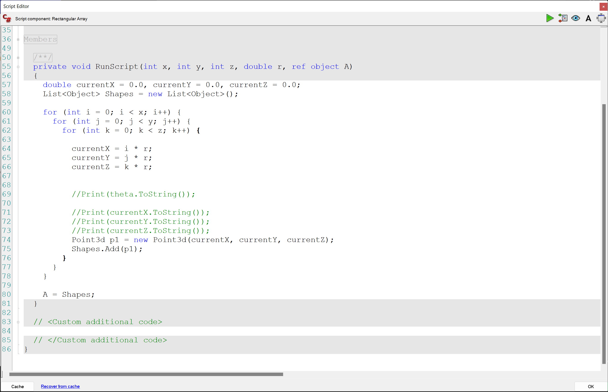
0.03.01 Basic rectangular grid
>>

Slide 49
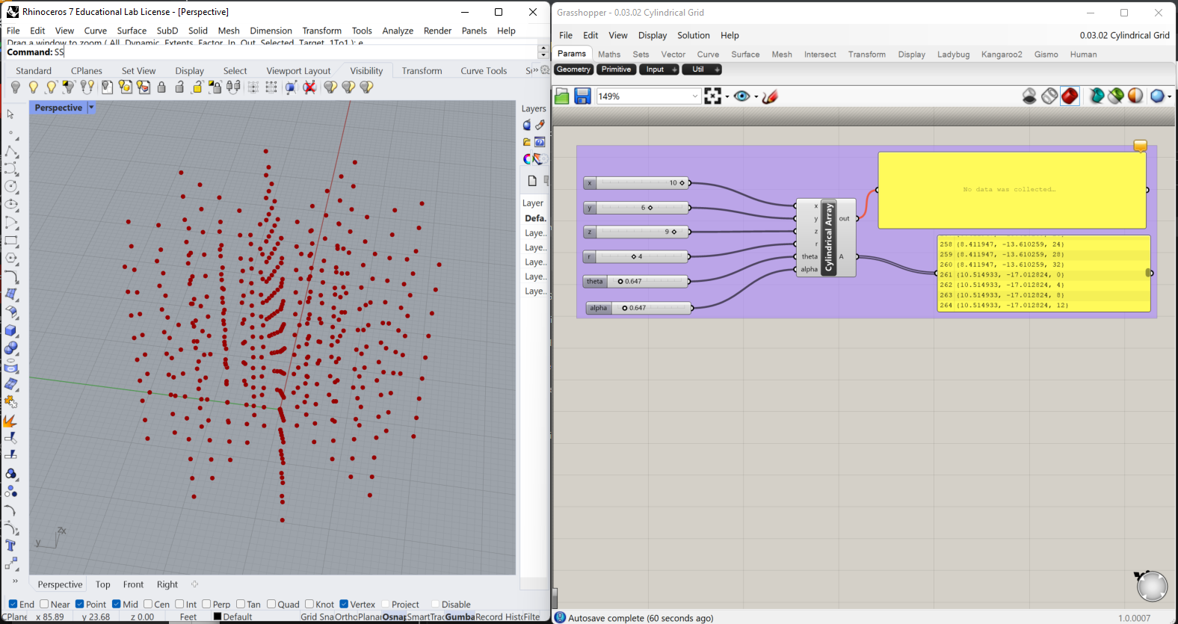
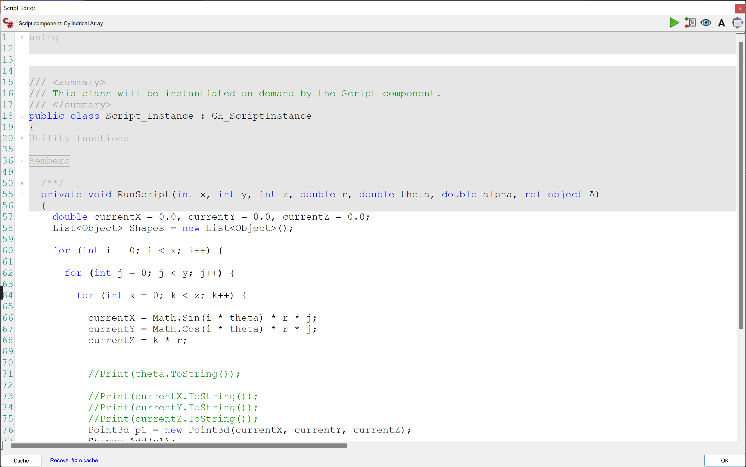
0.03.02 Basic cylindrical grid
>>

Slide 50
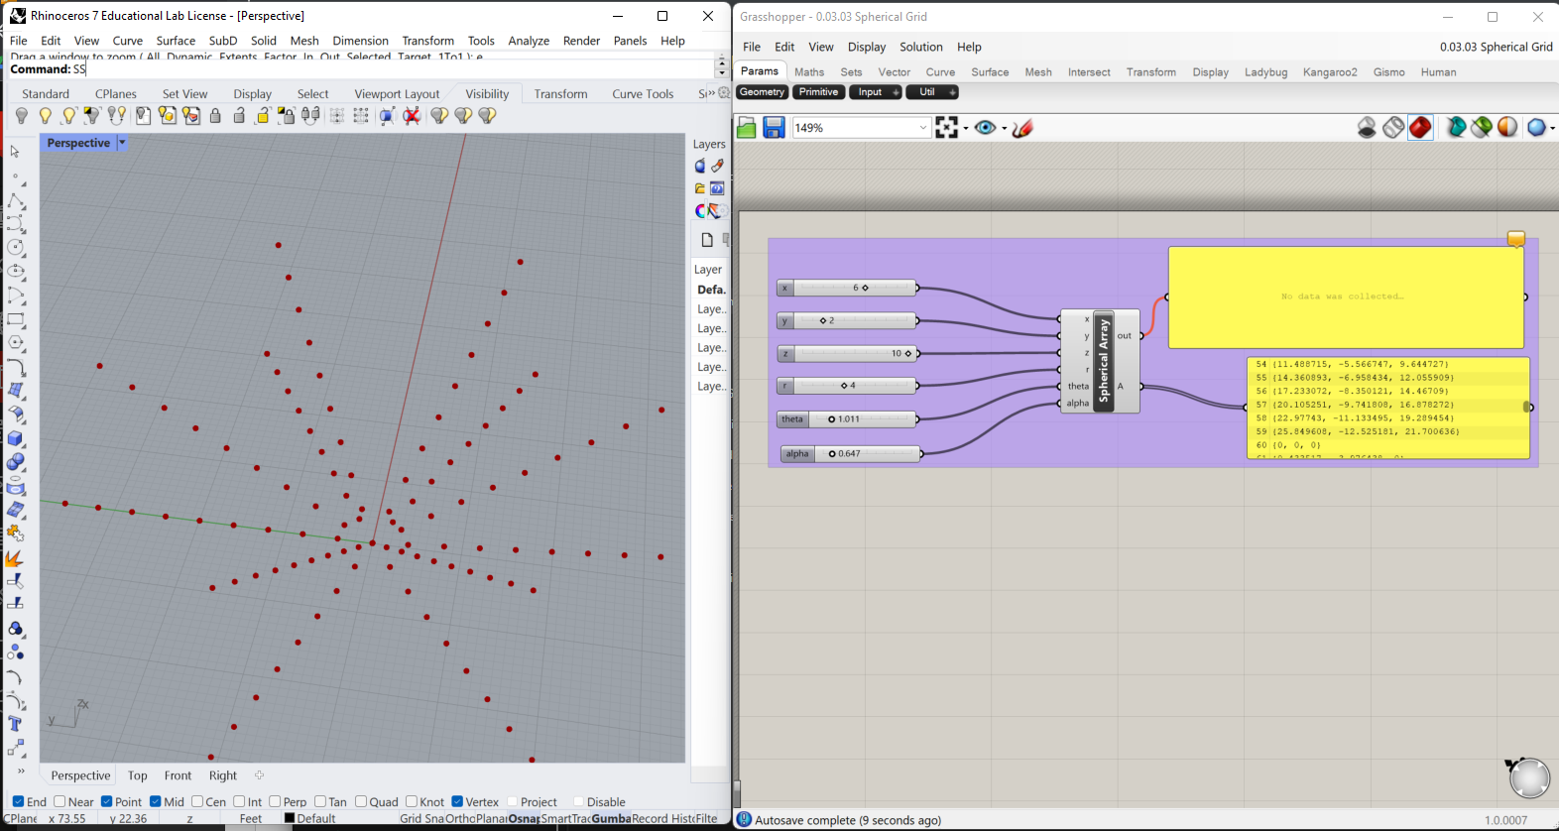
0.03.02 Basic spherical grid
>>

Slide 51
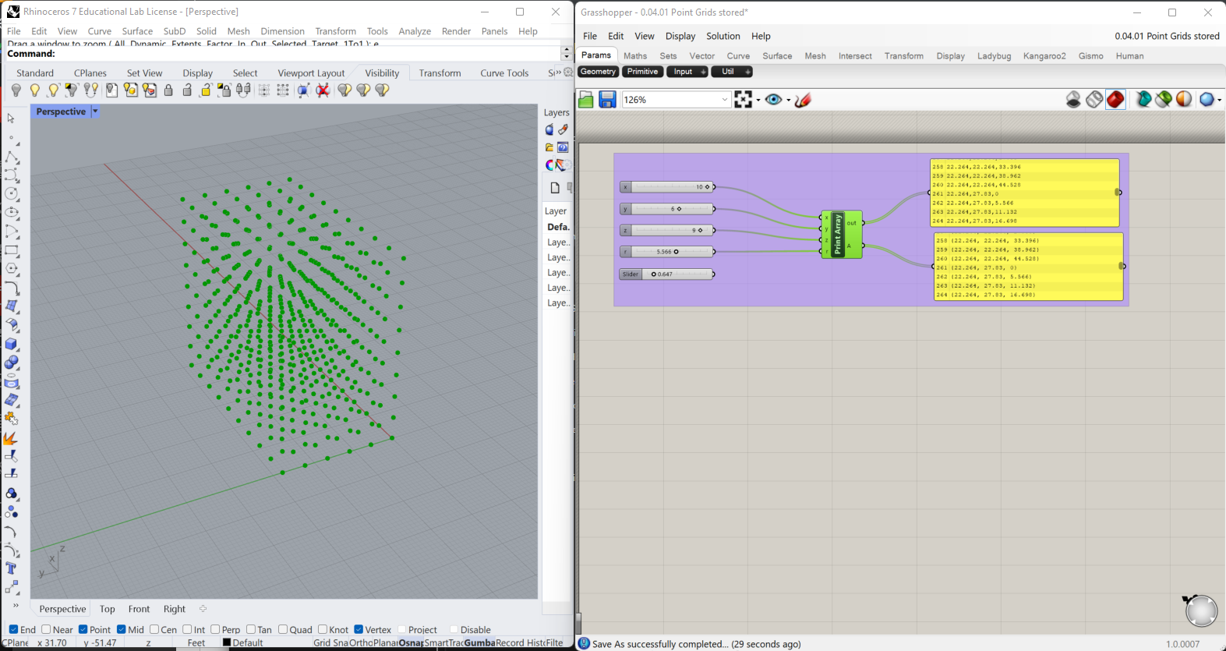
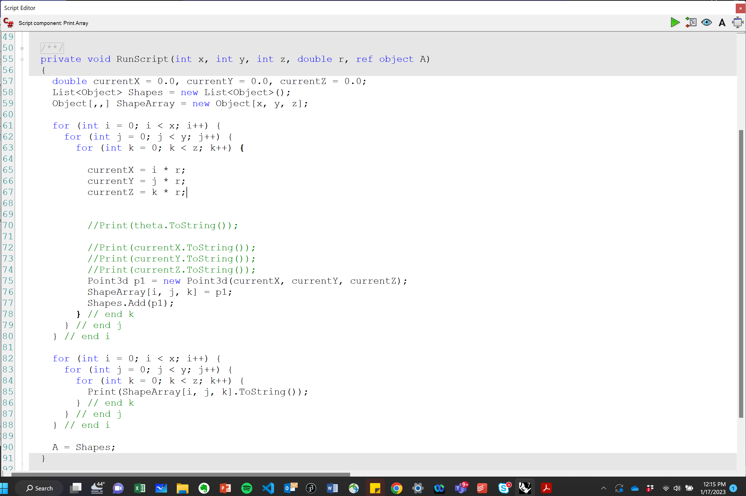
0.04.01 Basic grid with stored points
>>

Slide 52
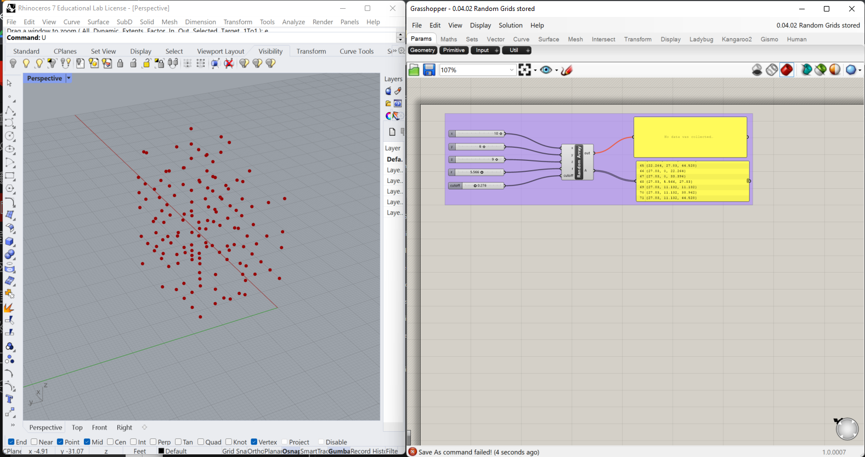
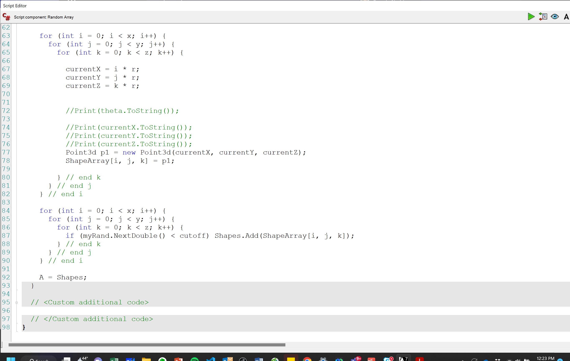
0.04.02 Random Grids stored.gh
>>

Slide 53
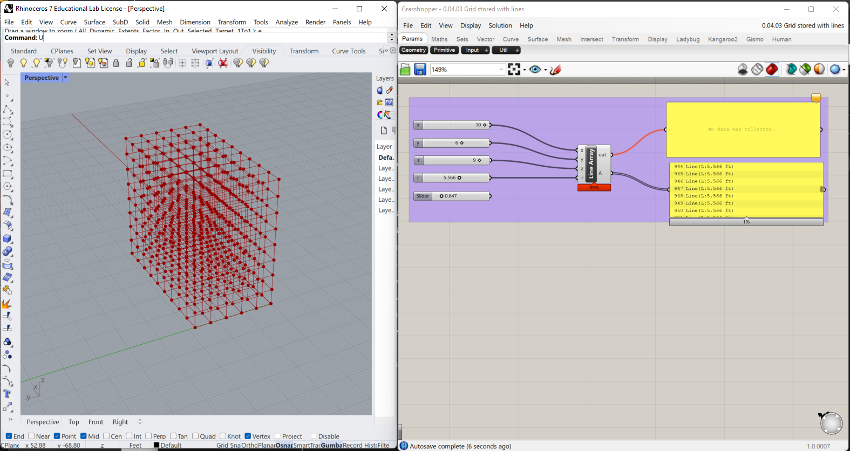
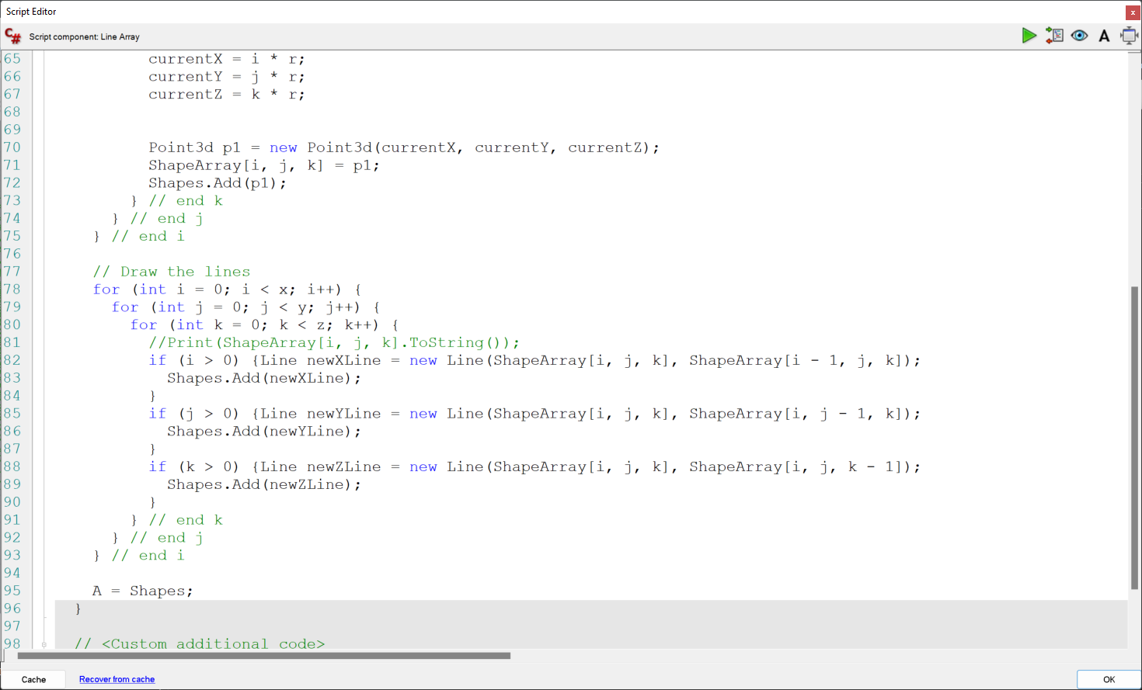
0.04.03 Grid stored with lines.gh
>>

Slide 54
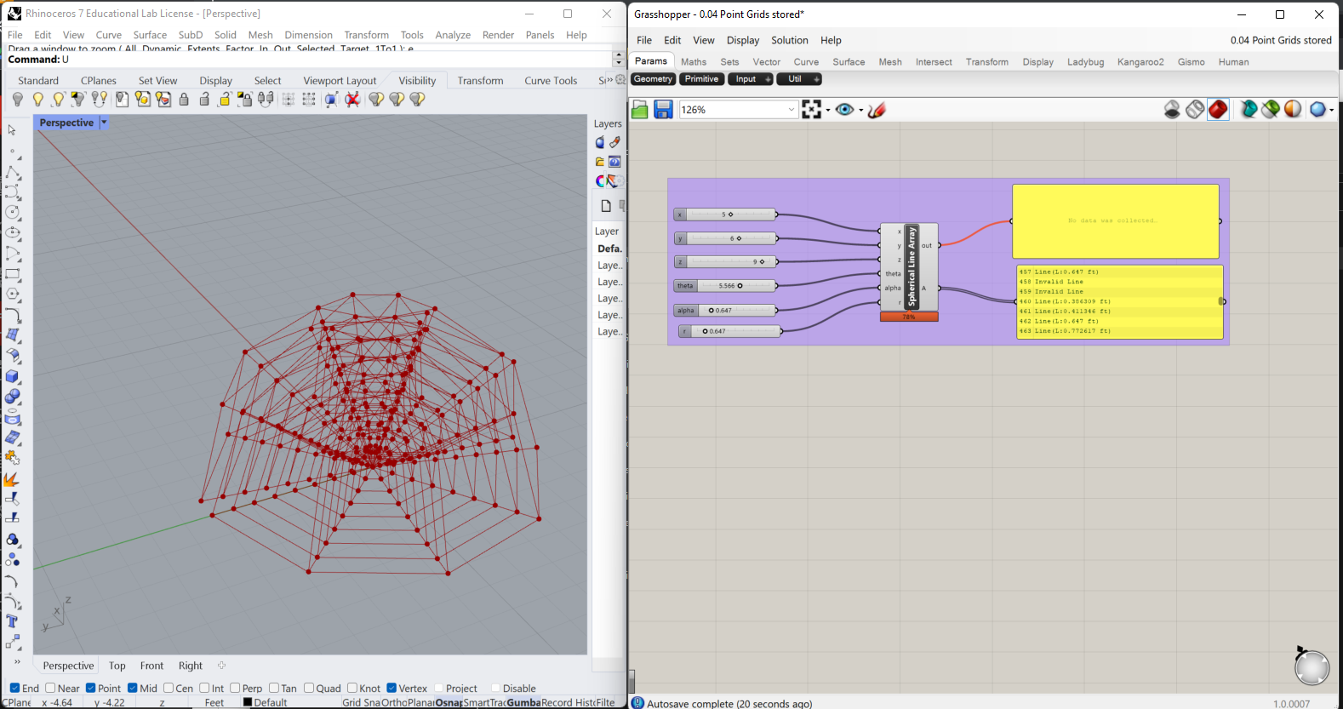

0.04.04 Spherical Grid stored with lines.gh
>>

Slide 55


0.05.01 1D Functional Curves.gh
>>

Slide 56


0.05.02 2D Polynomial Curve2.gh
>>

Slide 57


0.05.03 2D Sin Curve in 1 direction.gh
>>

Slide 58


0.05.04 2D Sin Curve in 2 directions.gh
>>

Slide 59

Week 3 – Objects & the Rhino Common Library
Part 1
A few additional C# language constructs
Enum
Struct
Classes, instances & instance
Part 2
Rhino Common Geometry
Point3d
Vectors
Lightweight Curves
Lightweight Surfaces

Slide 60
User Defined Data Types
2_9: User-defined data types
We mentioned above that there are built-in data types and come with and are supported by the programming language such as int, double, string and object. However, users can create their own custom types with custom functionality that suits the application. There are a few ways to create custom data types. We will explain the most common ones: enumerations, structures and classes.
2_9_1: Enumerations
Enumerations help make the code more readable. An enumeration “provides an efficient way to define a set of named integral constants that may be assigned to a variable”⁷. You can use enumerations to group a family of options under one category and use descriptive names. For example, there are only three values in a traffic light signal.
enum Traffic
{
Red = 1,
Yellow = 2,
Green = 3
}
Traffic signal = Traffic.Yellow; if( signal == Traffic.Red)
Print("STOP");
else if(signal == Traffic.Yellow) Print("YIELD");
else if(signal == Traffic.Green) Print("GO");
else
Print("This is not a traffic signal color!");
>>
⁷ https://docs.microsoft.com/en-us/dotnet/csharp/programming-guide/enumeration-types

Slide 61
2_9_4: Value vs reference types
It is worth stressing the two data classifications: value-types and reference-types. We touched on that topic when introducing methods and how parameters are passed by value or by reference. There are also differences in how the two are stored and managed in memory. Here is a summary comparison between the two classifications:
 | Value data types | Reference data types
Examples | All built-in numeric data types (such as Integer, double, bool, and char), Arrays, Structures. | Lists Classes
Memory storage | Stored inline in the program stack. | Stored in the heap.
Memory management | Cheaper to create and clear from memory especially for small data. | Costly to clear (use garbage collectors), but more efficient for big data.
When passed as parameters in methods | Passes a copy of the data to methods, which means that the original data is not changed even when altered inside the method. | Passes the address of the original data, and hence any changes to the data inside the method changes the original data as well.
int b = a;
int b: address 0x0002
int a: address 0x0001
1 | 0 | 0 | 1 | 1 | 0 | 0 | 1
int ref b = (ref) a;
int ref b
int a: address 0x0001
0 | 0 | 0 | 0 | 0 | 0 | 0 | 1
1 | 0 | 0 | 1 | 1 | 0 | 0 | 1
b.Value
1 | 0 | 0 | 1 | 1 | 0 | 0 | 1

Slide 62

How memory is managed

Slide 63

How memory is managed
>>
Stack
Global / Script_Instance Scope
globalVariable | 0
a | 0
RunScript() Scope
RunScriptVariable | 1
a | 1
myFunction() Scope
myFunctionVariable | 2
a | 2
Heap

Slide 64

User Defined Data Types - Structs
2_9_2: Structures
A structure is used to define a new value-type. In C# programming , we use the keyword struct to define new structure. The following is an example of a simple structure that defines a number of variables (fields) to create a custom type of a colored 3D point. We use private access to the fields, and use properties to get and set the fields.
struct ColorPoint{
//fields for the point XYZ location and color private double _x;
private double _y; private double _z;
private System.Drawing.Color _c;
//properties to get and set the location and color public double X { get { return _x; } set { _x = value; } } public double Y { get { return _y; } set { _y = value; } } public double Z { get { return _z; } set { _z = value; } }
public System.Drawing.Color C { get { return _c; } set { _c = value; } }
}
>>
As an example, you might have two instances of the ColorPoint type, and you need to compare their location and color. Notice that when you instantiate a new instance of ColorPoint object, the object uses a default constructor that sets all fields to “0”:
ColorPoint cp0 = new ColorPoint(); //Using default constructor sets the fields to zero Print("Default ColorPoint 0: X=" + cp0.X + ", Y=" + cp0.Y + ", Z=" + cp0.Z + ", Color=" + cp0.C.Name); //set fields cp0.X = x; cp0.Y = y; cp0.Z = z; cp0.C = c; Print("ColorPoint 0: X=" + cp0.X + ", Y=" + cp0.Y + ", Z=" + cp0.Z + ", Color=" + cp0.C.Name); ColorPoint cp1 = new ColorPoint(); //set fields cp1.X = x1; cp1.Y = y1; cp1.Z = z1; cp1.C = c1; Print("ColorPoint 1: X=" + cp1.X + ", Y=" + cp1.Y + ", Z=" + cp1.Z + ", Color=" + cp1.C.Name); //compare location MatchLoc = false; if(cp0.X == cp1.X && cp0.Y == cp1.Y && cp0.Z == cp1.Z) MatchLoc = true; //compare color MatchColor = cp0.C.Equals(cp1.C);
This is the output you get when implementing the above struct and function in a C# component:
>>

Slide 65
User Defined Data Types - Structs
Structs typically define one or more constructors to allow setting the fields. Here is how we expand the example above to include a constructor.
struct ColorPoint{
//fields
private double _x; private double _y; private double _z;
private System.Drawing.Color _c;
//constructor
public ColorPoint(double x, double y, double z, System.Drawing.Color c)
{
_x = x;
_y = y;
_z = z;
_c = c;
}
//properties
public double X { get { return _x; } set { _x = value; } } public double Y { get { return _y; } set { _y = value; } } public double Z { get { return _z; } set { _z = value; } }
public System.Drawing.Color C { get { return _c; } set { _c = value; } }
}
You can use properties to only set or get data. For example you can write a property that get the color saturation:
//property
public double Saturation { get { return _c.GetSaturation(); } }
We can rewrite the Saturation property as a method as in the following:
//method
public double Saturation() { return _c.GetSaturation(); }
However, methods typically include more complex functionality, multiple input or possible exceptions. There are no fixed rules about when to use either, but it is generally acceptable that properties involve data, while methods involve actions. We can write a method to calculate the average location and color of two input ColorPoints.
//method
public static Average (ColorPoint a, ColorPoint b)
{
ColorPoint avPt = new ColorPoint(); avPt.X = (a.X + b.X) / 2;
avPt.Y = (a.Y + b.Y) / 2;
avPt.Z = (a.Z + b.Z) / 2;
avPt.C = Color.FromArgb((a.C.A + b.C.A) / 2, (a.C.R + b.C.R) / 2, (a.C.G + b.C.G) / 2, (a.C.B + b.C.B) / 2);
return avPt;
}

Slide 66

User Defined Data Types - Structs
Structures can include members and methods that can be called even if there is no instance created of that type. Those use the keyword static. For example, we can add a member called OriginBlack that creates a black point located at the origin. We can also include a static method to compare if two existing points have the same color, as in the following.
//static methods
public static bool IsEqualLocation(ColorPoint p1, ColorPoint p2)
{
return (p1.X == p2.X && p1.Y == p2.Y && p1.Z == p2.Z);
}
public static bool IsEqualColor(ColorPoint p1, ColorPoint p2)
{
return p1.C.Equals(p2.C);
}
>>
Because structs are value types, if you pass your colored points to a function, and change the location (x,y,z), it will only be changed inside or within the scope of that function, but will not affect the original data, unless explicitly passed by reference as in the following example:
void ChangeLocationByValue(ColorPoint cp)
{
cp.X += 10;
cp.Y += 10;
cp.Z += 10;
Print(" Inside change location= (" + cp.X + "," + cp.Y + "," + cp.Z + ")");
}
void ChangeLocationByReference(ref ColorPoint cp)
{
cp.X += 10;
cp.Y += 10;
cp.Z += 10;
Print(" Inside change location= (" + cp.X + "," + cp.Y + "," + cp.Z + ")");
}
>>
Using our ColorPoint struct, the following is a program that generates 2 colored points, compares their location and color, then finds their average:
//create 2 instances of ColorPoints type ColorPoint cp0 = new ColorPoint(1, 1, 1, System.Drawing.Color.Red); ColorPoint cp1 = new ColorPoint(1, 1, 1, System.Drawing.Color.Blue); //compare location bool matchLoc = ColorPoint.isEqualLocation(cp0, cp1); //compare color Bool matchColor = ColorPoint.isEqualColor(cp0, cp1); //Output average point and color ColorPoint avPt = ColorPoint.Average(cp0, cp1);
Structures have limitations, most notable is the inability to build a hierarchy of objects. Also, they are not preferred for objects that are large in their size in bytes.

Slide 67
Object oriented programming
Procedural Programming
There are data and operations on data.
Data
All data are of a type
int a; // a variable
Operations
take 1 or more data as inputs
do something internally
return data as output
add(a, 6); // add two numbers, returns a number

Slide 68
Object oriented programming
Procedural Programming
There are data and operations on data.
Data
All data are of a type
int a; // a variable
Operations
take 1 or more data as inputs
do something internally
return data as output
add(a, 6); // add two numbers, returns a number
Versus Object Oriented Programming
There are object classes and instances
MySpecialInteger a; // a is an instance of the
// MySpecialInteger class
There are object state valuables and methods
a.value; // returns the internal value of a
a.Add(b) // asks a to do something
Data and operations are packaged together.
A dot (.) signals we are asking the object to do something, or “passing it a message”

Slide 69
Object Oriented Programming
Examples
myCar.drive();
Sally.drive(myCar);
BuildingElement myElement;
myElement.draw();
myElement.delete();

Slide 70


Simple C# example
>>

Slide 71


Simple C# example – with inheritance
>>

Slide 72
Struct vs. Class
Structs are light versions of classes. Structs are value types and can be used to create objects that behave like built-in types. Structs share many features with classes but with the following limitations as compared to classes.
Struct cannot have a default constructor (a constructor without parameters) or a destructor.
Structs are value types and are copied on assignment.
Structs are value types while classes are reference types.
Structs can be instantiated without using a new operator.
A struct cannot inherit from another struct or class, and it cannot be the base of a class. All structs inherit directly from System.ValueType, which inherits from System.Object.
Struct cannot be a base class. So, Struct types cannot abstract and are always implicitly sealed.
Abstract and sealed modifiers are not allowed and struct member cannot be protected or protected internals.
Function members in a struct cannot be abstract or virtual, and the override modifier is allowed only to the override methods inherited from System.ValueType.
Struct does not allow the instance field declarations to include variable initializers. But, static fields of a struct are allowed to include variable initializers.
A struct can implement interfaces.
A struct can be used as a nullable type and can be assigned a null value.
https://www.c-sharpcorner.com/blogs/difference-between-struct-and-class-in-c-sharp

Slide 73
Values vs reference types: structs & classes
Pass by value
Point3d a = {1,2,3};
Point3d b = a;
int b: address 0x0002
int a: address 0x0001
0 | 0 | 0 | 0 | 0 | 0 | 0 | 1
0 | 0 | 0 | 0 | 0 | 0 | 1 | 0
0 | 0 | 0 | 0 | 0 | 1 | 0 | 0
0 | 0 | 0 | 0 | 0 | 0 | 0 | 1
0 | 0 | 0 | 0 | 0 | 0 | 1 | 0
0 | 0 | 0 | 0 | 0 | 1 | 0 | 0
Pass by reference
Point3d a = {1,2,3};
Point3d ref b = (ref) a;
Print b.Value
int ref b
int a: address 0x0001
0 | 0 | 0 | 0 | 0 | 0 | 0 | 1
1 | 0 | 0 | 1 | 1 | 0 | 0 | 1
b.Value
0 | 0 | 0 | 0 | 0 | 0 | 0 | 1
0 | 0 | 0 | 0 | 0 | 0 | 1 | 0
0 | 0 | 0 | 0 | 0 | 1 | 0 | 0

Slide 74
3_1 RhinoCommon Geometry
Chapter Three: RhinoCommon Geometry
3_1: Overview
RhinoCommon is the .NET SDK for Rhino. It is used by Rhino plug-in developers to write .NET plug-ins for Rhino and Grasshopper. All Grasshopper scripting components can access RhinoCommon including all geometry objects and functions. The full RhinoCommon documentation is available here:
https://developer.rhino3d.com/api/RhinoCommon
In this chapter, we will focus on the part of the SDK dealing with Rhino geometry. We will show examples of how to create and manipulate geometry using the Grasshopper C# component.
The use of the geometry classes in the SDK requires basic knowledge in vector mathematics, transformations and NURBS geometry. If you need to review or refresh your knowledge in these topics, then refer to the “Essential Mathematics for Computational Design”, a free download is available from here:
https://www.rhino3d.com/download/rhino/6/essentialmathematics
If you recall from Chapter 2, we worked with value types such as int and double. Those are system built-in types provided by the programming language, C# in this case. We also learned that you can pass the value types to a function without changing the original variables (unless passed by reference using the ref keyword). We also learned that some types such as objects, are always passed by reference. That means changes inside the function also changes the original value.
The system built-in types whether they are value or reference types, are often very limiting in specialized programming applications. For example, in computer graphics, we commonly deal with points, lines, curves or matrices. These types need to be defined by the SDK to ease the creation, storage and manipulation of geometry data. Programming languages offer the ability to define new types using structures ( value types) and classes ( reference types). The RhinoCommon SDK defines many new types as we will see in this chapter.

Slide 75
3_2: Geometry structures
3_2: Geometry structures
RhinoCommon defines basic geometry types using structures. We will dissect the Point3d structure and show how to read in the documentation and use it in a script. This should help you navigate and use other structures. Below is a list of the geometry structures.
Structures | Summary description
Point3d | Location in 3D space. There are other points that have different dimensions such as: Point2d (parameter space point) and Point4d to represent control points.
Vector3d | Vector in 3D space. There is also Vector2d for vectors in parameter space
Interval | Domain. Has min and max numbers
Line | A line defined by two points (from-to)
Plane | A plane defined by a plane origin, X-Axis, Y-Axis and Z-Axis
Arc | Represents the value of a plane, two angles and a radius in a subcurve of a circle
Circle | Defined by a plane and radius
Ellipse | Defined by a plane and 2 radii
Rectangle3d | Represents the values of a plane and two intervals that form an oriented rectangle
Cone | Represents the center plane, radius and height values in a right circular cone.
Cylinder | Represents the values of a plane, a radius and two heights -on top and beneath- that define a right circular cylinder.
BoundingBox | Represents the value of two points in a bounding box defined by the two extreme corner points.This box is therefore aligned to the world X, Y and Z axes.
Box | Represents the value of a plane and three intervals in an orthogonal, oriented box that is not necessarily parallel to the world Y, X, Z axes.
Sphere | Represents the plane and radius values of a sphere.
Torus | Represents the value of a plane and two radii in a torus that is oriented in 3D space.
Transform | 4x4 matrix of numbers to represent geometric transformation

Slide 76

3_2_1 The Point3d structure
3_2_1 The Point3d structure
The Point3d⁸ type includes three fields (X, Y and Z). It defines a number of properties and also has constructors and methods. We will walk through all the different parts of Point3d and how it is listed in the RhinoCommon documentation. First, you can navigate to Point3d from the left menu under the Rhino.Geometry namespace. When you click on it, the full documentation appears on the right. At the very top, you will see the following:
Here is a break down of what each part in the above Point3d documentation means:
Part | Description
Point3D Structure Represents the ... | Title and description
Namespace: Rhino.Geometry | The namespace that contains Point3d⁹
Assembly: RhinoCommon (in RhinoCommon.dll) | The assembly that includes that type. All geometry types are part of the RhinoCommon.dll
[SerializableAttribute] | Allow serializing the object¹⁰
public struct Point3d | public: public access: your program can instantiate an object of that type struct: structure value type. Point3d: name of your structure
: ISerializable, IEquatable<Point3d>, IComparable<Point3d>, IComparable, IEpsilonComparable<Point3d> | The “:” is used after the struct name to indicate what the struct implements. Structures can implement any number of interfaces. An interface contains a common functionality that a structure or a class can implement. It helps with using consistent names to perform similar functionality across different types. For example IEquatable interface has a method called “Equal”. If a structure implements IEquatable, it must define what it does (in Point3d, it compares all X, Y and Z values and returns true or false).¹¹
⁸ Point3d documentation: https://developer.rhino3d.com/api/RhinoCommon/html/T_Rhino_Geometry_Point3d.htm

Slide 77


Point3d Constructors
Point3d Constructors:
Structures define constructors to instantiate the data. One of the Point3d constructors takes three numbers to initialize the values of X, Y and Z. Here are all the constructors of the Point3d structure .
The following example shows how to define a variable of type Point3d using a GH C# component.
private void RunScript(double x, double y, double z, ref object Point) {
//Create an instance of a point and initialize to x, y and z Point3d pt = new Point3d(x, y, z); //Assign the point "pt" to output Point = pt;
}
>>
⁹ Namespace in .NET: https://docs.microsoft.com/en-us/dotnet/csharp/programming-guide/namespaces/
¹⁰ For details, refer to Microsoft documentation: https://docs.microsoft.com/en- us/dotnet/csharp/programming-guide/concepts/serialization/
¹¹ Interfaces: https://docs.microsoft.com/en-us/dotnet/csharp/programming-guide/interfaces/index

Slide 78

Point3d Properties
Point3d Properties:
Properties are mostly used to “get” and/or “set” the fields of the structure. For example, there are the “X”, “Y” and “Z” properties to get and set the coordinates of an instance of Point3d. Properties can be static to get specific points, such as the origin of the coordinate system (0,0,0). The following are Point3d properties as they appear in the documentation:

Slide 79


Here are two GH examples to show how to get and set the coordinates of a Point3d.
private void RunScript(Point3d pt, ref object A, ref object B, ref object C) {
//Assign the point coordinates to output A = pt.X; B = pt.Y; C = pt.Z;
}
>>
private void RunScript(double x, double y, double z, ref object Point) {
//Declare a new point Point3d newPoint = new Point3d(Point3d.Unset); //Set "new_pt" coordinates newPoint.X = x; newPoint.Y = y; newPoint.Z = z; //Assign the point coordinates to output Point = newPoint;
}
>>

Slide 80

Static properties get or set a generic data of that type. The above example uses the static
Point3d method Unset to unset the new point. Another example that is commonly used is the
origin property in Point3d to get the origin of the coordinate system, which is (0,0,0) as in the following example.
private void RunScript( ref object Origin) {
Origin = Point3d.Origin;
}
>>

Slide 81


Point3d Methods:
The methods are used to help inquire about the data or perform specific calculations, comparisons, etc. For example, Point3d has a method to measure the distance to another point. All methods are listed in the documentation with full details about the parameters and the return value, and sometimes an example to show how they are used. In the documentation, Parameters refer to the input passed to the method and the Return Value describes the data returned to the caller. Notice that all methods can also be navigated through the left menu.
Here is how the DistanceTo method is used in an example.
private void RunScript( double x, double y, double z, Point3d other, ref object Point, ref object Distance) {
//Create an instance of a point and initialize to x, y and z Point3d pt = new Point3d(x, y, z); //Calculate the distance from "pt" to the "other" input point double dis = pt.DistanceTo(other); //Assign the point "point" to the A output Point = pt; //Assign the distance to the B output Distance = dis;
}
>>
The DistanceTo method does not change the fields (the X, Y and Z). However, other methods such as Transform change the fields. The Transform method resets the X, Y and Z values to reflect the new location after applying the transform.

Slide 82


Here is an example that uses Point3d.Transform.
private void RunScript(Point3d pt, Transform xform, ref object Point) {
//Create an instance of a point and initialize to input point Point3d newPoint = new Point3d(pt); //Transform the point newPoint.Transform(xform); //Assign the point "new_pt" to the A output Point = newPoint;
}
>>

Slide 83


Point3d static methods:
Point3d has static methods that are accessible without instantiating an instance of Point3d. For example, if you would like to check if a list of given instances of points are all coplanar, you can call the static method Point3d.ArePointsCoplanar without creating an instance of a point.
Static methods have the little red “s” symbol in front of them in the documentation.
The ArePointsCoplanar has the following syntax, parameters and the return value.
Here is an example that uses the static method Point3d.ArePointsCoplanar.
private void RunScript(List<Point3d> pts, double tol, ref object IsCoplanar) {
//Test if the list of input points are coplanar bool coplanar = Point3d.ArePointsCoplanar(pts, tol); //Assign the co-planar test to output IsCoplanar = coplanar;
}
>>

Slide 84


Point3d Operators:
Many Structures and Classes in RhinoCommon implement operators whenever relevant. Operators enable you to use the “+” to add two points or use the “=” to assign the coordinates of one point to the other. Point3d structure implements many operators and this simplifies the coding and its readability. Although it is fairly intuitive in most cases, you should check the documentation to verify which operators are implemented and what they return. For example,
the documentation of adding 2 Point3d indicates the result is a new instance of Point3d where X, Y and Z are calculated by adding corresponding fields of 2 input Point3d.
Note that all operators are declared public and static. Here is an example that shows how the “+” operator in Point3d is used. Note that the “+” returns a new instance of a Point3d.
private void RunScript(Point3d pt1, Point3d pt2, ref object Point) {
//Add 2 points and assign result to output Point = pt1 + pt2;
}

Slide 85

Point3d as a function parameter:
Point3d is a value type because it is a structure. That means if you pass an instance of Point3d to a function and change its value inside that function, the original value outside the function will not be changed, as in the following example:
private void RunScript(double x, double y, double z, Point3d pt2, ref object Point) {
Point3d pt = new Point3d(x, y, z); Print("pt.X before ChangeX: " + pt.X); //Call a function to change the value of X in the point ChangeX(pt); Print("pt.X after ChangeX: x=" + pt.X); Point = pt;
}
public void ChangeX(Point3d pt) { pt.X = 100; Print("pt.X inside ChangeX: x=" + pt.X); }

Slide 86
>>
3_2_2: Points and vectors
RhinoCommon has a few structures to store and manipulate points and vectors¹². Take for example the double precision points. There are three types of points that are commonly used listed in the table below.
Class name | Member variables | Notes
Point2d | X as Double Y as Double | Used for parameter space points.
Point3d | X as Double Y as Double | Most commonly used to represent points in three dimensional coordinate space
Point4d | X as Double Y as Double Z as Double W as Double | Used for grips or control points. Grips have weight information in addition to the 3D location.
As for vectors, there are two main types.
Class name | Member variables | Notes
Vector2d | X as Double Y as Double | Used in two dimensional space
Vector3d | X as Double | Used in three dimensional space
 | Y as Double Z as Double
¹² For more detailed explanation of vectors and points, please refer to the “Essential Mathematics for Computational Design”, a publication by McNeel. https://www.rhino3d.com/download/rhino/6/essentialmathematics

Slide 87





The following are a few point and vector operations with examples of output. The script starts with declaring and initializing a few values, then applying some operations.
Create a new instance of a point and vector
Point3d p0 = new Point3d(3, 6, 0); Vector3d v0 = new Vector3d(4, 1.5, 0); double factor = 0.5;
Move a point by a vector
Point3d p1 = new Point3d(Point3d.Unset); p1 = p0 + v0;
Distance between 2 points
double distance = p0.DistanceTo(p1);
Point subtraction (create vector between two points)
Vector3d v1 = new Vector3d(Vector3d.Unset); v1 = Point3d.Origin - p0;
Vector addition (create average vector)
Vector3d addVectors = new Vector3d(Vector3d.Unset); addVectors = v0 + v1;
Vector subtraction
Vector3d subtractVectors = v0 - v1;
Vector dot product (if result Is positive number then vectors are In the same direction)
double dot = v0 * v1; /*--- For example if v0 = <10, 0, 0> v1 = <0, 10, 0> then dot = 0 */
Vector cross product (result is a vector normal to the 2 input vectors)
>>

Slide 88


Vector cross product (result is a vector normal to the 2 input vectors)
Vector3d cross = new Vector3d(Vector3d.Unset); cross = Vector3d.CrossProduct(v0, v1);
Scale a vector
Vector3d scaleV0 = new Vector3d(Vector3d.Unset); scaleV0 = factor * v0;
Get vector length
double v0Length = v0.Length;
Use vector operations to get the angle between 2 vectors
// Unitize the input vectors v0.Unitize(); v1.Unitize(); double dot = v0 * v1; // Force the dot product of the two input vectors to // fall within the domain for inverse cosine, which // is -1 <= x <= 1. This will prevent runtime // "domain error" math exceptions. if ((dot < -1.0)) dot = -1.0; if ((dot > 1.0)) dot = 1.0; double angle = System.Math.Acos(dot); | v0 = <10, 0, 0> v1 = <0, 10, 0> dot = 0 angle = acos(0) = 90 degrees
>>

Slide 89
3_2_3: Lightweight curves
RhinoCommon defines basic types of curves such as lines and circles as structures and hence most of them are value types. The mathematical representation is easier to understand and is typically more light-weight. If needed, it is relatively easy to get the Nurbs approximation of these curves using the method ToNurbsCurve. The following is a list of the lightweight curves.
Lightweight Curves Types
Line | Line between two points
Polyline | Polyline connecting a list of points (not value type)
Arc | Arc on a plane from center, radius, start and end angles
Circle | Circle on a plane from center point and radius
Ellipse | Defined by a plane and 2 radiuses
The following shows how to create instances of different lightweight curve objects:

Slide 90





3_2_3: Lightweight curves
The following shows how to create instances of different lightweight curve objects:
Declare and initialize 3 new points
Point3d p0 = new Point3d(0, 0, 0); Point3d p1 = new Point3d(5, 1, 0); Point3d p2 = new Point3d(6, -3, 0);
Create an instance of a Line
//Create an instance of a lightweight Line Line line = new Line(p0, p1);
Create an instance of a Arc
//Create an instance of a lightweight Arc Arc arc = new Arc(p0, p1, p2);
Create an instance of a Polyline
//Put the 3 points in a list Point3d[ ] pointList = {p0, p1, p2}; //Create an instance of a lightweight Polyline Polyline polyline = new Polyline(pointList);
Create an instance of a Circle
double radius = 3.5; //Create an instance of a lightweight Circle Circle circle = new Circle(p0, radius);
Create an list of instances of an Ellipse
double angle = 0.01; //angle in radian int ellipseCount = 20; //number of ellipses double x = 1.5; // shift along X axis //Declare a new list of ellipse curve type List<Ellipse> ellipseListist = new List<Ellipse>(); //Use a loop to create a number of ellipse curves Plane plane = Plane.WorldXY; for (Int i = 1; i <= ellipseCount; i++) { Point3d pt = new Point3d(x, 0, 0); Vector3d y = new Vector3d(0,1,0); plane.Rotate(angle * i, y , pt); //Declare and instantiate a new ellipse Ellipse ellipse = new Ellipse(plane, (double) i / 2, i); //Add the ellipse to the list ellipseList.Add(ellipse); }
>>
>>
>>
>>

Slide 91




3_2_4: Lightweight surfaces
Just like with curves, RhinoCommon defines a number of lightweight surfaces that are defined as structures. They can be converted to Nurbs surfaces using the ToNurbsSurface() method. They include common surfaces such as cones and spheres. Here is a list of them:
Lightweight Surface Types | Description
Sphere | Defined by a center (or a plane) and a radius.
Cylinder | Defined by a circle and height
Cone | Defined by the center plane, radius and height
Torus | Created from a base plane and two radii
The following shows how to create instances of different lightweight surface objects:
Create an instance of a Sphere
Point3d center = Point3d.Origin; double radius = 7.5; Sphere sphere = new Sphere(center, radius);
Create an instance of a Cylinder
double height = 7.5; double radius = 2.5; Point3d center = Point3d.Origin; Circle baseCircle = new Circle(center, radius); Cylinder cy = new Cylinder(baseCircle, height);
Create an instance of a Cone
double height = 7.5; double radius = 7.5; Cone cone = new Cone(Plane.WorldXY, height, radius);
Create an instance of a Torus
double minorRadius = 2.5; double majorRadius = 7.5; Torus torus = new Torus(Plane.WorldXY, majorRadius, minorRadius);
>>
>>
>>
>>

Slide 92




3_2_5: Other geometry structures
Now that we have explained the Point3d structure in some depth, and some of the lightweight geometry structures you should be able to review and use the rest using the RhinoCommon documentation. As a wrap up, the following example uses eight different structures defined in the Rhino.Geometry namespace. Those are Plane, Point3d, Interval, Arc, Vector3d, Line, Sphere, and Cylinder. The goal is to create the following composition.
1- Create an instance of a circle on the xy-plane, center (2,1,0) and a random radius between 10 and 20
//Generate a random radius of a circle Random rand = new Random(); double radius = rand.Next(10, 20); //Create xy_plane using the Plane static method WorldXY Plane plane = Plane.WorldXY; //Set plane origin to (2,1,0) Point3d center = new Point3d(2, 1, 0); plane.Origin = center; //Create a circle from plane and radius Circle circle = new Circle(plane, radius);
2- Create an instance of an arc from the circle and angle interval between 0 and Pi
//Create an arc from an input circle and interval Interval angleInterval = new Interval(0, Math.PI); Arc arc = new Arc(circle, angleInterval);
3- Extract the end points of the arc and create a vertical lines with length = 10 units
//Extract end points Point3d startPoint = arc.StartPoint; Point3d endPoint = arc.EndPoint; //Create a vertical vector Vector3d vec = Vector3d.ZAxis; //Use the multiplication operation to scale the vector by 10 vec = vec * 10; //Create start and end lines Line line1 = new Line(startPoint, vec); Line line2 = new Line(endPoint, vec);
4- Create a cylinder around the start line with radius = line height/4, and a sphere around the second line centered in the middle and with radius = line height/4
//Create a cylinder at line1 with radius = 1/4 the length double height = line1.Length; double radius = height / 4; Circle circle = new Circle(line1.From, radius); Cylinder cylinder = new Cylinder(c_circle, height); //Create a sphere at the center of line2 with radius = 1/4 the length Point3d sphereCenter = line2.PointAt(0.5); Sphere sphere = new Sphere(sphereCenter, radius);

Slide 93
Assignment Week 03
Develop a composition of primitive and lightweight geometries that can be parametrically driven.
Minimum requirements:
At least 10 instances / elements
At least 3 different types / classes
At least 3 input parameters
Export geometry
Print (to out) some meaningful data along the way
Include screen captures of the resulting spatial configurations of the algorithm and the code used to generate your two versions. Paste these screen captures in this presentation, show two different states. Include your name on each slide.
Use this template to start the project.

Slide 94
User Defined Data Types - Structs
Structures can include members and methods that can be called even if there is no instance created of that type. Those use the keyword static. For example, we can add a member called OriginBlack that creates a black point located at the origin. We can also include a static method to compare if two existing points have the same color, as in the following.
//static methods
public static bool IsEqualLocation(ColorPoint p1, ColorPoint p2)
{
return (p1.X == p2.X && p1.Y == p2.Y && p1.Z == p2.Z);
}
public static bool IsEqualColor(ColorPoint p1, ColorPoint p2)
{
return p1.C.Equals(p2.C);
}
>>
Because structs are value types, if you pass your colored points to a function, and change the location (x,y,z), it will only be changed inside or within the scope of that function, but will not affect the original data, unless explicitly passed by reference as in the following example:
void ChangeLocationByValue(ColorPoint cp)
{
cp.X += 10;
cp.Y += 10;
cp.Z += 10;
Print(" Inside change location= (" + cp.X + "," + cp.Y + "," + cp.Z + ")");
}
void ChangeLocationByReference(ref ColorPoint cp)
{
cp.X += 10;
cp.Y += 10;
cp.Z += 10;
Print(" Inside change location= (" + cp.X + "," + cp.Y + "," + cp.Z + ")");
}
>>
Using our ColorPoint struct, the following is a program that generates 2 colored points, compares their location and color, then finds their average:
//create 2 instances of ColorPoints type ColorPoint cp0 = new ColorPoint(1, 1, 1, System.Drawing.Color.Red); ColorPoint cp1 = new ColorPoint(1, 1, 1, System.Drawing.Color.Blue); //compare location bool matchLoc = ColorPoint.isEqualLocation(cp0, cp1); //compare color Bool matchColor = ColorPoint.isEqualColor(cp0, cp1); //Output average point and color ColorPoint avPt = ColorPoint.Average(cp0, cp1);
Structures have limitations, most notable is the inability to build a hierarchy of objects. Also, they are not preferred for objects that are large in their size in bytes.

Slide 95
2_9_5: Interface
You may need your structures and classes to implement some common functionality. For example, you may need to check if two instances of the same type are equal. In this case, you would like to make sure that you use the same method name and signature. To ensure that, you can define that functionality inside a separate entity called interface, and have your structure and classes implement that same interface.
The .NET Framework provides interfaces, but you can also define your own. For example, we can implement an IEquatable interface in the ColorPoint struct as in the following.
struct ColorPoint: IEquatable<ColorPoint>
{
//fields
private double _x; private double _y; private double _z;
private System.Drawing.Color _c;
//properties
public double X { get { return _x; } set { _x = value; } } public double Y { get { return _y; } set { _y = value; } } public double Z { get { return _z; } set { _z = value; } }
public System.Drawing.Color C { get { return _c; } set { _c = value; } }
//implement Equals method inside IEquatable interface - if omitted, you’ll get error public bool Equals( ColorPoint pt )
{
return (this._x == pt._x && this._y == pt._y && this._z == pt._z && this._c == pt._c);
}
}

Slide 96
2_9_3: Classes
Classes help create new data types that are reference-type. They also have added functionality compared to structures. The main one is that they support creating a hierarchy of types where each new level inherits the members and methods of the level above it. Many of the geometry types in RhinoCommon use classes to define them. Let us redefine the ColorPoint above as a class that inherits from a generic Point class.
class CPoint{
//fields
private double _x;
private double _y; private double _z;
//constructors
public CPoint() : this(0,0,0) //default calls another constructor
{
}
public CPoint(double x, double y, double z)
{
_x = x;
_y = y;
_z = z;
}
//properties
public double X { get { return _x; } set { _x = value; } } public double Y { get { return _y; } set { _y = value; } } public double Z { get { return _z; } set { _z = value; } }
//static methods
public static bool IsEqualLocation(CColorPoint p1, CColorPoint p2)
{
return (p1.X == p2.X && p1.Y == p2.Y && p1.Z == p2.Z);
}
}
class CColorPoint: CPoint{
//fields
private System.Drawing.Color _c;
//constructors
public CColorPoint() : base()//default
{
_c = System,.Drawing.Color.White;
}
public CColorPoint(double x, double y, double z, System.Drawing.Color c) : base (x, y, z)
{
_c = c;
}
//properties
public System.Drawing.Color C { get { return _c; } set { _c = value; } }
//static methods
public static bool IsEqualColor(CColorPoint p1, CColorPoint p2)
{
return p1.C.Equals(p2.C);
}
//method
public static CColorPoint Average (CColorPoint a, CColorPoint b)
{
CColorPoint avPt = new CColorPoint(); avPt.X = (a.X + b.X) / 2;
avPt.Y = (a.Y + b.Y) / 2;
avPt.Z = (a.Z + b.Z) / 2;
avPt.C = Color.FromArgb((a.C.A + b.C.A) / 2, (a.C.R + b.C.R) / 2, (a.C.G + b.C.G) / 2, (a.C.B + b.C.B) / 2);
return avPt;
}
}

Slide 97
private double _y; private double _z;
//constructors
public CPoint() : this(0,0,0) //default calls another constructor
{
}
public CPoint(double x, double y, double z)
{
_x = x;
_y = y;
_z = z;
}
//properties
public double X { get { return _x; } set { _x = value; } } public double Y { get { return _y; } set { _y = value; } } public double Z { get { return _z; } set { _z = value; } }
//static methods
public static bool IsEqualLocation(CColorPoint p1, CColorPoint p2)
{
return (p1.X == p2.X && p1.Y == p2.Y && p1.Z == p2.Z);
}
}
class CColorPoint: CPoint{
//fields
private System.Drawing.Color _c;
//constructors
public CColorPoint() : base()//default
{
_c = System,.Drawing.Color.White;
}
public CColorPoint(double x, double y, double z, System.Drawing.Color c) : base (x, y, z)
{
_c = c;
}
//properties
public System.Drawing.Color C { get { return _c; } set { _c = value; } }
//static methods
public static bool IsEqualColor(CColorPoint p1, CColorPoint p2)
{
return p1.C.Equals(p2.C);
}
//method
public static CColorPoint Average (CColorPoint a, CColorPoint b)
{
CColorPoint avPt = new CColorPoint(); avPt.X = (a.X + b.X) / 2;
avPt.Y = (a.Y + b.Y) / 2;
avPt.Z = (a.Z + b.Z) / 2;
avPt.C = Color.FromArgb((a.C.A + b.C.A) / 2, (a.C.R + b.C.R) / 2, (a.C.G + b.C.G) / 2, (a.C.B + b.C.B) / 2);
return avPt;
}
}
You can use the same program written above for ColorPoint struct to create an average point between 2 color points. The only difference is that if you now pass an instance of the class CColorPoint to a function, it will be passed by reference, even without using the ref keyword. Here are the key differences between structures and classes:

Slide 98
You can use the same program written above for ColorPoint struct to create an average point between 2 color points. The only difference is that if you now pass an instance of the class CColorPoint to a function, it will be passed by reference, even without using the ref keyword. Here are the key differences between structures and classes:
Struct | Class | What does it mean?
Value type | Reference type | Value types (struct) are cheaper to allocate and deallocate in memory, however the assignment of a large value type can be more costly than a reference type (class).
Passed to functions by value | Passed to functions by reference | When you pass a parameter to a function as an instance of a reference type, changes inside the function affect all references pointing to that same instance. Value types are copied when passed by value.
Cannot use inheritance | Can use inheritance | Use classes when building a hierarchy of objects or when the data type is large, and use structs when creating types that are generally small, short lived and embedded inside other objects.

Slide 99

2_10: Read and write text files
There are many ways to read from and write to files in C# and many tutorials and documents are available online. In general, reading a file involves the following:
Open the file. Generally you need a path to point to.
Read a string (whole text or line by line).
Tokenize the string using some delimiter characters (such as a comma, space, etc.).
Cast each token to the appropriate data type.
Store the result in your data structure.
We will discuss a simple example that parses points from a text file. Using the following text file format, we will read each line as a point and use the first value as x coordinate, the second as y and the third as z of the point. We will then use these points to create a NURBS curve.
>>
The input to the scripting component is the path to the text file, and the output is an array of points. You can then use these points as input to create a curve in Grasshopper.

Slide 100

The input to the scripting component is the path to the text file, and the output is an array of points. You can then use these points as input to create a curve in Grasshopper.
Here is the code inside the script component. It reads the file line by line, then parses each into a point assuming that each point is stored in one line and the coordinates are comma separated.
//Read the file
string[] lines = File.ReadAllLines(path);
//Declare list of points (Point3d is a data type in RhinoCommon SDK) List<Point3d> pts = new List<Point3d>();
//Loop through lines foreach (string line in lines)
{
//Tokenize line into array of strings separated by "," string[] parts = line.Split(",".ToCharArray());
//Convert each coordinate from string to double double x = Convert.ToDouble(parts[0]);
double y = Convert.ToDouble(parts[1]); double z = Convert.ToDouble(parts[2]);
pts.Add(new Point3d(x, y, z));
}
Points = pts;

Slide 101
The above code does not do any validation of the data and will only work if the text file has no errors such as empty lines, invalid numbers, or simply does not follow the expected format.
Validating the data before using it is a good practice that helps make your program robust and
avoid crashes and errors.The following is a rewrite of the same code, but with validation (highlighted).
if ((!File.Exists(path)) || !read) {
//Show message box
System.Windows.Forms.MessageBox.Show("File does not exist or could not be read");
//Give feedback in the component out parameter Print("Exit without reading");
return;
}
//Read the file
string[] lines = File.ReadAllLines(path);
//Check that file is not empty if ((lines == null))
{
Print("File has no content. Exit without reading"); return;
}
//Declare list of points (Point3d is a data type in RhinoCommon SDK) List<Point3d> pts = new List<Point3d>();
//Characters to remove
//Loop through lines foreach (string line in lines)
{
//Trim invalid char var tLine = line;
foreach (var c in charsToRemove)
{
tLine = tLine.Replace(c, string.Empty);
//Tokenize line into array of strings separated by "," string[] parts = tLine.Split(",".ToCharArray());
//Make sure that each line has exactly 3 values if (parts.Length != 3)
continue;
//Convert each coordinate from string to double double x = Convert.ToDouble(parts[0]);
double y = Convert.ToDouble(parts[1]); double z = Convert.ToDouble(parts[2]);
pts.Add(new Point3d(x, y, z));
}
A = pts;
var charsToRemove = new string[] { " ", ")", "(", "[", "]", "{", "}" };
}
if (String.IsNullOrEmpty(line)) continue;

Slide 102
2_11: Recursive functions
Recursive functions are functions that call themselves until a stopping condition is met. Recursion is not very common to use, but is useful in data search, subdividing and generative systems.
Just like conditional loops, recursive functions need to be designed and tested carefully for all possible input; otherwise you run the risk of crashing your code.
The following example takes an input line then makes a copy that is shorter and rotated. It keeps doing that for each newly generated line until the line length becomes less than some minimum length. The following table shows the input and output parameters.
Function parameters
Input parameters | Line inputLine | Starting line
 | double angle | Angle in radians
 | double minLength | The stopping condition
Output parameters | Line [] A | The result as an array of lines
To compare the two approaches, wWe will solve the problem recursively and iteratively to be able to compare the two approaches. Note that not all recursive cases can be solved iteratively. Also some cases are easier to solve recursively that iteratively or vice versa. If you do not design your recursive function carefully, you can end up in an infinite loop.

Slide 103

In the following recursive solution, note that inside the DivideAndRotate function includes:
A stopping condition to exit the function.
A call to the same function from within the function (recursive function call themselves).
The result (array of lines) is passed by reference to keep adding new lines to the list.
private void RunScript(Line inputLine, double angle, double minLength, ref object Lines) {
//Declare all lines List<Line> allLines = new List<Line>(); //Append input line as a first line in the list of lines allLines.Add(inputLine); //Call recursive function DivideAndRotate(inputLine, ref allLines, angle, minLength);
>>
//Assign return value Lines = allLines;
} public void DivideAndRotate(Line currLine, ref List<Line> allLines, double angle, double minLength) { //Check the stopping condition if (currLine.Length < minLength) return; //Take a portion of the line Line newLine = new Line(); newLine = currLine; Point3d endPt = new Point3d(); endPt = newLine.PointAt(0.95); newLine.To = endPt; //Rotate Transform xform = default(Transform); xform = Transform.Rotation(angle, Vector3d.ZAxis, newLine.From); newLine.Transform(xform); allLines.Add(newLine); //Call self DivideAndRotate(newLine, ref allLines, angle, minLength); }

Slide 104
We can solve the same problem using an iterative solution through a conditional loop. Note that:
The stopping condition appears in the while loop condition.
The DivideAndRotate function parameters are passed by value (not changed inside the function). The function simply calculates and returns the new line.
private void RunScript(Line inputLine, double angle, double minLength, ref object Lines) {
//Declare all lines var allLines = new List<Line>(); //Find current length double length = inputLine.Length; Line newLine = default(Line); newLine = inputLine; //Loop until length is less than min length
>>
while (length > minLength) { //Generate the new line newLine = DivideAndRotate(newLine, angle); //Add to list allLines.Add(newLine); //Stopping condition length = newLine.Length; } //Assign return value Lines = allLines;
} public Line DivideAndRotate(Line currLine, double angle) { //Take a portion of the line Line newLine = new Line(); newLine = currLine; Point3d endPt = new Point3d(); endPt = newLine.PointAt(0.95); newLine.To = endPt; //Rotate newLine.Transform(Transform.Rotation(angle, Vector3d.ZAxis, newLine.From)); //Function return return newLine; }

Slide 106

1 Vector Mathematics
1 Vector Mathematics
A vector indicates a quantity, such as velocity or force, that has direction and length. Vectors in 3D coordinate systems are represented with an ordered set of three real numbers and look like:
v = <a1, a2, a3>
Vector representation
In this document, lower case bold letters will notate vectors. Vector components are also enclosed in angle brackets. Upper case letters will notate points. Point coordinates will always be enclosed by parentheses.
Using a coordinate system and any set of anchor points in that system, we can represent or visualize these vectors using a line-segment representation. An arrowhead shows the vector direction.
For example, if we have a vector that has a direction parallel to the x-axis of a given 3D coordinate system and a length of 5 units, we can write the vector as follows:
v = <5, 0, 0>
To represent that vector, we need an anchor point in the coordinate system. For example, all of the arrows in the following figure are equal representations of the same vector despite the fact that they are anchored at different locations.
Figure (1): Vector representation in the 3-D coordinate system.
Given a 3D vector v = < a1, a2, a3 >, all vector components a1, a2, a3 are real numbers. Also all line segments from a point A(x,y,z) to point B(x+a1, y+a2, z+a3) are equivalent representations of vector v.
So, how do we define the end points of a line segment that represents a given vector?
Let us define an anchor point (A) so that: A = (1, 2, 3)
And a vector:
v = <5, 6, 7>
The tip point (B) of the vector is calculated by adding the corresponding components from anchor point and vector v:
B = A + v
B = (1+5, 2+6, 3+7)
B = (6, 8, 10)

Slide 107



Figure (2): The relationship between a vector, the vector anchor point, and the point coinciding with the vector tip location.
Position vector
One special vector representation uses the origin point (0,0,0) as the vector anchor point. The position vector v = <a1,a2,a3> is represented with a line segment between two points, the origin and B, so that:
Origin point = (0,0,0) B = (a1,a2,a3)
Figure (3): Position vector. The tip point coordinates equal the corresponding vector components.
A position vector for a given vector v= < a1,a2,a3 > is a special line segment representation from the origin point (0,0,0) to point (a1,a2,a3).
Vectors vs. points
Do not confuse vectors and points. They are very different concepts. Vectors, as we mentioned, represent a quantity that has direction and length, while points indicate a location. For example, the North direction is a vector, while the North Pole is a location (point).
If we have a vector and a point that have the same components, such as:
v = <3,1,0>
P = (3,1,0)
We can draw the vector and the point as follows:
Figure (4): A vector defines a direction and length. A point defines a location.

Slide 108


Vector length
As mentioned before, vectors have length. We will use |a| to notate the length of a given vector a. For example:
a = <4, 3, 0>
|a| = √(4² + 3² + 0²)
|a| = 5
In general, the length of a vector a<a1,a2,a3> is calculated as follows:
|a| = √(a1² + a2² + a3²)
>>
Figure (5): Vector length.
Unit vector
A unit vector is a vector with a length equal to one unit. Unit vectors are commonly used to compare the directions of vectors.
>>
A unit vector is a vector whose length is equal to one unit.
To calculate a unit vector, we need to find the length of the given vector, and then divide the vector components by the length. For example:
a = <4, 3, 0>
|a| = √(4² + 3² + 0²)
|a| = 5 unit length
If b = unit vector of a, then:
b = <4/5, 3/5, 0/5>
b = <0.8, 0.6, 0>
|b| = √(0.8² + 0.6² + 0²)
|b| = √(0.64 + 0.36 + 0)
|b| = √(1) = 1 unit length In general:
a = <a1, a2, a3>
The unit vector of a = <a1/|a|, a2/|a|, a3/|a|>
Figure (6): Unit vector equals one-unit length of the vector.

Slide 109

Vector operations
Vector scalar operation
Vector scalar operation involves multiplying a vector by a number. For example:
a = <4, 3, 0>
2*a = <2*4, 2*3, 2*0>
2*a = <8, 6, 0>
Figure (7): Vector scalar operation
In general, given vector a = <a1, a2, a3>, and a real number t t*a = < t*a1, t*a2, t*a3 >
Vector addition
Vector addition takes two vectors and produces a third vector. We add vectors by adding their components.
Vectors are added by adding their components.
For example, if we have two vectors:
a<1, 2, 0>
b<4, 1, 3>
a+b = <1+4, 2+1, 0+3>
a+b = <5, 3, 3>

Slide 110


Vector operations
Figure (8): Vector addition.
In general, vector addition of the two vectors a and b is calculated as follows:
a = <a1, a2, a3>
b = <b1, b2, b3>
a+b = <a1+b1, a2+b2, a3+b3>
Vector addition is useful for finding the average direction of two or more vectors. In this case, we usually use same-length vectors. Here is an example that shows the difference between using same-length vectors and different-length vectors on the resulting vector addition:
Figure (9): Adding various length vectors (left). Adding same length vectors (right) to get the average direction.
Input vectors are not likely to be same length. In order to find the average direction, you need to use the unit vector of input vectors. As mentioned before, the unit vector is a vector of that has a length equal to 1.
Vector subtraction
Vector subtraction takes two vectors and produces a third vector. We subtract two vectors by subtracting corresponding components. For example, if we have two vectors a and b and we subtract b from a, then:
a<1, 2, 0>
b<4, 1, 4>
a-b = <1-4, 2-1, 0-4>
a-b = <-3, 1, -4>
If we subtract b from a, we get a different result:
b - a = <4-1, 1-2, 4-0>
b - a = <3, -1, 4>

Slide 111


Note that the vector b - a has the same length as the vector a - b, but goes in the opposite direction.
Figure (10): Vector subtraction.
In general, if we have two vectors, a and b, then a - b is a vector that is calculated as follows:
a = <a1, a2, a3>
b = <b1, b2, b3>
a - b = <a1 - b1, a2 - b2, a3 - b3>
Vector subtraction is commonly used to find vectors between points. So if we need to find a vector that goes from the tip point of the position vector b to the tip point of the position vector a, then we use vector subtraction (a-b) as shown in Figure (11).
Figure (11): Use vector subtraction to find a vector between two points.
Vector properties
There are eight properties of vectors. If a, b, and c are vectors, and s and t are numbers, then:
a + b = b + a a + 0 = a
s * (a + b) = s * a + s * b
s * t * (a) = s * (t * a)
a + (b + c) = (a + b) + c a + (-a) = 0
(s + t) * a = s * a + t * a
1 * a = a

Slide 112

Vector dot product
The dot product takes two vectors and produces a number. For example, if we have the two vectors a and b so that:
a = <1, 2, 3>
b = <5, 6, 7>
Then the dot product is the sum of multiplying the components as follows:
a · b = 1 * 5 + 2 * 6 + 3 * 7
a · b = 38
In general, given the two vectors a and b:
a = <a1, a2, a3>
b = <b1, b2, b3>
a · b = a1 * b1 + a2 * b2 + a3 * b3
We always get a positive number for the dot product between two vectors when they go in the same general direction. A negative dot product between two vectors means that the two vectors go in the opposite general direction.
Figure (12): When the two vectors go in the same direction (left), the result is a positive dot product. When the two vectors go in the opposite direction (right), the result is a negative dot product.
When calculating the dot product of two unit vectors, the result is always between 1 and +1. For example:
a = <1, 0, 0>
b = <0.6, 0.8, 0>
a · b = (1 * 0.6, 0 * 0.8, 0 * 0) = 0.6
In addition, the dot product of a vector with itself is equal to that vector’s length to the power of two. For example:
a = <0, 3, 4>
a · a = 0 * 0 + 3 * 3 + 4 * 4
a · a = 25
Calculating the square length of vector a:
| a | = √(4² + 3² + 0²)
| a | = 5
| a |² = 25

Slide 113


Vector dot product
>>

Slide 114



Vector dot product
>>
The dot product of two non-zero unit vectors equals the cosine of the angle between them.
Vectors a and b are orthogonal if, and only if, a · b = 0.
If a, b, and c are vectors and s is a number, then:
a · a = | a |²
a · (b + c) = a · b + a · c 0 · a = 0
a · b = b · a
(s * a) · b = s * (a · b) = a · (s * b)

Slide 115


Dot product, cosine and angle
>>
w
v · w = |v| |w| cos(a)
If |v| = |w| = 1 then
v · w = cos(a)
angle = cos⁻¹(v · w)
a
v

Slide 116

Vector dot product, lengths, and angles
There is a relationship between the dot product of two vectors and the angle between them.
The dot product of two non-zero unit vectors equals the cosine of the angle between them.
In general:
a · b = | a | * | b | * cos(ө), or
a · b / (| a | * | b |) = cos(ө) Where:
ө is the angle included between the vectors.
If vectors a and b are unit vectors, we can simply say:
a · b = cos(ө)
And since the cosine of a 90-degree angle is equal to 0, we can say:
Vectors a and b are orthogonal if, and only if, a · b = 0.
For example, if we calculate the dot product of the two orthogonal vectors, World xaxis and yaxis, the result will equal zero.
x = <1, 0, 0>
y = <0, 1, 0>
x · y = (1 * 0) + (0 * 1) + (0 * 0)
x · y = 0
There is also a relationship between the dot product and the projection length of one vector onto another. For example:
a = <5, 2, 0>
b = <9, 0, 0>
unit(b) = <1, 0, 0>
a · unit(b) = (5 * 1) + (2 * 0) + (0 * 0)
a · unit(b) = 2 (which is equal to the projection length of a onto b)
Figure (13): The dot product equals the projection length of one vector onto a non-zero unit vector.
In general, given a vector a and a non-zero vector b, we can calculate the projection length pL of vector a onto vector b using the dot product.
pL = |a| * cos(ө)
pL = a · unit(b)

Slide 117

Vector cross product
The cross product takes two vectors and produces a third vector that is orthogonal to both.
Figure (14): Calculating the cross product of two vectors.
For example, if you have two vectors lying on the World xy-plane, then their cross product is a vector perpendicular to the xy-plane going either in the positive or negative World z-axis direction. For example:
a = <3, 1, 0>
b = <1, 2, 0>
a × b = < (1 * 0 – 0 * 2), (0 * 1 - 3 * 0), (3 * 2 - 1 * 1) >
a × b = <0, 0, 5>
The vector a x b is orthogonal to both a and b.
You will probably never need to calculate a cross product of two vectors by hand, but if you are curious about how it is done, continue reading; otherwise you can safely skip this section. The cross product a × b is defined using determinants. Here is a simple illustration of how to calculate a determinant using the standard basis vectors:
i = <1, 0, 0>
j = <0,1, 0>
k = <0, 0, 1>

Slide 118


The cross product of the two vectors a<a1, a2, a3> and b<b1, b2, b3> is calculated as follows using the above diagram:
a × b = i (a2 * b3) + j (a3 * b1) + k (a1 * b2) - k (a2 * b1) - i (a3 * b2) - j (a1 * b3)
a × b = i (a2 * b3 - a3 * b2) + j (a3 * b1 - a1 * b3) + k (a1 * b2 - a2 * b1)
a × b = <a2 * b3 – a3 * b2, a3 * b1 - a1 * b3, a1 * b2 - a2 * b1 >
Cross product and angle between vectors
There is a relationship between the angle between two vectors and the length of their cross product vector. The smaller the angle (smaller sine); the shorter the cross product vector will be. The order of operands is important in vectors cross product.
For example:
a = <1, 0, 0>
b = <0, 1, 0>
a × b = <0, 0, 1>
b × a = <0, 0, -1>
Figure (15): The relationship between the sine of the angle between two vectors and the length of their cross product vector.

Slide 119


Vector cross product
>>

Slide 120

Right hand coordinate system
In Rhino's right-handed system, the direction of a × b is given by the right-hand rule (where a = index finger, b = middle finger, and a × b = thumb).
In general, for any pair of 3-D vectors a and b:
| a × b | = | a | | b | sin(ө) Where:
ө is the angle included between the position vectors of a and b
If a and b are unit vectors, then we can simply say that the length of their cross product equals the sine of the angle between them. In other words:
| a × b | = sin(ө)
The cross product between two vectors helps us determine if two vectors are parallel. This is because the result is always a zero vector.
Vectors a and b are parallel if, and only if, a x b = 0.
Cross product properties
If a, b, and c are vectors, and s is a number, then:
a × b = -b × a
(s * a) × b = s * (a × b) = a × (s * b)
a × (b + c) = a × b + a × c (a + b) × c = a × c + b × c a · (b × c) = (a × b) · c
a × (b × c) = (a · c) * b – (a · b) * c

Slide 121

Vector equation of line
The vector line equation is used in 3D modeling applications and computer graphics.
Figure (16): Vector equation of a line.
For example, if we know the direction of a line and a point on that line, then we can find any other point on the line using vectors, as in the following:
L = line
v = <a, b, c> line direction unit vector Q = (x0, y0, z0) line position point
P = (x, y, z) any point on the line We know that:
a = t * v --- (2)
p = q + a --- (1)
From 1 and 2:
p = q + t * v --- (3)
However, we can write (3) as follows:
<x, y, z> = <x0, y0, z0> + <t * a, t * b, t * c>
<x, y, z> = <x0 + t * a, y0 + t * b, z0 + t * c> Therefore:
x = x0 + t * a
y = y0 + t * b
z = z0 + t * c
Which is the same as: P = Q + t * v
Given a point Q and a direction v on a line, any point P on that line can be calculated using the vector equation of a line P = Q + t * v where t is a number.
121

Slide 122




Vector equation of line
>>
The vector line equation is used in 3D modeling applications and computer graphics.
Given a point Q and a direction v on a line, any point P on that line can be calculated using the vector equation of a line P = Q + t * v where t is a number.
Unit line equation
line equation
122

Slide 123

Midpoint of a line
Another common example is to find the midpoint between two points. The following shows how to find the midpoint using the vector equation of a line:
q is the position vector for point Q p is the position vector for point P a is the vector going from Q to P
From vector subtraction, we know that:
a = p - q
From the line equation, we know that: M = Q + t * a
And since we need to find midpoint, then:
t = 0.5
Hence we can say: M = Q + 0.5 * a
Figure (17): Find the midpoint between two input points.
In general, you can find any point between Q and P by changing the t value between 0 and 1 using the general equation:
M = Q + t * (P - Q)
Given two points Q and P, any point M between the two points is calculated using the equation M = Q + t * (P - Q) where t is a number between 0 and 1.

Slide 124

Vector equation of a plane
One way to define a plane is when you have a point and a vector that is perpendicular to the plane. That vector is usually referred to as normal to the plane. The normal points in the direction above the plane.
One example of how to calculate a plane normal is when we know three non-linear points on the plane.
In Figure (16), given:
A = the first point on the plane
B = the second point on the plane
C = the third point on the plane And:
a = a position vector of point A
b = a position vector of point B
c = a position vector of point C
We can find the normal vector n as follows:
n = (b - a) × (c - a)
Figure (18): Vectors and planes
We can also derive the scalar equation of the plane using the vector dot product:
n · (b - a) = 0
If:
n = <a, b, c>
b = <x, y, z>
a = <x0, y0, z0>
Then we can expand the above:
<a, b, c> · <x-x0, y-y0, z-z0 > = 0
Solving the dot product gives the general scalar equation of a plane: a * (x - x0) + b * (y - y0) + c * (z - z0) = 0

Slide 125



Tangent spheres
This tutorial will show how to create two tangent spheres between two input points. This is what the result looks like:
Input:
Two points (A and B) in the 3-D coordinate system.
Parameters:
The following is a diagram of the parameters that we will need in order to solve the problem:
A tangent point D between the two spheres, at some t parameter (0-1) between points A and B.
The center of the first sphere or the midpoint C1 between A and D.
The center of the second sphere or the midpoint C2 between D and B.
The radius of the first sphere (r1) or the distance between A and C1.
The radius of the second sphere (r2) or the distance between D and C2.

Slide 126



Solution:
1. Use the Expression component to define point D between A and B at some parameter t. The expression we will use is based on the vector equation of a line: D = A + t*(B-A).
B-A: is the vector that goes from B to A using the vector subtraction operation. t*(B-A): where t is between 0 and 1 to get us a location on the vector.
A+t*(B-A): gets a point on the vector between A and B.
2. Use the Expression component to also define the mid points C1 and C2.
3. The first sphere radius (r1) and the second sphere radius (r2) can be calculated using the Distance component.

Slide 127



4. The final step involves creating the sphere from a base plane and radius. We need to make sure the origins are hooked to C1 and C2 and the radius
from r1 and r2.
Using the Grasshopper C# component:

Slide 128
Basic Matrix operations
Basic Matrix – vector multiplication
M * v
v₀ | v₁
M₀₀ | M₀₁
M₁₀ | M₁₁
v₀
v₁
M₀₀ v₀ ₊ M₀₁ v₁
M₁₀ v₀ ₊ M₁₁ v₁
*
=

Slide 129
Basic Matrix operations
Basic Matrix – vector multiplication
M * v
v₀ | v₁
M₀₀ | M₀₁
M₁₀ | M₁₁
v₀
v₁
M₀₀ v₀ ₊ M₀₁ v₁
M₁₀ v₀ ₊ M₁₁ v₁
*
=
Transformation matrix – in 2D
v_{x} | v_{y}
M_{xx} | M_{xy}
M_{yx} | M_{xx}
v_{x}
v_{y}
M_{xx} v_{x +} M_{xy} v_{y}
M_{yx} v_{x +} M_{yy} v_{y}
*
=

Slide 130
Basic Matrix operations
Identity matrix transformation
v_{x} | v_{y}
M_{xx} = 1 | M_{xy}= 0
M_{yx}= 0 | M_{xx}= 1
v_{x}
v_{y}
1 v_{x} + 0 v_{y}
0 v_{x} +1v_{y}
*
=
Scaling transformation
v_{x} | v_{y}
M_{xx} = 2 | M_{xy}= 0
M_{yx}= 0 | M_{xx}= 2
v_{x}
v_{y}
2v_{x} + 0 v_{y}
0 v_{x} +2v_{y}
*
=
Project to x axis
v_{x} | v_{y}
M_{xx} = 1 | M_{xy}= 0
M_{yx}= 0 | M_{xx}= 0
v_{x}
v_{y}
1 v_{x} + 0 v_{y}
0 v_{x} +0v_{y}
*
=

Slide 131
Basic Matrix operations – homogeneous coordinates
Transformation matrix – in 2D
v_{x} | v_{y}
M_{xx} | M_{xy}
M_{yx} | M_{xx}
v_{x}
v_{y}
M_{xx} v_{x +} M_{xy} v_{y}
M_{yx} v_{x +} M_{yy} v_{y}
*
=

Slide 132
Basic Matrix operations – homogeneous coordinates
Transformation matrix – in 2D
v_{x} | v_{y}
M_{xx} | M_{xy}
M_{yx} | M_{xx}
v_{x}
v_{y}
M_{xx} v_{x +} M_{xy} v_{y}
M_{yx} v_{x +} M_{yy} v_{y}
*
=
Homogeneous coordinates transformation matrix – in 2D
v_{x} | v_{y} | 1
M_{xx} v_{x} + M_{xy} v_{y}+ 1*t_{x}
M_{yx} v_{x} + M_{yy} v_{y}+ 1*t_{y}
0 v_{x} + 0 v_{y}+ 1*1 = 1
M_{xx} | M_{xy} | t_{x}
M_{yx} | M_{xx} | t_{y}
0 | 0 | 1
v_{x}
v_{y}
1
*
=

Slide 133


2 Matrices and Transformations
Transformations refer to operations such as moving (also called translating), rotating, and scaling objects. They are stored in 3D programming using matrices, which are nothing but rectangular arrays of numbers. Multiple transformations can be performed very quickly using matrices. It turns out that a [4x4] matrix can represent all transformations. Having a unified matrix dimension for all transformations saves calculation time.
Matrix operations
The one operation that is most relevant in computer graphics is matrix multiplication. We will explain it with some detail.
Matrix multiplication
Matrix multiplication is used to apply transformations to geometry. For example if we have a point and would like to rotate it around some axis, we use a rotation matrix and multiply it by the point to get the new rotated location.
Most of the time, we need to perform multiple transformations on the same geometry. For example, if we need to move and rotate a thousand points, we can use either of the following methods.
Method 1
Multiply the move matrix by 1000 points to move the points.
Multiply the rotate matrix by the resulting 1000 points to rotate the moved points.
Number of operations = 2000.
Method 2
Multiply the rotate and move matrices to create a combined transformation matrix.
Multiply the combined matrix by 1000 points to move and rotate in one step. Number of operations = 1001.

Slide 134



Notice that method 1 takes almost twice the number of operations to achieve the same result. While method 2 is very efficient, it is only possible if both the move and rotate matrices are [4x4]. This is why in computer graphics a [4x4] matrix is used to represent all transformations, and a [4x1] matrix is used to represent points.
Three-dimensional modeling applications provide tools to apply transformations and multiply matrices, but if you are curious about how to mathematically multiply matrices, we will explain a simple example. In order to multiply two matrices, they have to have matching dimensions. That means the number of columns in the first matrix must equal the number of rows of the second matrix. The resulting matrix has a size equal to the number of rows from the first matrix and the number of columns from the second matrix. For example, if we have two matrices, M and P, with dimensions equal to [4x4] and [4x1] respectively, then there resulting multiplication matrix M · P has a dimension equal to [4x1] as shown in the following illustration:
Identity matrix
The identity matrix is a special matrix where all diagonal components equal 1 and the rest equal 0.
The main property of the identity matrix is that if it is multiplied by any other matrix, the values multiplied by zero do not change.

Slide 135



Transformation operations
Most transformations preserve the parallel relationship among the parts of the geometry. For example collinear points remain collinear after the transformation. Also points on one plane stay coplanar after transformation. This type of transformation is called an affine transformation.
Translation (move) transformation
Moving a point from a starting position by certain a vector can be calculated as follows:
P' = P + V
Suppose:
P(x,y,z) is a given point
v<a,b,c> is a translation vector Then:
P'(x) = x + a
P'(y) = y + b
P'(z) = z + c
>>
Points are represented in a matrix format using a [4x1] matrix with a 1 inserted in the last row.
For example the point P(x,y,z) is represented as follows:
x y z 1
Using a [4x4] matrix for transformations (what is called a homogenous coordinate system), instead of a [3x3] matrices, allows representing all transformations including translation. The general format for a translation matrix is:
1 | 0 | 0 | a1
0 | 1 | 0 | a2
0 | 0 | 1 | a3
0 | 0 | 0 | 1
For example, to move point P(2,3,1) by vector v<2,2,2>, the new point location is: P’ = P + v = (2+2, 3+2, 1+2) = (4, 5, 3)
If we use the matrix form and multiply the translation matrix by the input point, we get the new point location as in the following:
1 | 0 | 0 | 2 | 2 | (1*2 + 0*3 + 0*1 + 2*1) |  | 4
0 | 1 | 0 | 2 | 3 = | (0*2 + 1*3 + 0*1 + 2*1) | = | 5
0 | 0 | 1 | 2 | 1 | (0*2 + 0*3 + 1*1 + 2*1) |  | 3
0 | 0 | 0 | 1 | 1 | (0*2 + 0*3 + 0*1 + 1*1) |  | 1

Slide 136




Similarly, any geometry is translated by multiplying its construction points by the translation matrix. For example, if we have a box that is defined by eight corner points, and we want to move it 4 units in the x-direction, 5 units in the y-direction and 3 units in the z- direction, we must multiply each of the eight box corner points by the following translation matrix to get the new box.
1 | 0 | 0 | 4
0 | 1 | 0 | 5
0 | 0 | 1 | 3
0 | 0 | 0 | 1
Figure (19): Translate all box corner points.
Rotation transformation
This section shows how to calculate rotation around the z-axis and the origin point using trigonometry, and then to deduce the general matrix format for the rotation.
Take a point on x,y plane P(x,y) and rotate it by angle(b). From the figure, we can say the following:
x = d cos(a) ---(1)
y = d sin(a) ---(2)
x' = d cos(b+a) ---(3)
y' = d sin(b+a) --- (4)
Expanding x' and y' using trigonometric identities for the sine and cosine of the sum of angles:
x' = d cos(a)cos(b) - d sin(a)sin(b) ---(5)
y' = d cos(a)sin(b) + d sin(a)cos(b) ---(6) Using Eq 1 and 2:
x' = x cos(b) - y sin(b) y' = x sin(b) + y cos(b)
The rotation matrix around the z-axis looks like:
>>
cos(b) | -sin(b) | 0 | 0
sin(b) | cos(b) | 0 | 0
0 | 0 | 1 | 0
0 | 0 | 0 | 1

Slide 137




The rotation matrix around the x-axis by angle b looks like:
1 | 0 | 0 | 0
0 | cos(b) | -sin(b) | 0
0 | sin(b) | cos(b) | 0
0 | 0 | 0 | 1
The rotation matrix around the y-axis by angle b looks like:
cos(b) | 0 | sin(b) | 0
0 | 1 | 0 | 0
-sin(b) | 0 | cos(b) | 0
0 | 0 | 0 | 1
For example, if we have a box and would like to rotate it 30 degrees, we need the following:
1. Construct the 30-degree rotation matrix. Using the generic form and the cos and sin values of 30-degree angle, the rotation matrix will look like the following:
0.87 | -0.5 | 0 | 0
0.5 | 0.87 | 0 | 0
0 | 0 | 1 | 0
0 | 0 | 0 | 1
2. Multiply the rotation matrix by the input geometry, or in the case of a box, multiply by each of the corner points to find the box's new location.
Figure (20): Rotate geometry.
Scale transformation
In order to scale geometry, we need a scale factor and a center of scale. The scale factor can be uniform scaling equally in x-, y-, and z-directions, or can be unique for each dimension. Scaling a point can use the following equation:
P' = ScaleFactor(S) * P
Or:
P'.x = S_{x} * P.x P'.y = S_{y} * P.y
>>

Slide 138






P'.z = S_{z} * P.z
This is the matrix format for scale transformation, assuming that the center of scale is the World origin point (0,0,0).
Scale-x | 0 | 0 | 0
0 | Scale-y | 0 | 0
0 | 0 | Scale-z | 0
0 | 0 | 0 | 1
For example, if we would like to scale a box by 0.25 relative to the World origin, the scale matrix will look like the following:
Figure (21): Scale geometry
Shear transformation
Shear in 3D is measured along a pair of axes relative to a third axis. For example, a shear along a zaxis will not change geometry along that axis, but will alter it along x and y. Here are few examples of shear matrices:
1. Shear in x and z, keeping the y-coordinate fixed:
Shear x-axis Shear z-axis
>>
1.0 | 0.5 | 0.0 | 0.0 | 1.0 | 0.0 | 0.0 | 0.0
0.0 | 1.0 | 0.0 | 0.0 | 0.0 | 1.0 | 0.0 | 0.0
0.0 | 0.0 | 1.0 | 0.0 | 0.0 | 0.5 | 1.0 | 0.0
0.0 | 0.0 | 0.0 | 1.0 | 0.0 | 0.0 | 0.0 | 1.0
2. Shear in y and z, keeping the x-coordinate fixed:
Shear y-axis Shear z-axis
1.0 | 0.0 | 0.0 | 0.0 | 1.0 | 0.0 | 0.0 | 0.0
0.5 | 1.0 | 0.0 | 0.0 | 0.0 | 1.0 | 0.0 | 0.0
0.0 | 0.0 | 1.0 | 0.0 | 0.5 | 0.0 | 1.0 | 0.0
0.0 | 0.0 | 0.0 | 1.0 | 0.0 | 0.0 | 0.0 | 1.0

Slide 139



3. Shear in x and y, keeping the z-coordinate fixed:
Shear x-axis Shear y-axis
1.0 | 0.0 | 0.5 | 0.0 | 1.0 | 0.0 | 0.0 | 0.0
0.0 | 1.0 | 0.0 | 0.0 | 0.0 | 1.0 | 0.5 | 0.0
0.0 | 0.0 | 1.0 | 0.0 | 0.0 | 0.0 | 1.0 | 0.0
0.0 | 0.0 | 0.0 | 1.0 | 0.0 | 0.0 | 0.0 | 1.0
Figure (22): Shear Matrices.
Mirror or reflection transformation
The mirror transformation creates a reflection of an object across a line or a plane. 2-D objects are mirrored across a line, while 3-D objects are mirrored across a plane. Keep in mind that the mirror transformation flips the normal direction of the geometry faces.
>>
Figure (23): Mirror matrix across World xy-plane. Face directions are flipped.

Slide 140



Planar Projection transformation
Intuitively, the projection point of a given 3-D point P(x,y,z) on the world xy-plane equals P_{xy}(x,y,0) setting the z value to zero. Similarly, a projection to xz-plane of point P is P_{xz}(x,0,z). When projecting to yz-plane, P_{xz} = (0,y,z). Those are called orthogonal projections¹.
If we have a curve as an input, and we apply the planar projection transformation, we get a curve projected to that plane. The following shows an example of a curve projected to xyplane with the matrix format.
Note: NURBS curves (explained in the next chapter) use control points to define curves. Projecting a curve amounts to projecting its control points.
>>
1.0 | 0.0 | 0.0 | 0.0
0.0 | 1.0 | 0.0 | 0.0
0.0 | 0.0 | 0.0 | 0.0
0.0 | 0.0 | 0.0 | 1.0
1.0 | 0.0 | 0.0 | 0.0
0.0 | 0.0 | 0.0 | 0.0
0.0 | 0.0 | 1.0 | 0.0
0.0 | 0.0 | 0.0 | 1.0
0.0 | 0.0 | 0.0 | 0.0
0.0 | 1.0 | 0.0 | 0.0
0.0 | 0.0 | 1.0 | 0.0
0.0 | 0.0 | 0.0 | 1.0
Figure (24): Projection matrices.
¹ Wikipedia: Bézier curve.

Slide 141

Summary - all transformations & multiply
>>

Slide 142

Make your own Matrix
>>

Slide 143

3_3: Geometry classes
Just like structures, classes enable defining custom types by grouping other types together along with some custom methods and events. A class is like a blueprint that encapsulates the data and the behavior of the user-defined type. But, unlike structures, classes allow inheritance which enables defining a hierarchy of types that starts with a generic type and branches into more specific types. For example, the Curve class in RhinoCommon branches into specialized curve types such as ArcCurve and NurbsCurve. The following diagram shows the hierarchy of the Curve class:
Most geometry classes are derived from the GeometryBase class. The following diagram shows the hierarchy of these classes.

Slide 144
GeometryBase
AnnotationBase
 | Dimension
 |  | AngularDimension
 |  | Centermark
 |  | LinearDimension
 |  | OrdinateDimension
 |  | RadialDimension
 | Leader
TextEntity
Abstract class (cannot create an instance of an abstract class)
Abstract class derived from AnnotationBase
Classes derived from Dimension class
Classes derived from AnnotationBase class
Brep BrepLoop Curve
ArcCurve
CurveProxy
 | BrepEdge
 | BrepTrim
LineCurve
NurbsCurve
PolyCurve
PolylineCurve
Abstract Curve class
Classes derived from Curve base class
DetailView Hatch
InstanceDefinitionGeometry
InstanceReferenceGeometry Light
Mesh MorphControl Point
BrepVertex
Class derived from Point base class
Point3dGrid PointCloud Surface
Extrusion NurbsSurface PlaneSurface
Abstract Surface class
ClippingPlaneSurface
Classes derived from Surface base class
RevSurface SumSurface SurfaceProxy
BrepFace
TextDot

Slide 145
Curves
Explicit
y = f(x) // y is a function of x
y = x^2
Implicit
x = f(t)
y = f(t)
y
x
p(t) = (x_{t}, y_{t})
y
t
x

Slide 146


You can instantiate an instance of most of the classes above. However, there are some classes that you cannot instantiate. Those are usually up in the hierarchy such as the GeometryBase, Curve and Surface. Those are called abstract classes.
Abstract Classes: The “GeometryBase” in RhinoCommon is one example of an abstract class. You cannot create an object or instantiate an instance of an abstract class. The purpose is to define common data and functionality that all derived classes can share.
Base Classes: refer to parent classes that define common functionality for the classes that are derived from them. The Curve class is an example of a base class that also happens to be an abstract (cannot instantiate an object from it). Base classes do not have to be abstract though.
private void RunScript(ref object A) {
//ERROR: attempt to create an instance of the abstract "Curve" class Rhino.Geometry.Curve crv = new Rhino.Geometry.Curve();
}
Derived Classes: inherit the members of a class they are derived from and add their own specific functionality and implementation. The NurbsCurve is an example of a derived class from the Curve class. The NurbsCurve can use all members in Curve class methods. The same is true for all other classes derived from Curve, such as ArcCurve, PolyCurve. The following example shows how to create a new instance of the PolylineCurve class.
private void RunScript(List<Point3d> pts, int degree, ref object Crv, ref object Type) {
//Declare and create a new instance of a polyline curve from points var crv = new Rhino.Geometry.PolylineCurve(pts); //Assign curve to A output Crv = crv; //Assign curve type to B output Type = crv.GetType();
}

Slide 147


The most common way to create an instance of a class is to use the new keyword when declaring the object.
private void RunScript( Point3d p0, Point3d p1, ref object Line ) {
//Create an instance of a point object and unset var lineCurve = new Rhino.Geometry.LineCurve(p0, p1); Print(lineCurve.ToString()); Line = lineCurve
}
There is another common way to create instances of classes. That is to use special methods in some classes to help create and initialize a new instance of an object. For example, the Curve class has static methods to create a variety of curve types as in the following example. Notice that you do not need to use new in this case.
private void RunScript(List<Point3d> points, int degree, ref object A, ref object B) {
//Declare a curve variable Rhino.Geometry.Curve inter_crv = default(Rhino.Geometry.Curve); //Create new instance of a curve from interpolate points inter_crv = Rhino.Geometry.Curve.CreateInterpolatedCurve(points, degree); //Declare a curve variable Rhino.Geometry.Curve nurbs_crv = default(Rhino.Geometry.Curve); //Create new instance of a curve from control points nurbs_crv = Rhino.Geometry.Curve.CreateControlPointCurve(points, degree); //Assign output A = inter_crv; B = nurbs_crv;
}
The following table summarizes the different ways to create new instances of objects, which applied to both class and structure types.

Slide 148


DIfferent way to create a new instance of an object
1- Use the class constructor
Need to use the new keyword. For example, the following creates a line from two points. Rhino.Geometry.LineCurve lc = new Rhino.Geometry.LineCurve(p0, p1); Note that each class may have a number of constructors that include different sets of parameters. For example the LineCurve class has the following constructors: Many times, there are “protected” constructors. Those are used internally by the class and you cannot use them to create a new instance of the object with them. They are basically locked. The LineCurve class has one marked in the image above.
2- Use the class static Create methods
Some classes include a Create method to generate a new instance of the class. Here is an example: Rhino.Geometry.NurbsCurve nc = NurbsCurve.Create(isPeriodic, degree, controlPoints); You can find these methods in the RhinoCommon help when you navigate the class “members”. Here are different ways to create a NurbsCurve for example and how they appear in the help.
3- Use the static Create methods of the parent class

Slide 149


There are times when the parent class has “Create” methods that can be used to instantiate an instance of the derived class. For example, the Curve class has few static methods that a derived class like NurbsCurve can use as in the example: Rhino.Geometry.Curve crv= Curve.CreateControlPointCurve(controlPoints, degree); Rhino.Geometry.NurbsCurve nc = crv as Rhino.Geometry.NurbsCurve; For the full set of the Curve Create methods, check the RhinoCommon documentation. Here is an example of a few of them.
4- Use the return value of a function
Class methods return values and sometimes those are new instances of objects. For example the Offset method in the Curve class returns a new array of curves that is the result of the offset. Curve[ ] offsetCurves = x.Offset( Plane.WorldXY, 1.4, 0.01, CurveOffsetCornerStyle.None );
Once you create an instance of a class or a structure, you will be able to see all class methods and properties through the auto-complete feature. When you start filling the method parameters, the auto-complete will show you which parameter you are at and its type. This is a great way to navigate all available methods for each class and be reminded of what parameters are needed. Here is an example from a Point3d structure. Note that you don’t always get access to all the methods via the auto-complete. For the complete list of properties, operations and methods of each class, you should use the RhinoCommon help file.

Slide 150


Figure(23) Auto-complete help navigate the type methods
Classes and structures define properties to set and retrieve data. Each property has either a Get or a Set method, or both. The following example shows how to get and set the coordinates of a Point3d object.
private void RunScript(double degree, ref object A) {
//Create an instance of a point object and initialize to origin (0,0,0) Point3d pt = new Point3d(0, 0, 0); //Get coordinates and print to "output" Print("X = " + pt.X); //Set the x coordinate to a new value from input pt.X = x; //Print the new x value Print("X = " + pt.X); //Get the pt "x" value and assign to output A = pt.X;
}
Copying data from an existing class to a new one can be done a few different ways depending on what the class supports. The following example shows how to copy data between two points using three different ways. It also shows how to use the DuplicateCurve method of the Curve class to create a new identical instance of a Curve.

Slide 151

private void RunScript(Point3d pt, Curve crv, ref object newCrv) {
//Different ways to copy data between objects //Use the constructor when you instantiate an instance Of the Point3d class Point3d newPt1 = new Point3d(pt); Print("new pt1 = " + newPt1.ToString()); //Use the “= Operator” If the Class provides one Point3d newPt2 = new Point3d(Point3d.Unset); newPt2 = pt; Print("new pt2 = " + newPt2.ToString()); //Copy the properties one by one Point3d newPt3 = new Point3d(Point3d.Unset); newPt3.X = pt.X; newPt3.Y = pt.Y; newPt3.Z = pt.Z; Print("new pt3 = " + newPt3.ToString()); //Some geometry classes provide “Duplicate” method that Is very efficient to use newCrv = crv.DuplicateCurve();
}

Slide 152


3_3_1: Curves
The RhinoCommon SDK has the abstract Rhino.Geometry.Curve class that provides a rich set of functionality across all curves. There are many classes derived from the parent Curve class and we will learn about how to create and manipulate them. The following is a list of the classes derived from the Curve class.
Curve Types | Notes
ArcCurve | Used to create arcs and circles
LineCurve | Used to create lines
NurbsCurve | Used to create free form curves
PolyCurves | A curve that has multiple segments joined together
PolylineCurve | A curve that has multiple lines joined together
CurveProxy | Cannot instantiate an instance of it. Both BrepEdge and BrepTrim types are derived from the CurveProxy class.
Create curve objects:
One way to create a curve object is to use the create methods available as static methods in the parent Rhino.Geometry.Curve class. Here is an example.
Create an instance of a NurbsCurve from control points and degree
Curve nc = Rhino.Geometry.Curve.CreateControlPointCurve(points, degree);
Create an array of tween curves using two input curves and a the number of tween curves
//Declare a variable of type Curve Curve[ ] tweenCurves = null; //Create an array of tween curves tweenCurves = Rhino.Geometry.Curve.CreateTweenCurves(curve0, curve1, count, 0.01);

Slide 153


Explicit vs implicit curve functions

Slide 154


Explicit vs implicit curve functions - circle
>>

Slide 155

Point at parameter
>>

Slide 156



Curve functions – closest point
>>

Slide 157



Curve functions – evaluate
>>

Slide 158

Another way to create new curves is to use the constructor of the curve with the new keyword. The following are examples to create different types of curves using the constructor or the Create method in the class. You can reference the RhinoCommon help for more details about the constructors of each one of the derived curve classes.
Declare and initialize 3 new points
Point3d p0 = new Point3d(0, 0, 0); Point3d p1 = new Point3d(5, 1, 0); Point3d p2 = new Point3d(6, -3, 0);
Create an instance of a LineCurve using the class constructor and new keyword
//Create an instance of an LineCurve LineCurve line = new LineCurve(p0, p1);
Create an instance of a ArcCurve using the class constructor and new keyword
//Create an instance of a lightweight Arc to pass to the // constructor of the ArchCurve class Arc arc = new Arc(p0, p1, p2); //Create a new instance of ArcCurve ArcCurve arcCurve = new ArcCurve(arc);
Create an instance of a PolylineCurve using the class constructor and new keyword
//Put the 3 points in a list Point3d[ ] pointList = {p0, p1, p2}; //Create an instance of an PolylineCurve PolylineCurve polyline = new PolylineCurve(pointList);
Create one open and one closed (periodic) curves using the Create function of the NurbsCurve class
bool isPeriodic = false; int degree = 3; NurbsCurve openCurve = NurbsCurve.Create(isPeriodic , degree, pointList);
>>
>>
>>
isPeriodic = true;
NurbsCurve periodicCurve = NurbsCurve.Create(isPeriodic , degree, pointList);

Slide 159

Curves can also be the return value of a method. For example offsetting a given curve creates one or more new curves. Also the surface IsoCurve method returns an instance of a curve.
Multiple offset of curve
private void RunScript(Curve crv, int num, double dis, double tol, Plane plane) { //Declare the list of curve List<Curve> crvs = new List<Curve>(); Curve lastCurve = crv; for (int i = 1; i <= num; i++) { Curve[ ] curveArray = last_crv.Offset(plane, dis, tol, CurveOffsetCornerStyle.None); //Ignore if output is multiple offset curves if (crv.IsValid && curveArray.Count() == 1) { //append offset curve to array crvs.Add(curveArray[0]); //update the next curve to offset lastCUrve = curveArray[0]; } else break; } }
>>

Slide 160






Curve methods:
Each class can define methods that help navigate the data of the class and extract some relevant information. For example, you might want to find the endpoints of a curve, find the tangent at some point, get a list of control points or divide the curve. The AutoComplete helps to quickly navigate and access these methods, but you can also find the full description in the RhinoCommon help.
Keep in mind that a derived class such as NurbsCurve can access not only its own methods, but also the methods of the classes it was derived from. Therefore an instance of a NurbsCurve, can access the NurbsCurve methods and the Curve methods as well. The methods that are defined under the Curve are available to all of the classes derived from the Curve class such as LineCurve, ArcCurve, NurbsCurve, etc. Here are a few examples of curve methods.
Some of the Curve and NurbsCurve methods
//Get the domain or interval of the curve Interval domain = crv.Domain;
//Get the start and end points of a curve Point3d startPoint = crv.PointAtStart; Point3d endPoint = crv.PointAtEnd;
//Get the tangent at start of a curve Vector3d startTangent = crv.TangentAtStart;
//Get the control points of a NurbsCurve (nc) List<Point3d> cpList = new List<Point3d>(); int count = nc.Points.Count; //Loop to get all cv points for (int i = 0; i <= count - 1; i++) { ControlPoint cp = nc.Points[i]; cpList.Add(cp.Location); }
//Get the knot list of a NurbsCurve (nc) List<double> knotList = new List<double>(); int count = nc.Points.Count; //Loop to get all knots values for (int i = 0; i <= count - 1; i++) { double knot = nc.Knots[i]; knotList.Add(knot); }
//Divide curve (crv) by number (num) //Declare an array of points Point3d[ ] points = { }; //Divide the curve by number crv.DivideByCount(num, true, out points);
>>
>>
>>
>>

Slide 161


Surfaces
Explicit
z = f_{s}(x, y)
Implicit
x = f_{x}(u, v)
y = f_{y}(u, v)
z = f_{z}(u, v)
v
u

Slide 162




>>
Examples of the Surface and NurbsSurface methods
Surface srf = … //from input //Check if the input surface is closed in the u or v direction bool isClosedU = srf.IsClosed(0); bool isClosedV = srf.IsClosed(1); //Check if the surface is planar at zero tolerance bool isPlanar = srf.IsPlanar();
Surface srf = … //from input double u = 0.5; double v = 0.5; //Declare and instantiate the evaluation point and derivative vectors Point3d evalPt = new Point3d(Point3d.Unset); Vector3d[ ] derivatives = {}; //Evaluate the surface and extract the first derivative to get tangents srf.Evaluate(u, v, 1, out evalPt, out derivatives); Vector3d tanU = derivatives[0]; Vector3d tanV = derivatives[1];
//Declare the list of surfaces List<Surface> srfs = new List<Surface>(); Surface lastSrf = srf; for (int i = 1; i <= num; i++) {t Surface offset_srf = last_srf.Offset(dis, tol); if (srf.IsValid) { //append offset surface to array srfs.Add(offset_srf); //update the next curve to offset lastSrf = offset_srf; } else break; }
//Declare and instantiate an axis and a curve Line axis = new Line (Point3d.Origin, new Point3d(0, 0, 10)); LineCurve crv = new LineCurve(new Point3d(2, 0, 0), new Point3d(3.5, 0, 5)); //Create surface of revolution RevSurface revSrf = RevSurface.Create(crv, axis); //Try to get a Cone Cone cone; if( revSrf.TryGetCone(out cone)) Print(“Cone was successfully create from surface”);
>>
>>
>>
3_3_3: Meshes
Meshes represent a geometry class that is defined by faces and vertices. The mesh data structure basically includes a list of vertex locations, faces that describe vertices connections and normal of vertices and faces. More specifically, the geometry lists of a mesh class include the following.

Slide 163

Curves can also be the return value of a method. For example offsetting a given curve creates one or more new curves. Also the surface IsoCurve method returns an instance of a curve.
Extract iso-curve from a surface. A new instance of a curve is the return value of a method
//srf = input surface, p = input parameter var isoCurve = srf.IsoCurve(0, p);
>>

Slide 164

3_3_2: Surfaces
There are many surface classes derived from the abstract Rhino.Geometry.Surface class. The Surface class provides common functionality among all of the derived types. The following is a list of the surface classes and a summary description.
Surface derived Types | Notes
Extrusion | Represents surfaces from extrusion. It is much lighter than a NurbsSurface
NurbsSurface | Used to create free form surfaces
PlaneSurface | Used to create planar surfaces
RevSurface | Represents a surface of revolution
SumSurface | Represents a sum surface, or an extrusion of a curve along a curved path.
SurfaceProxy | Cannot instantiate an instance of it. Provides a base class to brep faces and other surface proxies.
Create surface objects:
One way to create surfaces is by using the static methods in the Rhino.Geometry.Surface
class that start with the keyword Create. Here are some of these create methods..
The Create methods in Rhino.Geometry.Surface class
CreateExtrusion | Constructs a surface by extruding a curve along a vector.
CreateExtrusionToPoint | Constructs a surface by extruding a curve to a point.
CreatePeriodicSurface | Constructs a periodic surface from a base surface and a direction.
CreateRollingBallFillet | Constructs a rolling ball fillet between two surfaces.
CreateSoftEditSurface | Creates a soft edited surface from an existing surface using a smooth field of influence.
The following is an example to create a fillet surface between 2 input surfaces given some radius and tolerance.
private void RunScript(Surface srfA, Surface srfB, double radius, double tol, ref object A) { //Declare an array of surfaces Surface[ ] surfaces = {}; //Check for a valid input if (srfA != null && srfB != null) { //Create fillet surfaces surfaces = Surface.CreateRollingBallFillet(srfA, srfB, radius, tol); } }
However, the most common way to create a new instance of a derived surface type is to either use the constructor (with new keyword), or the Create method of the derived surface class.
Here are a couple examples that show how to create instances from different surface types.

Slide 165




Create an instance of a PlaneSurface using the constructor and new keyword
var plane = Plane.WorldXY; var x_interval = new Interval(1.0, 3.5); var y_interval = new Interval(2.0, 6.0); //Create planar surface var planeSrf = new PlaneSurface(plane, x_interval, y_interval);
Create an instance of a RevSurface from a line and a profile curve
RevCurve revCrv = … //from input Line revAxis = … //from input //Create surface of revolution var revSrf = RevSurface.Create(revCrv, revAxis);
Create an instance of a NurbsSurface from a list of control points
List<Point3d> points = … //from input //Create nurbs surface from control points NurbsSurface ns = null; ns = NurbsSurface.CreateThroughPoints(points, 2, 2, 1, 1, false, false);
Create an instance of a NurbsSurface from extruding a curve in certain direction
Curve cv = … //from input Vector3d dir = … //from input //Create a nurbs surface from extruding a curve in some dir var nSrf = NurbsSurface.CreateExtrusion(crv, dir); //Create an extrusion from extruding a curve in some dir var ex = Extrusion.Create(crv, 10, false); //Note that in Grasshopper 1.0 there is no support to extrusion objects and hence the output within GH is converted to a nurbs surface. The only way to bake an Extrusion instance is to add the object to the active document from within the scripting component as in the following Rhino.RhinoDoc.ActiveDoc.Objects.AddExtrusion(ex);
Surface methods:
Surface methods help edit and extract information about the surface object. For example, you might want to learn if the surface is closed or if it is planar. You might need to evaluate the surface at some parameter to calculate points on the surface, or get its bounding box. There are also methods to extract a lightweight geometry out of the surface. They start with “Try” keyword. For example, you might have a RevSurface that is actually a portion of a torus. In that case, you can call TryGetTorus. All these methods and many more can be accessed through the surface methods. A full list of these methods is documented in the RhinoCommon SDK documentation.

Slide 166
3_3_3: Meshes
A general mesh is conceptually a collection of triangles – or possibly more general polygons (ie quads). Precisely we can define:
A collection of vertices V0 - … Vn
A collection of faces that reference the indices of these vertices: F0 -> (V0, V1, V2)
Possible additional information on each of the faces, or the vertices of the faces.

Slide 167
3_3_3: Meshes
A general mesh is conceptually a collection of triangles – or possibly more general polygons (ie quads). Precisely we can define:
A collection of vertices V0 - … Vn
A collection of triangles that reference the indices of these vertices: F0 -> (V0, V1, V2)
Euler’s formula: V−E+F=2(1−g)
Possible additional information on each of the vertices of the faces:
It’s “2D coordinates”
It’s normal

Slide 168




Slide 169

V1
V0
F0
F1
V4
V2
F2
Euler’s formula: V−E+F=2(1−g)
V3
F1
F0
F2

Slide 170
V1
V0
F0
F1
V4
V2
F2
F0: V0, V2, V1
F1: V1, V2, V4
F2: V2, V3, V4
V3
Euler’s formula:
V−E+F=1 // for planar graphs
V−E+F=2(1−g)
V = Vertices
E = Edges
F = Faces
G = Genus (# holes)
5 – 7 + 3 = 1

Slide 171
vn1
V1
vn0
vn4
V0
F0
F1
V4
vn2
V2
F2
vn3
V3
vt1
vt4
F1
F0: V0, V2, V1
F1: V1, V2, V4
F2: V2, V3, V4
F0
F2
vt0
vt2
vt3

Slide 172






Slide 173


3_3_3: Meshes
Meshes represent a geometry class that is defined by faces and vertices. The mesh data structure basically includes a list of vertex locations, faces that describe vertices connections and normal of vertices and faces. More specifically, the geometry lists of a mesh class include the following.
Mesh geometry lists | Description
Vertices | Of type MeshVertexList - includes a list of vertex locations type Point3f.
Normals | Of type MeshVertexNormalList - includes a list of normals of type Vector3f.
Faces | Of type MeshFaceList - includes a list of normals of type MeshFace.
FaceNormals | Of type “MeshFaceNormalList” - includes a list of normals of type Vector3f.
Create mesh objects:
You can create a mesh from scratch by specifying vertex locations, faces and compute the normal as in the following examples.
//Create a simple rectangular mesh that has 1 face //Create a new instance of a mesh Rhino.Geometry.Mesh mesh = new Rhino.Geometry.Mesh(); //Add mesh vertices mesh.Vertices.Add(0.0, 0.0, 0.0); //0 mesh.Vertices.Add(5.0, 0.0, 0.0); //1 mesh.Vertices.Add(5.0, 5.0, 0.0); //2 mesh.Vertices.Add(0.0, 5.0, 0.0); //3 //Add mesh faces mesh.Faces.AddFace(0, 1, 2, 3); //Compute mesh normals mesh.Normals.ComputeNormals(); //Generate any additional mesh data mesh.Compact();
//Create simple triangular mesh that has 2 faces //Create a new instance of a mesh Rhino.Geometry.Mesh mesh = new Rhino.Geometry.Mesh(); //Add mesh vertices mesh.Vertices.Add(0.0, 0.0, 0.0); //0 mesh.Vertices.Add(5.0, 0.0, 2.0); //1 mesh.Vertices.Add(5.0, 5.0, 0.0); //2 mesh.Vertices.Add(0.0, 5.0, 2.0); //3 //Add mesh faces mesh.Faces.AddFace(0, 1, 2); mesh.Faces.AddFace(0, 2, 3); //Compute mesh normals mesh.Normals.ComputeNormals(); //Generate any additional mesh data mesh.Compact();
>>
>>

Slide 174



Creating meshes
The Mesh class includes many CreateFrom static methods to create a new mesh from various other geometry. Here is the list with description as it appears in the RhinoCommon help.
Here are a couple examples to show how to create a mesh from a brep and a closed polyline.
//Set mesh parameters to default var mp = MeshingParameters.Default; //Create meshes from brep var newMesh = Mesh.CreateFromBrep(brep, mp);
//Create a new mesh from polyline var newMesh = Mesh.CreateFromClosedPolyline(pline);
>>
>>

Slide 175



Navigate mesh geometry and topology:
You can navigate mesh data using Vertices and Faces properties. The list of vertices and faces are stored in a collection class or type with added functionality to manage the list efficiently.
Vertices list for example, is of type MeshVertexList. So if you need to change the locations of
mesh vertices, then you need to get a copy of each vertex, change the coordinates, then reassign in the vertices list. You can also use the Set methods inside the MeshVertexList class to change vertex locations.
The following example shows how to randomly change the Z coordinate of a mesh using two different approaches. Notice that mesh vertices use a Point3f and not Point3d type because mesh vertex locations are stored as a single precision floating point.
Change the location of mesh vertices by assigning the new value to the Vertices’ list
//Change mesh vertex location int index = 0; Random rand = new Random(); foreach (Point3f loc in mesh.Vertices) { Point3f newLoc = loc; newLoc.Z = rand.Next(10) / 3; mesh.Vertices[index] = newLoc; index = index + 1; }
Change the location of mesh vertices using the SetVertix method
Mesh mesh = … // from input //Create a new instance of random generator Random rand = new Random(); for (int i = 0; i <= mesh.Vertices.Count - 1; i++){ //Get vertex Point3f loc = mesh.Vertices[i]; loc.Z = rand.Next(10) / 3; //Assign new location mesh.Vertices.SetVertex(i, loc); }
>>
>>
Here is an example that deletes a mesh vertex and all surrounding faces
Delete mesh faces randomly
Mesh mesh = … // from input int index = 32; //Remove a mesh vertex (make sure index falls within range) if (index >= 0 & i < mesh.Vertices.Count) { mesh.Vertices.Remove(index, true); }
>>

Slide 176


Navigate mesh geometry and topology
You can also manage the Faces list of a mesh. Here is an example that deletes about half the faces randomly from a given mesh.
Delete mesh faces randomly
List<int> faceIndices = new List<int>(); int count = mesh.Faces.Count; //Create a new instance of random generator Random rand = new Random(); for (int i = 0; i <= count - 1; i += 2){
>>
int index = rand.Next(count); faceIndices.Add(index);
}
//delete duplicate indexes
List<int> distinctIndices = faceIndices.Distinct().ToList();
//delete faces mesh.Faces.DeleteFaces(distinctIndices);
Meshes keep track of the connectivity of the different parts of the mesh. If you need to navigate related faces, edges or vertices, then this is done using the mesh topology. The following example shows how to extract the outline of a mesh using the mesh topology.
Mesh topology example: extract the outline of a mesh
// Get the mesh's topology Rhino.Geometry.Collections.MeshTopologyEdgeList meshEdges = mesh.TopologyEdges; List<Line> lines = new List<Line>(); // Find all of the mesh edges that have only a single mesh face for (int i = 0; i <= meshEdges.Count - 1; i++) { int numOfFaces = meshEdges.GetConnectedFaces(i).Length; if ((numOfFaces == 1)) { Line line = meshEdges.EdgeLine(i); lines.Add(line); } }
>>

Slide 177



Mesh methods
Once a new mesh object is created, you can edit and extract data out of that mesh object. The following example extracts naked edges out of some input mesh.
Extract the outline of a mesh
Mesh mesh = … // from input //Declare an array of polylines Polyline[ ] naked_edges = { }; //Create a new mesh from polyline nakedEdges = mesh.GetNakedEdges();
Test if a given point is inside a closed mesh
Mesh mesh = … // from input Point3d pt = … // from input //Test if the point is inside the mesh mesh.IsPointInside(pt, tolerance, true);
>>
>>
Delete every other mesh face, then split disjoint meshes
Mesh mesh = … // from input List<int> faceIndeces = new List<int>(); //Loop through faces and delete every other face for (int i = 0; i <= mesh.Faces.Count - 1; i += 2) { faceIndeces.Add(i); } //delete faces mesh.Faces.DeleteFaces(faceIndeces); //Split disjoint meshes Mesh[ ] meshArray = mesh.SplitDisjointPieces();
>>

Slide 178

Delaunay Triangulation
A Delaunay Triangulation in a plan is a mesh such that no vertex is contained in the circle circumscribed by the 2 points of any given triangle.

Slide 179



Delaunay Triangulation
>>

Slide 180

Convex Hull
>>

Slide 181



Vornoi
>>

Slide 182

3_3_4: Boundary representation (Brep)
The boundary representation is used to unambiguously represent trimmed nurbs surfaces and polysurfaces. There are two sets of data that are needed to fully describe the 3D objects using the boundary representation. Those are geometry and topology.
Brep geometry:
Three geometry elements are used to create any Breps:
The 3D untrimmed nurbs surfaces in the modeling space.
The 3D curves, which are the geometry of edges in modeling space.
The 2D curves, which are the geometry of trims in the parameter space.
Figure(24): Geometry elements of a typical trimmed nurbs surface.
(1) Trimmed surface with control points turned on. (2) Underlying 3-D untrimmed surface. (3) 3-D curves (for the edges) in modeling space. (4) 2-D curves (for the trims) in parameter space
Brep topology:
A topology refers to how different parts of the 3-D object are connected. For example we might have two adjacent faces with one of their edges aligned. There are two possibilities to describe

Slide 183


the relationship or connectivity between these two faces. They could either be two separate entities that they can be pulled apart, or they are joined in one object sharing that edge. The topology is the part that describes such relationships.
Figure(25): Topology describes connectivity between geometry elements. Two adjacent faces can either be joined together in one polysurface or are two separate faces that can be pulled apart.
Brep topology includes faces, edges, vertices, trims and loops. The following diagram lists the Brep topology elements and their relation to geometry in the context of RhinoCommon.
Figure(26): The Brep topology elements and their relation to geometry
The topology elements of the Brep can be defined as follows:
Topology | Referenced Geometry | Description
Vertices | 3D points (location in 3D space) | They describe the corners of the brep. Each vertex has a 3D location. They are located at the ends of edges and are shared between neighboring edges.
Edges | 3D Nurbs curves (in 3D modeling space) | Edges describe the bounds of the brep. Each references the 3D curve, two end vertices and the list of trims. If an edge has more than one trim that means the edge is shared among more than one face. Multiple edges can reference the same 3D curve (typically different portion of it).
Faces | 3D underlying Nurbs surfaces (in 3D modeling space) | Faces reference the 3D surface and at least one outer loop. A face normal direction might not be the same as that of the underlying surface normal. Multiple faces can reference the same 3D surface (typically different portion of it).

Slide 184


Loops | 2D closed curves of connected trims (in 2D parameter space) | Each face has exactly one outer loop defining the outer boundary of the face. A face can also have inner loops (holes). Each loop contains a list of trims.
Trims | 2D Curves (in 2D parameter space) | Each trim references one 2D curve and exactly one edge, except in singular trims, there is no edge. The 2D curves of the trims run in a consistent direction. Trims of outer or boundary of the face run anti-clockwise regardless of the 3D curve direction of its edge. The 2D curves of the trims of the inner loops run clockwise.
Each brep includes lists of geometry and topology elements. Topology elements point to each other and the geometry they reference which makes it easy to navigate through the brep data structure. The following diagram shows navigation paths of the brep topology and geometry elements.
Figure(27): Navigation diagram of the Brep data structure in RhinoCommon.
The topology of the Brep and navigating different parts
Brep brep = … //from input //BrepFace topology (3D modeling space) Rhino.Geometry.Collections.BrepFaceList faces = brep.Faces; for(int fi = 0; fi < faces.Count; fi++) { BrepFace face = faces[fi]; //Get Adjacent faces var aFaces = face.AdjacentFaces(); //Get Adjacent edges var aEdges = face.AdjacentEdges(); //Get face loops var faceLoops = face.Loops; //Get the 3D untrimmed surface var face3dSurface = face.UnderlyingSurface(); } //BrepLoop topology (2D parameter space) Rhino.Geometry.Collections.BrepLoopList loops = brep.Loops; for(int li = 0; li < loops.Count; li++) { BrepLoop loop = loops[li]; //Get loop face var loopFace = loop.Face; //Get loop trims

Slide 185
var loopTrims = loop.Trims;
//Get loop 2D and 3D curves
var loop2dCurve = loop.To2dCurve(); var loop3dCurve = loop.To3dCurve();
}
//BrepEdge topology (3D modeling space) Rhino.Geometry.Collections.BrepEdgeList edges = brep.Edges; for(int ei = 0; ei < edges.Count; ei++)
{
BrepEdge edge = edges[ei];
//Get edge faces
var eFaces_i = edge.AdjacentFaces();
//Get edge start and end vertices var eStartVertex = edge.StartVertex; var eEndVertex = edge.EndVertex;
//Get edge trim indices
var eTrimIndeces = edge.TrimIndices();
//Get edge 3D curve
var e3dCurve = edge.EdgeCurve;
}
//BrepTrim topology (2D parameter space) Rhino.Geometry.Collections.BrepTrimList trims = brep.Trims; for(int ti = 0; ti < trims.Count; ti++)
{
BrepTrim trim = trims[ti];
//Get the edge
var trimEdge = trim.Edge;
//Get trim start and end vertices
var trimStartVertex = trim.StartVertex; var trimEndVertex = trim.EndVertex;
//Get trim loop
var trimLoop = trim.Loop;
//Get trim face
var trimFace = trim.Face;
//Get trim 2D curve
var trim2dCurve = trim.TrimCurve;
}
//BrepVertex topology (3D modeling space) Rhino.Geometry.Collections.BrepVertexList vertices = brep.Vertices; for(int vi = 0; vi < vertices.Count; vi++)
{
BrepVertex vertex = vertices[vi];
//Get vertex edges
var vEdges = vertex.EdgeIndices();
//Get vertex location
var vPoint = vertex.Location;
}
In polysurfaces (which are Breps with multiple faces), some geometry and topology elements are shared along the connecting curves and vertices where polysurface faces join together. In the following example, the two faces F0 and F1 share one edge E0 and two vertices V0 and V2.

Slide 186




Figure (28): Vertices, edges and 3-D curves are shared between neighboring faces. Edge (E0) and Vertices (V0 and V2) are shared between the two faces (F0 & F1)..
As illustrated before, Breps has a rather complex data structure and it is useful to learn how to navigate this data. The following examples show how to get some of the geometry parts.
Example to count geometry and topology elements of a Brep and then extract the 3D geometry
Brep brep = … //from input //Print the number of geometry elements Print("brep.Vertices.Count = {0}", brep.Vertices.Count); Print("brep.Curves3D.Count = {0}", brep.Curves3D.Count); Print("brep.Curves2D.Count = {0}", brep.Curves2D.Count); Print("brep.Surfaces.Count = {0}", brep.Surfaces.Count); //Print the number of topology elements Print("brep.Trims.Count = {0}", brep.Trims.Count); Print("brep.Loops.Count = {0}", brep.Loops.Count); Print("brep.Faces.Count = {0}", brep.Faces.Count); Print("brep.Edges.Count = {0}", brep.Edges.Count); //Extract 3d geometry elements var V = brep.Vertices; var C = brep.Curves3D; var S = brep.Surfaces;
Example to extract the outline of a Brep ignoring all holes
Brep brep = … //from input //Declare outline list of curves List<Curve> outline = new List<Curve>(); //Check all the loops and extract naked that are not inner foreach (BrepLoop eLoop in brep.Loops) { //Make sure the loop type is outer if (eLoop.LoopType == BrepLoopType.Outer) { //Navigate through the trims of the loop foreach (BrepTrim trim in eLoop.Trims) { //Get the edge of each trim BrepEdge edge = trim.Edge;

Slide 187



//Check if the edge has only one trim if (edge.TrimCount == 1) { //Add a copy of the edge curve to the list outline.Add(edge.DuplicateCurve()); } } } }
Example to extract all the faces of a Brep box and move them away from the center
Brep brep = … //from input //Declare a new list of faces List<Brep> faces = new List<Brep>(); //Find the center Point3d center = brep.GetBoundingBox(true).Center; for (int i = 0; i <= brep.Faces.Count - 1; i++) { //Extract the faces int[ ] iList = { i }; Brep face = brep.DuplicateSubBrep(iList); //Find face center Point3d faceCenter = face.GetBoundingBox(true).Center; //Find moving direction Vector3d dir = new Vector3d(); dir = faceCenter - center; //Move the face and add to the list face.Translate(dir); faces.Add(face); }
Create Brep objects:
The Brep class has many Create methods. For example, if you need to create a twisted box, then you can use the CreateFromBox method in the Brep class as in the following. You can also create a surface out of boundary curves or create a solid out of bounding surfaces.
Create a Brep from corners
List<Point3d> corners = … // from input //Create the brep from corners Brep twistedBox = Brep.CreateFromBox(corners);
Create a Brep from bounding edge curves
List<Curve> crvs = … // from input //Build the brep from edges Brep edgeBrep = Brep.CreateEdgeSurface(crvs);

Slide 188


Create Breps from bounding surfaces
List<Brep> breps = … // from input double tol = … // from input //Build the brep from corners Brep[ ] solids = Brep.CreateSolid(breps, tol);
Brep methods:
Here is a list of some of the commonly used create methods found under the Brep class. For the full list and details about each method, please refer to the RhinoCommon SDK help.
The Brep methods serve multiple functions. Some are to extract information such as finding out if the brep is solid (closed polysurface), others perform calculations in relation to the brep such as area, volume or find a point inside a solid. Some methods change the brep such as cap

Slide 189




holes or merge coplanar faces. Methods that operate on multiple instances of breps include joining or performing some boolean operations. Following are examples to show the range of Brep methods.
Example methods to extract Brep information: Find if a brep is valid and is a solid.
Brep[ ] breps = … // from input List<bool> isSolid = new List<bool>(); foreach( Brep brep in breps) if( brep.IsValid ) isSolid.Add(brep.IsSolid);
Example to calculate a brep area, volume and centroid
Brep brep = … // from input //Declare variable double area = 0; double volume = 0; Point3d vc = default(Point3d); //Create a new instance of the mass properties classes VolumeMassProperties volumeMp = VolumeMassProperties.Compute(brep); AreaMassProperties areaMp = AreaMassProperties.Compute(brep); //Calculate area, volume and centroid area = brep.GetArea(); //or use: area = areaMp.Area volume = brep.GetVolume(); //or use: volume = volumeMp.Volume centroid = volumeMp.Centroid;
Example methods that change a brep topology: merge coplanar faces in a brep
Brep brep = … // from input double tol = 0.01; bool merged = brep.MergeCoplanarFaces(tol);
Example methods that operate on multiple breps: Boolean union 2 breps
List<Brep> breps = … // from input //Boolean union the input breps Brep[ ] unionBrep = Brep.CreateBooleanUnion(breps, tol);

Slide 190

3_3_5: Other geometry classes
There are many important classes under the Rhino.Geometry namespace that are not derived from GeometryBase. Those are commonly used when writing scripts to create and manipulate geometry. We used a couple of them in the examples. You can find the full list of RhinoCommon classes in the documentation. Most of these classes are derived directly from the C# abstract class System.Object. This is the inheritance hierarchy for these classes.
System.Object | Abstract class in DotNet
AreaMassProperties | To calculate area, volume and centroid
Arrowhead | Create arrowhead
BezierCurve | Create a Bezier curve
BrepRegion
BrepRegionFaceSide
DevelopableSrf | Create a surface that can be unrolled flat
HiddenLineDrawing | All HiddenLineDrawing classes are related to Make2D functionality
HiddenLineDrawingObject
HiddenLineDrawingObjectCurve
HiddenLineDrawingParameter
HiddenLineDrawingPoint
HiddenLineDrawingSegment
Matrix | A data structure that holds transformation information
MeshDisplacementInfo
MeshExtruder
MeshParameters
MeshNgon
MeshPart
MeshPoint
One important cluster of classes in this list has to do with extracting 2D outlines of the geometry, (Make2D). These classes start with HiddenLineDrawing keyword. The following diagram shows the sequence of creating the drawing and which classes are used in each step.
Figure(29): Workflow and classes used to extract 2D drawing of the geometry

Slide 191

The first step involves setting the parameters such as the source geometry, view and all other options. Once the parameters are set, the HLD core class can calculate all the lines and hand back to the HLD Segment class with all visibility information and associated source. The user can then use this information to create the final drawing.
Create 2D drawing from 3D geometry (Make2D)
List<GeometryBase> geomList = … //from input List<Plane> cplaneList = … //from input //Use the active view in the Rhino document var _view = doc.Views.ActiveView; //Set Make2D Parameters var _hldParams = new HiddenLineDrawingParameters { AbsoluteTolerance = doc.ModelAbsoluteTolerance, IncludeTangentEdges = false, IncludeHiddenCurves = true }; _hldParams.SetViewport(_view.ActiveViewport); //add objects to hld_param foreach (var geom in geomList){ _hldParams.AddGeometry(geom, Transform.Identity, null); } //Add clipping planes foreach (var cplane in cplaneList ){ _hldParams.AddClippingPlane(cplane); } //perform HLD calculation var visibleList = new List<Curve>(); var hiddenList = new List<Curve>(); var secVisibleList = new List<Curve>(); var secHiddenList = new List<Curve>(); var _hld = HiddenLineDrawing.Compute(_hldParams, true); if (_hld != null) { //transform var flatten = Transform.PlanarProjection(Plane.WorldXY); BoundingBox pageBox = _hld.BoundingBox(true); var delta2D = new Vector2d(0, 0); delta2D = delta2D - new Vector2d(pageBox.Min.X, pageBox.Min.Y); var delta3D = Transform.Translation(new Vector3d(delta2D.X, delta2D.Y, 0.0));

Slide 192

flatten = delta3D * flatten;
//add curves to lists
foreach (HiddenLineDrawingSegment hldCurve in _hld.Segments)
{
if (hldCurve == null || hldCurve.ParentCurve == null ||
hldCurve.ParentCurve.SilhouetteType == SilhouetteType.None) continue;
var crv = hldCurve.CurveGeometry.DuplicateCurve(); if (crv != null)
{
crv.Transform(flatten);
if (hldCurve.SegmentVisibility == HiddenLineDrawingSegment.Visibility.Visible)
{
if (hldCurve.ParentCurve.SilhouetteType == SilhouetteType.SectionCut) secVisibleList.Add(crv);
else visibleList.Add(crv);
}
else if (hldCurve.SegmentVisibility == HiddenLineDrawingSegment.Visibility.Hidden)
{
if (hldCurve.ParentCurve.SilhouetteType == SilhouetteType.SectionCut) secHiddenList.Add(crv);
else hiddenList.Add(crv);
}
}
}
}
3_4: Geometry transformations
All classes derived from GeometryBase inherit four transformation methods. The first three are probably the most commonly used which are Rotate, Scale and Translate. But there is also a generic Transform method that takes a Transform structure and can be set to any transformation matrix. The following example shows how to use the scale, rotate and translate methods on a list of geometry objects.
Use different transformation methods (scale, Rotate and Translate)
List<GeometryBase> objs = … //from input //Create a new list of geometry objects List<GeometryBase> newObjs = new List<GeometryBase>(); foreach (GeometryBase obj in objs) { //scale, rotate And move obj.Scale(factor); obj.Rotate(angle, Vector3d.YAxis, Point3d.Origin); obj.Translate(dir); //add to list newObjs.Add(obj); }
The Transform structure is a 4x4 matrix with several methods to help create geometry transformations. This includes defining a shear, projection, rotation, mirror and others. The structure also has functions that support operations such as multiplications and transpose. For

Slide 193


more information about the mathematics of transformations, please refer to “The Essential Mathematics for Computational Design”. The following examples show how to create a shear transform and planar projection.
Create shear transformation and output the matrix
Brep brep = … //from input //Create a shear Transform Plane p = Plane.WorldXY; var v = new Vector3d(0.5, 0.5, 0); var y = Vector3d.YAxis; var z = Vector3d.ZAxis; var xform = Transform.Shear(p, v, y, z); //shear the brep brep.Transform(xform);
Create planar projection transform to project curves
List<GeometryBase> objs = … //from input //Create a new list of geometry objects List<GeometryBase> newObjs = new List<GeometryBase>(); foreach (GeometryBase obj in objs) { //Create a project transform obj.Transform(Transform.PlanarProjection(Plane.WorldXY)); //add to list newObjs.Add(obj); }

Slide 194

Chapter Four: Design Algorithms
4_1: Introduction
In this chapter we will implement a few examples to create mathematical curves and surfaces and solve a few generative algorithms using C# in Grasshopper.
4_2: Geometry algorithms
Using scripting, it is relatively easy to create curves and surfaces that follow certain mathematical equations. You can generate control points to create smooth Nurbs, or interpolate points to connect and create the geometry.
4_2_1: Sine curves and surface
The following example shows how to create NurbsCurves and NurbsSurfaces and a lofted Brep using the sine of an angle.
Create curves and surface using the sine equation
private void RunScript(int num, ref object OutCurves, ref object OutSurface, ref object OutLoft) { //list of all points List<Point3d> allPoints = new List<Point3d>(); //list of curves List<Curve> curves = new List<Curve>(); for(int y = 0; y < num; y++) { //curve points List<Point3d> crvPoints= new List<Point3d>(); for(int x = 0; x < num; x++) { double z = Math.Sin(Math.PI / 180 + (x + y)); Point3d pt = new Point3d(x, y, z); crvPoints.Add(pt); allPoints.Add(pt); } //create a degree 3 nurbs curve from control points NurbsCurve crv = Curve.CreateControlPointCurve(crvPoints, 3); curves.Add(crv); }

Slide 195

//create a nurbs surface from control points
NurbsSurface srf = NurbsSurface.CreateFromPoints(allPoints, num, num, 3, 3);
//create a loft brep from curves
Brep[ ] breps = Brep.CreateFromLoft(curves, Point3d.Unset, Point3d.Unset, LoftType.Tight, false);
//Assign output OutCurves = curves; OutSurface = srf; OutLoft = breps;
}
4_2_2: De Casteljau algorithm to interpolate a Bezier curve
You can create a cubic Bezier curve from four input points. De Casteljau algorithm is used in computer graphics to evaluate the Bezier curve at any parameter. If evaluated at multiple parameters, then the points can be connected to draw the curve any resolution. The following example shows a recursive function implementation to interpolate through a Bezier curve.
De Casteljau algorithm to draw a Bezier curve with 2, 4, 8 and 16 segments
private void RunScript(Point3d pt0, Point3d pt1, Point3d pt2, Point3d pt3, int segments, ref object BezierCrv) { if(segments < 2) segments = 2; List<Point3d> bezierPts = new List<Point3d>(); bezierPts.Add(pt0); bezierPts.Add(pt1); bezierPts.Add(pt2); bezierPts.Add(pt3); List<Point3d> evalPts = new List<Point3d>(); double step = 1 / (double) segments; for(int i = 0; i <= segments; i++) { double t = i * step; Point3d pt = Point3d.Unset; EvalPoint(bezierPts, t, ref pt); if(pt.IsValid) evalPts.Add(pt); } Polyline pline = new Polyline(evalPts); BezierCrv = pline; }
void EvalPoint(List<Point3d> points, double t, ref Point3d evalPt) { //stopping condition - point at parameter t is found if(points.Count < 2) return; List<Point3d> tPoints = new List<Point3d>(); for(int i = 1; i < points.Count; i++) {

Slide 196

Line line = new Line(points[i - 1], points[i]); Point3d pt = line.PointAt(t); tPoints.Add(pt);
}
if(tPoints.Count == 1) evalPt = tPoints[0];
EvalPoint(tPoints, t, ref evalPt);
}
4_2_3: Simple subdivision mesh
The following example takes a surface and closed polyline, then creates a subdivision mesh. It pulls the mid points of the polyline edges to the surface to then subdivide and pull again.
private void RunScript(Surface srf, List<Polyline> inPolylines, int degree, ref object OutPolylines, ref object OutMesh) { //instantiate the collection of all panels List<Polyline> outPanels = new List<Polyline>(); //limit to 6 subdivisions if( degree > 6) degree = 6; for(int i = 0; i < degree; i++) { //outer polylines List<Polyline> plines = new List<Polyline>(); //mid polylines List<Polyline> midPlines = new List<Polyline>(); //generate subdivided panels bool result = SubPanelOnSurface(srf, inPolylines.ToArray(), ref plines, ref midPlines); if( result == false) break; //add outer panels outPanels.AddRange(plines); //add mid panels only in the last iteration if(i == degree - 1) outPanels.AddRange(midPlines); else //subdivide mid panels only inPolylines = midPlines; } //Create a mesh from all polylines Mesh joinedMesh = new Mesh(); for(int i = 0; i < outPanels.Count; i++) { Mesh mesh = Mesh.CreateFromClosedPolyline(outPanels[i]); joinedMesh.Append(mesh); } //make sure all mesh faces normals are in the same general direction

Slide 197
joinedMesh.UnifyNormals(); //Assign output OutPolylines = outPanels; OutMesh = joinedMesh; }
bool SubPanelOnSurface( Surface srf, Polyline[] inputPanels, ref List<Polyline> outPanels, ref List<Polyline> midPanels) { //check for a valid input if (inputPanels.Length == 0 || null == srf) return false; for (int i = 0; i < inputPanels.Length; i++) { Polyline ipline = inputPanels[i]; if (!ipline.IsValid || !ipline.IsClosed) continue; //stack of points List<Point3d> stack = new List<Point3d>(); Polyline newPline = new Polyline(); for (int j = 1; j < ipline.Count; j++) { Line line = new Line(ipline[j - 1], ipline[j]); if (line.IsValid) { Point3d mid = line.PointAt(0.5); double s, t; srf.ClosestPoint(mid, out s, out t); mid = srf.PointAt(s, t); newPline.Add(mid); stack.Add(ipline[j - 1]); stack.Add(mid); } } //add the first 2 point to close last triangle stack.Add(stack[0]); stack.Add(stack[1]); //close newPline.Add(newPline[0]); midPanels.Add(newPline); for (int j = 2; j < stack.Count; j = j + 1) { Polyline pl = new Polyline { stack[j - 2], stack[j - 1], stack[j], stack[j - 2] }; outPanels.Add(pl); } } return true; }

Slide 198


4_3: Generative algorithms
Most of the generative algorithms require recursive functions that are only possible through scripting in Grasshopper. The following are four examples of generative solutions to generate the dragon curve, fractals, penrose tiling and game of live.
4_3_1: Dragon curve
Dragon curve
private void RunScript(string startString, string ruleX, string ruleY, int Num, double Length, ref object DragonCurve) { // declare string string dragonString = startString; // generate the string GrowString(ref Num, ref dragonString , ruleX, ruleY); //generate the points List<Point3d> dragonPoints = new List<Point3d>();; ParseDeagonString(dragonString, Length, ref dragonPoints); // create the curve PolylineCurve dragonCrv= new PolylineCurve(dragonPoints); // assign output DragonCurve = dragonCrv; }
void GrowString(ref int Num, ref string finalString, string ruleX, string ruleY) { // decrement the count with each new execution of the grow function Num = Num - 1; char rule; // create new string string newString = ""; for (int i = 0; i < finalString.Length ; i++) {

Slide 199
rule = finalString[i]; if (rule == 'X') newString = newString + ruleX; if (rule == 'Y') newString = newString + ruleY; if (rule == 'F' | rule == '+' | rule == '-') newString = newString + rule; } finalString = newString; // stopper condition if (Num == 0) return; // grow again GrowString(ref Num, ref finalString, ruleX, ruleY); }
void ParseDeagonString(string dragonString, double Length, ref List<Point3d> dragonPoints) { //parse instruction string to generate points //let base point be world origin Point3d pt = Point3d.Origin; dragonPoints .Add(pt); //drawing direction vector - strat along the x-axis //vector direction will be rotated depending on (+,-) instructions Vector3d V = new Vector3d(1.0, 0.0, 0.0); char rule; for(int i = 0 ; i < dragonString.Length;i++) { //always start for 1 and length 1 to get one char at a time rule = DragonString[i]; //move Forward using direction vector if( rule == 'F') { pt = pt + (V * Length); dragonPoints.Add(pt); } //rotate Left if( rule == '+') V.Rotate(Math.PI / 2, Vector3d.ZAxis); //rotate Right if( rule == '-') V.Rotate(-Math.PI / 2, Vector3d.ZAxis); } }

Slide 200


4_3_2: Fractal tree
Fractal tree
private void RunScript(string startString, string ruleX, string ruleY, int num, double length, ref object FractalLines) { // declare string string fractalString = startString; // generate the string GrowString(ref num, ref dragonString , ruleX, ruleY); //generate the points List<Line> fractalLines = new List<Line>();; ParsefractalString(fractalString, length, ref fractalLines ); // assign output FractalLines = fractalLines ; }
void GrowString(ref int num, ref string finalString, string ruleX, string ruleF) { // Decrement the count with each new execution of the grow function num = num - 1; char rule; // Create new string string newString = ""; for (int i = 0; i < finalString.Length ; i++) { rule = finalString[i]; if (rule == 'X') newString = newString + ruleX; if (rule == 'F') newString = newString + ruleF; if (rule == '[' || rule == ']' || rule == '+' || rule == '-') newString = newString + rule; } finalString = newString; // Stopper condition

Slide 201
if (num == 0) return; // Grow again GrowString(ref num, ref finalString, ruleX, ruleF); }
void ParsefractalString(string fractalString, double length, ref List<Line> fractalLines) { //Parse instruction string to generate points //Let base point be world origin Point3d pt = Point3d.Origin; //Declare points array //Vector rotates with (+,-) instructions by 30 degrees List<Point3d> arrPoints = new List<Point3d>(); //Draw forward direction //Vector direction will be rotated depending on (+,-) instructions Vector3d vec = new Vector3d(0.0, 1.0, 0.0); //Stacks of points and vectors List<Point3d> ptStack = new List<Point3d>(); List<Vector3d> vStack = new List<Vector3d>(); //Declare loop variables char rule; for(int i = 0 ; i < fractalString.Length; i++) { //Always start for 1 and length 1 to get one char at a time rule = fractalString[i]; //Rotate Left if( rule == '+') vec.Rotate(Math.PI / 6, Vector3d.ZAxis); //Rotate Right if( rule == '-') vec.Rotate(-Math.PI / 6, Vector3d.ZAxis); //Draw Forward by direction if( rule == 'F') { //Add current points Point3d newPt1 = new Point3d(pt); arrPoints.Add(newPt1); //Calculate next point Point3d newPt2 = new Point3d(pt); newPt2 = newPt2 + (vec * length); //Add next point arrPoints.Add(newPt2); //Save new location pt = newPt2; } //Save point location if( rule == '[') { //Save current point and direction Point3d newPt = new Point3d(pt); ptStack.Add(newPt); Vector3d newV = new Vector3d(vec); vStack.Add(newV); } //Retrieve point and direction

Slide 202


if( rule == ']')
{
pt = ptStack[ptStack.Count - 1]; vec = vStack[vStack.Count - 1];
//Remove from stack ptStack.RemoveAt(ptStack.Count - 1);
vStack.RemoveAt(vStack.Count - 1);
}
}
//Generate lines
List<Line> allLines = new List<Line>(); for(int i = 1; i < arrPoints.Count; i = i + 2)
{
Line line = new Line(arrPoints[i - 1], arrPoints[i]); allLines.Add(line);
}
}
4_3_3: Penrose tiling
Penrose tiling
private void RunScript(string startString, string rule6, string rule7, string rule8, string rule9, int num, ref object PenroseString) { // Declare string string finalString; finalString = startString;

Slide 203
// Generate the string GrowString(ref num, ref finalString, rule6, rule7, rule8, rule9); // Return the string PenroseString = finalString; }
void GrowString(ref int num, ref string finalString, string rule6, string rule7, string rule8, string rule9) { // Decrement the count with each new execution of the grow function num = num - 1; char rule; // Create new string string newString = ""; for (int i = 0; i < finalString.Length; i++) { rule = finalString[i]; if (rule == '6') newString = newString + rule6; if (rule == '7') newString = newString + rule7; if (rule == '8') newString = newString + rule8; if (rule == '9') newString = newString + rule9; if (rule == '[' || rule == ']' || rule == '+' || rule == '-') newString = newString + rule; } finalString = newString; // Stopper condition if (num == 0) return; // Grow again GrowString(ref num, ref finalString, rule6, rule7, rule8, rule9); }
private void RunScript(string penroseString, double length, ref object PenroseLines) { //Parse instruction string to generate points //Let base point be world origin Point3d pt = Point3d.Origin; //Declare points array //Vector rotates with (+,-) instructions by 36 degrees List<Point3d> arrPoints = new List<Point3d>(); //Draw forward direction //Vector direction will be rotated depending on (+,-) instructions Vector3d vec = new Vector3d(1.0, 0.0, 0.0); //Stacks of points and vectors List<Point3d> ptStack = new List<Point3d>(); List<Vector3d> vStack = new List<Vector3d>(); //Declare loop variables char rule;

Slide 204
for(int i = 0 ; i < penroseString.Length; i++)
{
//Always start for 1 and length 1 to get one char at a time rule = penroseString[i];
//Rotate Left if( rule == '+')
vec.Rotate(36 * (Math.PI / 180), Vector3d.ZAxis);
//Rotate Right if( rule == '-')
vec.Rotate(-36 * (Math.PI / 180), Vector3d.ZAxis);
//Draw Forward by direction if( rule == '1')
{
//Add current points
Point3d newPt1 = new Point3d(pt); arrPoints.Add(newPt1);
//Calculate next point
Point3d newPt2 = pt + (vec * length);
//Add next point arrPoints.Add(newPt2);
//Save new location pt = newPt2;
}
//Save point location if( rule == '[')
{
//Save current point and direction Point3d newPt = new Point3d(pt); ptStack.Add(newPt);
Vector3d newVec = new Vector3d(vec); vStack.Add(newVec);
}
//Retrieve point and direction if( rule == ']')
{
pt = ptStack[ptStack.Count - 1]; vec = vStack[vStack.Count - 1];
//Remove from stack ptStack.RemoveAt(ptStack.Count - 1);
vStack.RemoveAt(vStack.Count - 1);
}
}
//Generate lines
List<Line> allLines = new List<Line>(); for(int i = 1; i < arrPoints.Count; i = i + 2)
{
Line line = new Line(arrPoints[i - 1], arrPoints[i]); allLines.Add(line);
}
PenroseLines = allLines;
}

Slide 205

4_3_4: Conway game of live
A cellular automaton consists of a regular grid of cells, each in one of a finite number of states, "On" and "Off" for example. The grid can be in any finite number of dimensions. For each cell, a set of cells called its neighborhood (usually including the cell itself) is defined relative to the specified cell. For example, the neighborhood of a cell might be defined as the set of cells a distance of 2 or less from the cell. An initial state (time t=0) is selected by assigning a state for each cell. A new generation is created (advancing t by 1), according to some fixed rule (generally, a mathematical function) that determines the new state of each cell in terms of the current state of the cell and the states of the cells in its neighborhood.
Check wikipedia for full details and examples.
Conway game of live
private void RunScript(Surface srf, int uNum, int vNum, int seed, ref object PointGrid, ref object StateGrid) { if(uNum < 2) uNum = 2; if(vNum < 2) vNum = 2; double uStep = srf.Domain(0).Length / uNum; double vStep = srf.Domain(1).Length / vNum; double uMin = srf.Domain(0).Min; double vMin = srf.Domain(1).Min; //create a grid of points and a grid of states DataTree<Point3d> pointsTree = new DataTree<Point3d>(); DataTree<int> statesTree = new DataTree<int>(); int pathIndex = 0; Random rand = new Random(seed); for (int i = 0; i <= uNum; i++) { List<Point3d> ptList = new List<Point3d>(); List<int> stateList = new List<int>(); GH_Path path = new GH_Path(pathIndex); pathIndex = pathIndex + 1;

Slide 206
for (int j = 0; j <= vNum; j++) { Point3d srfPt = srf.PointAt(uMin + i * uStep, vMin + j * vStep); ptList.Add(srfPt); int randState = rand.Next(0, 2); stateList.Add(randState); } pointsTree.AddRange(ptList, path); statesTree.AddRange(stateList, path); } PointGrid = pointsTree; StateGrid = statesTree; }
private void RunScript(DataTree<int> grid, int gen, ref object OutGrid) { //Get state at the defined generation for(int i = 0; i < gen; i++) grid = NewGeneration(grid); OutGrid = grid; }
public DataTree<int> NewGeneration(DataTree<int> inStates) { int i, j, c, nc; List<int> prvBranch; List<int> nxtBranch; List<int> branch; DataTree<int> states = new DataTree<int>(); states = inStates; for (i = 0; i <= states.Branches.Count - 1; i++) { branch = states.Branches[i]; for (j = 0; j <= branch.Count - 1; j++) { c = branch[j]; nc = 0; // Check neighbouring states // next nc = nc + branch[(j + 1 + branch.Count) % branch.Count]; // prv nc = nc + branch[(j - 1 + branch.Count) % branch.Count]; // top nxtBranch = states.Branches[(i + 1 + states.Branches.Count) % states.Branches.Count]; nc = nc + nxtBranch[(j + 1 + nxtBranch.Count) % nxtBranch.Count]; nc = nc + nxtBranch[(j + nxtBranch.Count) % nxtBranch.Count]; nc = nc + nxtBranch[(j - 1 + nxtBranch.Count) % nxtBranch.Count]; // bottom prvBranch = states.Branches[(i - 1 + states.Branches.Count) % states.Branches.Count]; nc = nc + prvBranch[(j + 1 + prvBranch.Count) % prvBranch.Count]; nc = nc + prvBranch[(j + prvBranch.Count) % prvBranch.Count]; nc = nc + prvBranch[(j - 1 + prvBranch.Count) % prvBranch.Count]; // set the new state

Slide 207
if (c == 1)
{
if (nc < 2 | nc > 3) c = 0;
}
else if (c == 0)
{
if (nc == 3) c = 1;
}
branch[j] = c;
}
}
return states;
}

